Slide 1

SuPeRBE Training Material
Macro Area of Expertise:
SuPeRBE Training Material
AD1 Climate change and built environment
Climate change and built environment
Area of Expertise:
AD1.2 Policies and governance for climate adaptation
Fundamentals of climate change
Level of competence:3
Level of competence: 2
Activity 3.2
SuPeRBE Project (CE0200768)

Slide 2
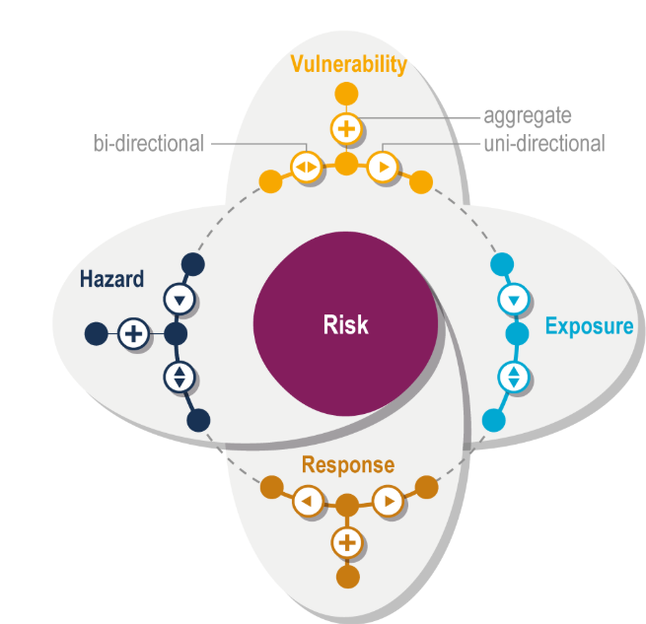
CLIMATE RISK
Potential for adverse consequences of a climate-related hazard on human or ecological systems
Results from dynamic interactions between climate-related hazards with the exposure and vulnerability of the affected human or ecological system
Risk = vulnerability + exposure + hazard + response
Risk management – plans, actions, strategies, or
policies to reduce the likelihood and/or magnitude
of adverse potential consequences, based on
assessed or perceived risks
Source: https://www.ipcc.ch/report/ar6/wg2/chapter/chapter-1/
Notes:
Additional resources:
https://www.ipcc.ch/report/ar6/wg2/chapter/chapter-1/

Slide 3
COMPONENTS OF RISK
Hazard:
“The potential occurrence of a natural or human-induced physical event or trend that may cause loss of life, injury, or other health impacts, as well as damage and loss to property, infrastructure, livelihoods, service provision, ecosystems, and environmental resources.” (https://www.ipcc.ch/sr15/chapter/glossary/ )
Vulnerability:
“The propensity or predisposition to be adversely affected” (https://www.ipcc.ch/sr15/chapter/glossary/ )
Exposure:
“The presence of people; livelihoods; species or ecosystems; environmental functions, services, and resources; infrastructure; or economic, social, or cultural assets in places and settings that could be adversely affected” (https://www.ipcc.ch/sr15/chapter/glossary/ )
Response (Adaptive capacity):
“The ability of systems, institutions, humans and other organisms to adjust to potential damage, to take advantage of opportunities, or to respond to consequences” (https://www.ipcc.ch/sr15/chapter/glossary/ )

Slide 4
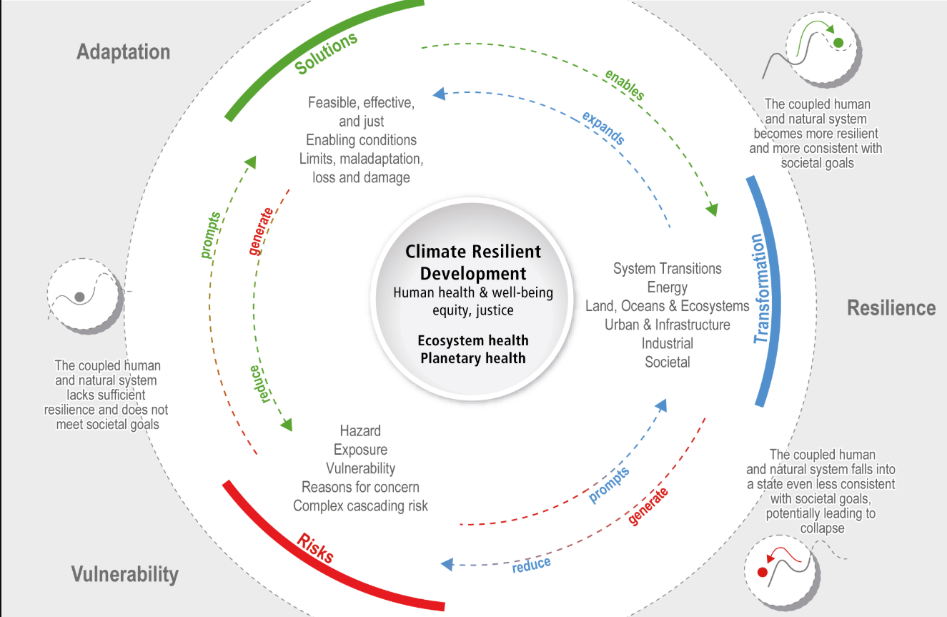
Source: https://www.ipcc.ch/report/ar6/wg2/chapter/chapter-1/

Slide 5
CLIMATE RISK AND VULNERABILITY ASSESSMENT (RVA)
The qualitative and/or quantitative scientific estimation of risks
A tool for understanding how likely communities, systems, or sectors are to be affected by climate change, and what can be done to adapt
Identifies short- and long-term climate risks to build resilience in development projects, policies and programs
Helps determine the overall level of climate risk:
  Identifies climate hazards
  Assesses exposure (assets, people, systems)
  Evaluates sensitivity (how badly they could be affected)
  Estimates adaptive capacity (how well they can cope or recover)

Slide 6
STEP BY STEP RVA
Define scope and objectives (what is being assessed, why, and what time frame)
Gather relevant data
Identify climate hazards (using climate data and scenarios)
Assess exposure (who and what is at risk)
Assess sensitivity (how vulnerable and exposed systems are)
Evaluate adaptive capacity (ability to cope, respond, or recover)
Highlight key risks (who and what is most at risk
Determine adaptation priorities and set adaptation objectives
Engage relevant stakeholders in the whole process
Notes:
Additional resources:
https://climatescreeningtools.worldbank.org/
https://climate-adapt.eea.europa.eu/en/mission/knowledge-and-data/regional-adaptation-support-tool/step-2-assessing-climate-change-risks-and-vulnerabilities
https://www.ipcc.ch/report/ar6/wg2/downloads/report/IPCC_AR6_WGII_TechnicalSummary.pdf
https://climate-adapt.eea.europa.eu/en/knowledge/tools/adaptation-support-tool

Slide 7
CLIMATE ADAPTATION
Adjustments in ecological, social, and economic systems in response to actual or expected climatic stimuli and their effect
Adaptation in processes by which individuals, communities, and countries seek to cope with the consequences of climate change
No one-size-fits-all solution → actions depend on the context
An important part in responding to climate change
Helps protect people, livelihoods, and ecosystems
Notes:
Additional resources:
https://unfccc.int/topics/adaptation-and-resilience/the-big-picture/introduction
https://www.adaptation-undp.org/sites/default/files/resources/adaptation_policy_frameworks_for_climate_change_-_developing_strategies_policies_and_measures_0.pdf

Slide 8
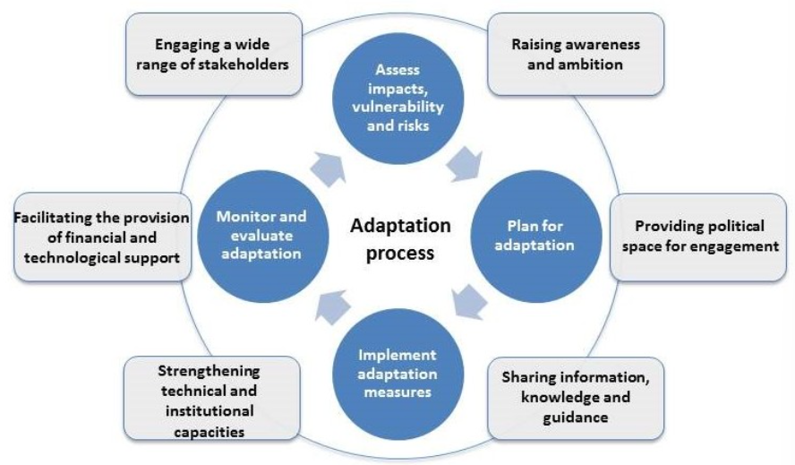
Source: https://unfccc.int/topics/adaptation-and-resilience/the-big-picture/introduction

Slide 9
CLIMATE ADAPTATION VS MITIGATION
ADAPTATION
Adjustments in ecological, social, and economic systems in response to actual or expected climatic stimuli and their effect.
Critical component in responding to climate change
Examples: flood defences, setting up early warning systems, switching to drought-resistant crops, redesigning communication systems, business operations, and government policies,…
MITIGATION
Actions taken to reduce or prevent greenhouse gas (GHG) emissions or to enhance carbon sinks that remove them from the atmosphere
Critical component in preventing climate change
Examples: shifting away from fossil fuels, improving energy efficiency, changing agricultural practices, sustainable management and conservation of forests, restoring and conserving critical ecosystems,…
Notes:
Additional resources:
https://climatepromise.undp.org/news-and-stories/what-climate-change-mitigation-and-why-it-urgent

Slide 10
CLIMATE RESILIENCE
“The capacity of social, economic, and environmental systems to cope with a hazardous event or trend or disturbance, responding or reorganizing in ways that maintain their essential function, identity, and structure while also maintaining the capacity for adaptation, learning, and transformation.” (https://www.ipcc.ch/sr15/chapter/glossary/)
Essential component of any climate action program
3 components of climate resilience:
  Resilient people and livelihoods – early warning systems; decent, secure and green jobs; resilient value chains; social protection; getting finance to local communities
  Resilient businesses and economies – climate risks are fully understood by all businesses, investors, and society; ensuring investments are climate risk-informed and deliver social, environmental, and economic impacts
  Resilient environmental systems – nature is the first line of defence against climate risks of extreme events and long-term changes in climate; biodiversity and ecosystems are protected to ensure food, clean air, fresh water, fertile soil, and pollination services
Notes:
Other resources:
https://www.c2es.org/document/what-is-climate-resilience-and-why-does-it-matter/
https://unfccc.int/sites/default/files/resource/ExecSumm_Resilience.pdf

Slide 11
STEPS TO BUILD CLIMATE RESILIENCE
Awareness raising and advocacy
Climate risk assessment
Develop and implement appropriate actions
Mobilize resources
Monitor and track progress
Share knowledge, experiences, and solutions
Notes:
Other resources: https://unfccc.int/sites/default/files/resource/ExecSumm_Resilience.pdf
Awareness-raising and advocacy – Be clear that the future will not resemble the past; base this on science and examine different scenarios (e.g. 1.5-degrees and higher) and their impacts.
Carry out climate risk assessments at the national, local (city/region), sectoral, or organizational level and use a systems approach.
Develop and implement appropriate actions and interventions.
Mobilize resources – Build capacity and scale up actions.
Monitor and track progress.
Share knowledge, experiences and solution

Slide 12
TYPES OF INTERVENTIONS TO BUILD CLIMATE RESILIENCE
Climate risk and vulnerability assessments
Early warning systems
Preparedness
Climate risk governance and capacity building
Nature-based solutions (NBS)
Climate-proofing
Risk transfer
Sharing knowledge and best practices
Access to finance
Notes:
Climate risk and vulnerability assessments, disclosure and monitoring
Early warning systems and early action
Preparedness: contingency plans/emergency response
Climate risk governance and capacity-building
Nature-based solutions used to reduce risks across sectors
Climate-proofing infrastructure and services
Risk transfer: insurance and social protection
Sharing of knowledge and best practices on climate risk management
Volume, quality and access of public and private finance

Slide 13
BUILDING RESILIENCE GUIDELINES
Reference technical standards for design and construction to take account of most weather-related hazards, including those generated by climate
Developed by International Code Council (ICC)
Principles:
  Urgency
  Clarity of objectives
  Robust climate science
  Risk clarity
  Forward-looking
  Durability
  Holistic approach
  Affordability
  Existing buildings
  Building maintenance
  Compliance
  Implementation
  Monitor and evaluate
  Engagement
  Emission reduction
Notes:
Other resources:
https://cdn-www-v2.iccsafe.org/wp-content/uploads/Delivering_Resilient_Building_Codes_and_Standards.pdf
https://www.iccsafe.org/wp-content/uploads/22-22032_GLOBAL_Comp_to_Global_Resilience_Guidelines.pdf#:~:text=The%20Global%20Building%20Resilience%20Guidelines%20%28Guidelines%29%20consists%20of,codes%20and%20standards%20that%20incorporate%20future-focused%20climate%20resilience.
Urgency - The need to respond to the associated impacts of climate change and extreme weather events on buildings and building occupants is more urgent than ever.
Clarity of objectives - attention to the changing climatic conditions buildings will face over their lifecycle and impacts on their expected operation following an extreme weather event
Robust climate science - evidence base that utilizes official climate forecasts in the local jurisdiction or models based on peerreviewed scientific research and ideally provide a demonstration of various future state possibilities
Risk clarity - Risk informed thinking and decision making is important in providing support for design decisions to balance cost, energy performance, greenhouse gas emissions and resilience, where changing risks can be balanced against certainty of performance for building development and maintenance
Forwards looking - A baseline assessment of current technical construction standards, where they exist, enables a comparison to be made with modelling and scenarios for future climate to help determine if they remain adequate or if new ones need to be developed
Durability - Understanding building design life is important not only to assist in determining minimum necessary technical construction standards, but to also calibrate the technical design requirements
Holistic approach - Building codes can contribute to improving building resilience as part of a broad suite of regulatory and non-regulatory measures
Affordability - Building codes and standards consider, where possible, a regulatory principle of setting minimum requirements necessary to achieve the level of desired performance, while doing so cost effectively
Existing buildings - Identify strategies to encourage existing building owners to bring their buildings up to a higher standard of resilience for the types of future weather-related natural hazards they may experience based on their location and climate projections
Building maintenance - Encourage property owners to engage in the need for planned periodic and specified maintenance of their buildings and promote essential resilience features
Compliance - Effective regulatory systems will incorporate appropriate resources to properly enforce the building codes and standards, as well as promote an ethic of compliance
Implementation - Complement any regulatory measures to improve compliance and support technical solutions with a wide range of education and practitioner capacity building tools
Monitor and evaluate - Routinely monitor the need to maintain the currency of building codes and standards in response to updated climate science and projections.
Engagement - Employ a clear and uncomplicated communication strategy that embraces and simplifies risk-based information; uses a common, credible and consistent set of evidence; and caters to the many and varied views of those with an interest in this subject
Emission reduction - Building code development can make an important contribution to mitigating the causes of climate change with subsequent long-term benefits for building resilience

Slide 14

CLIMATE ADAPTATION POLICIES
An essential part of managing the inevitable impacts of climate change
Help reduce human and economic losses
They are cost-effective investments in resilience
Promotion of social and climate justice
Supporting long-term development goals
Notes:
Even with global mitigation efforts, the world is experiencing more frequent and intense extreme weather events—heatwaves, floods, droughts, and sea-level rise. Adaptation policies are essential to manage these inevitable impacts and protect communities.
Well-designed adaptation policies reduce human and economic losses by preparing societies to cope with disruptions to agriculture, water supply, public health, infrastructure, and biodiversity.
They are cost-effective investments in resilience - Studies show that every dollar invested in climate resilience yields multiple dollars in avoided losses and economic benefits.
Promotion of social and climate justice - Vulnerable populations, especially in low-income and coastal regions, are often hit hardest by climate impacts. Adaptation policies can ensure that protective measures reach those most at risk, helping to close equity gaps.
Supporting long-term development goals - Climate adaptation is not separate from development—it is fundamental to achieving food security, health, stable economies, and sustainable cities in a changing climate.

Slide 15
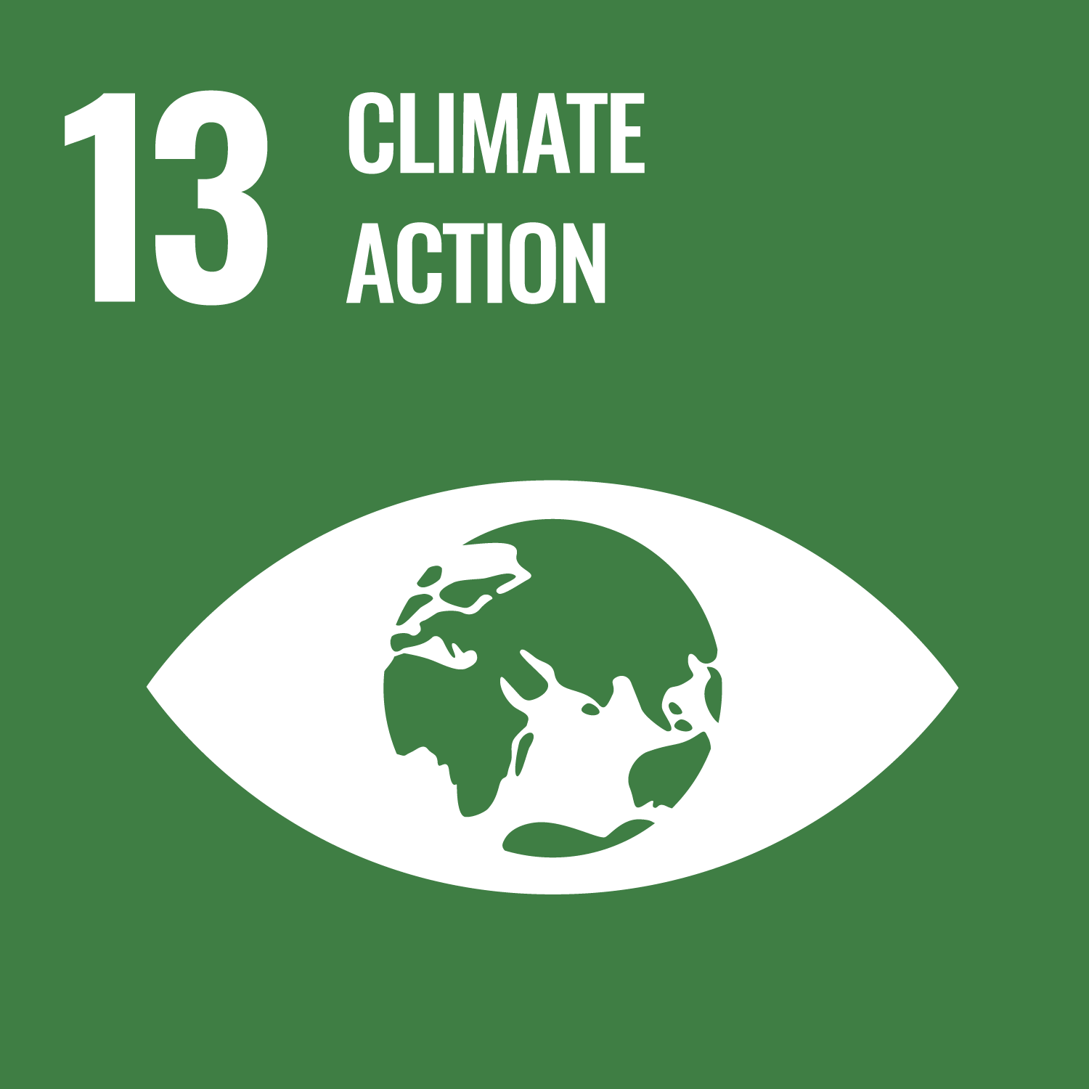


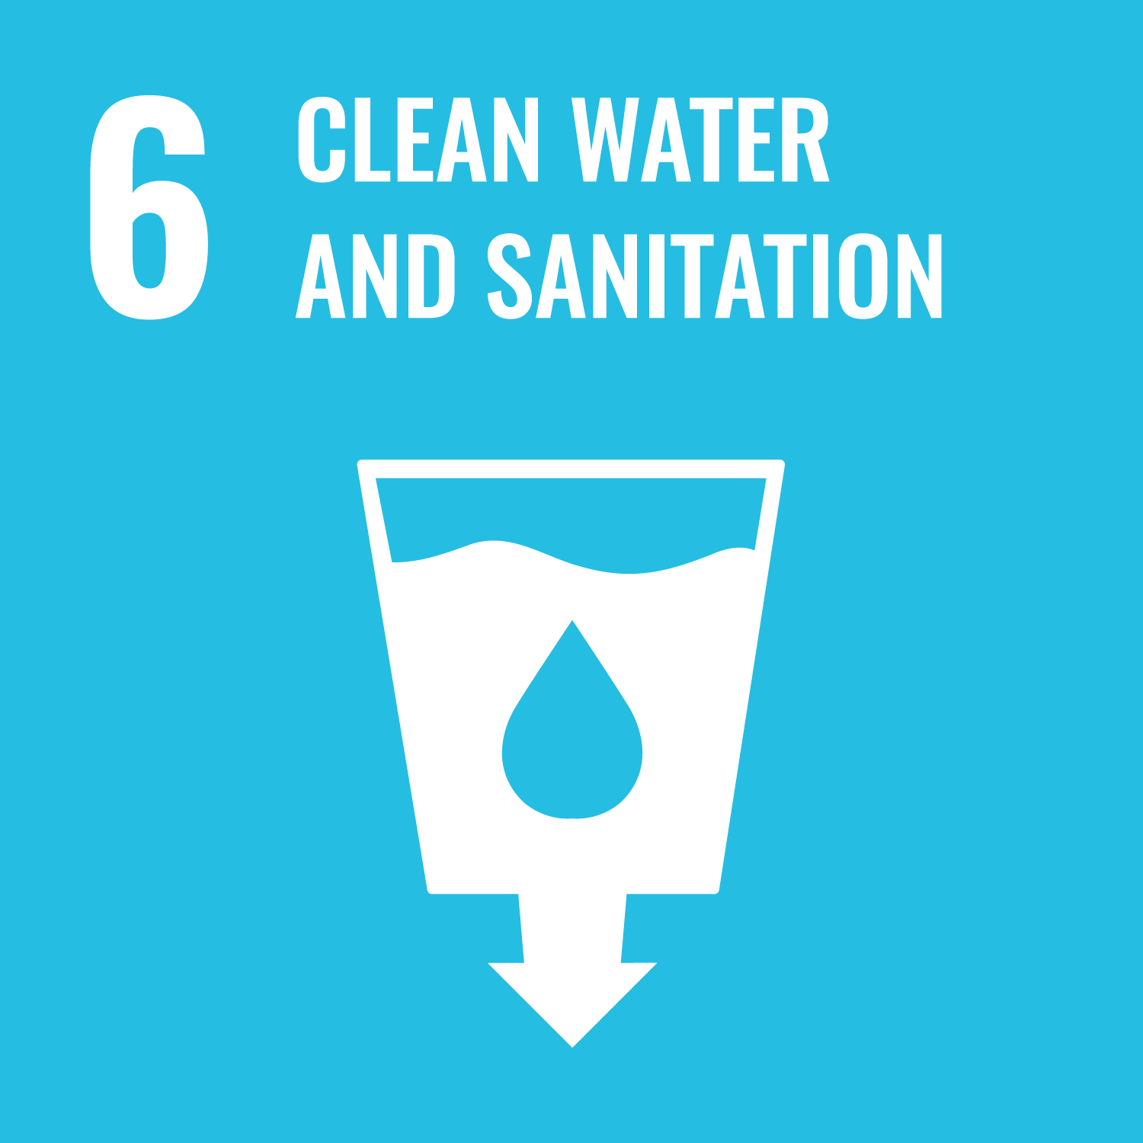

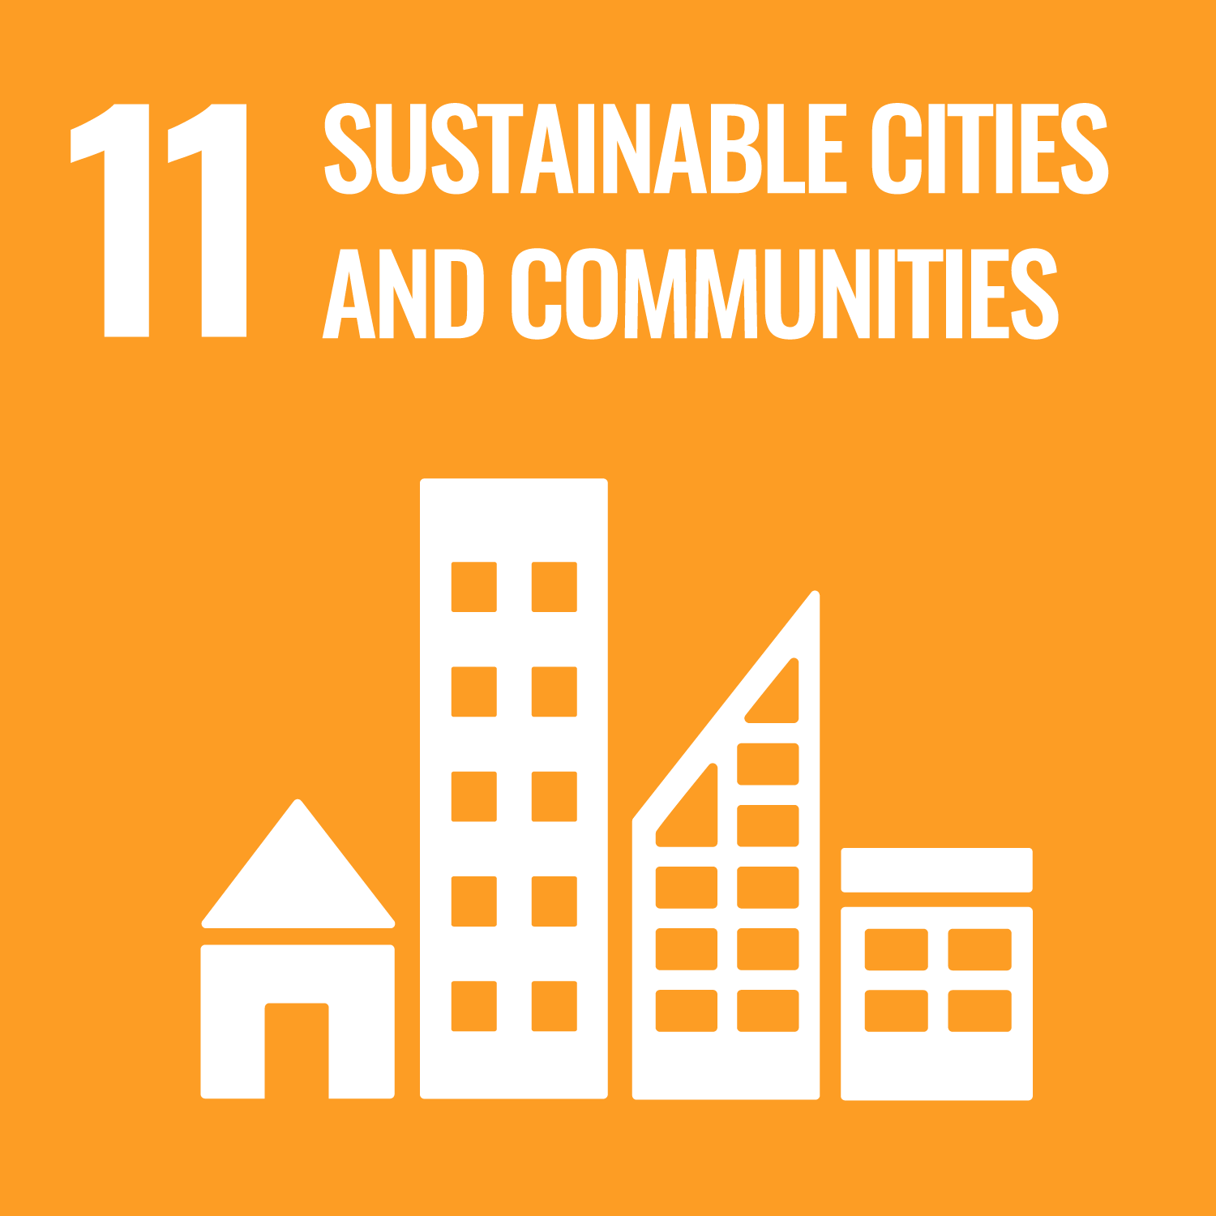
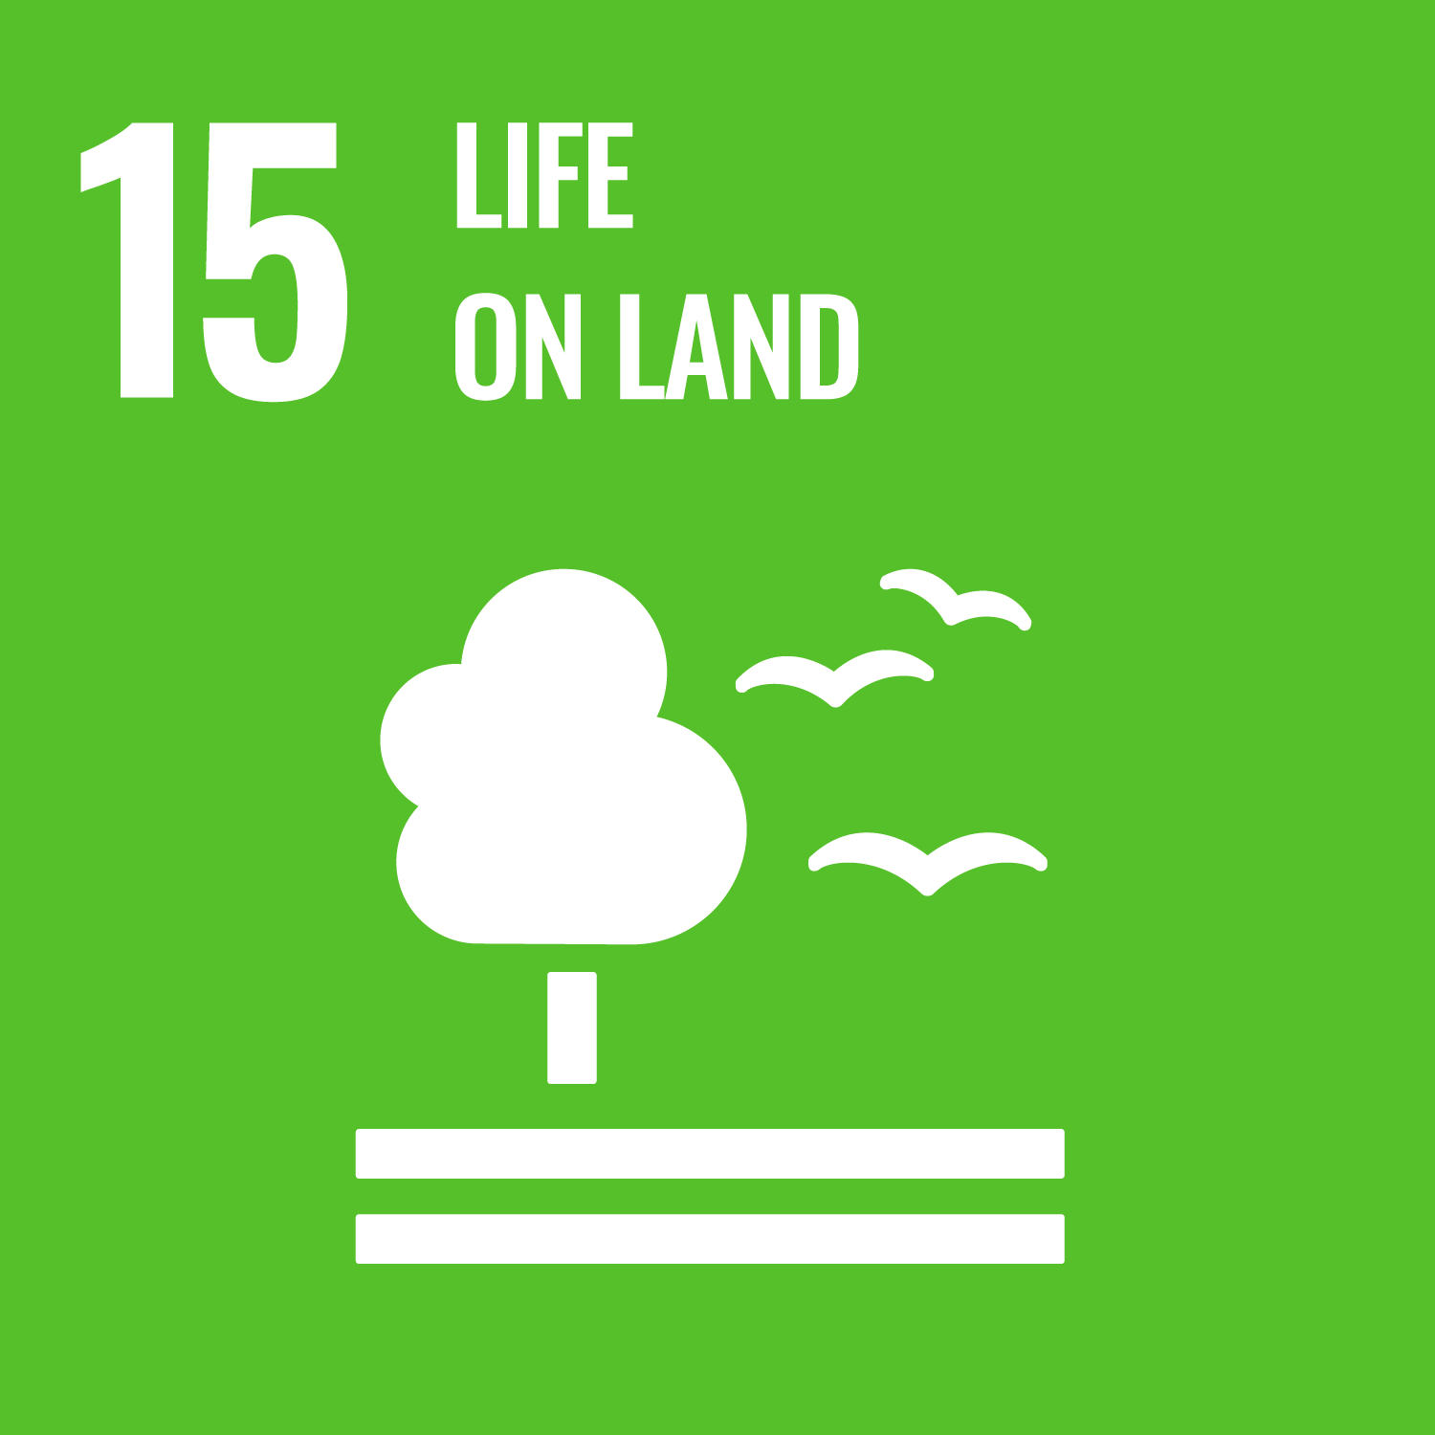
SUSTAINABLE DEVELOPMENT GOALS (SDGs)
A set of 17 global goals established by the UN in 2015, aimed at addressing various global challenges
Blueprint to achieve a better and sustainable future for all
SDG 13: Climate Action
  Target 13.1: Strengthen resilience and adaptive capacity to climate-related hazards
  Target 13.2: Integrate climate change measures into national policies and planning
Other related goals:
Source: https://www.un.org/sustainabledevelopment/
Notes:
Other resources: https://www.un.org/sustainabledevelopment/
A set of 17 global goals established by the UN in 2015, aimed at addressing various global challenges, including poverty, inequality, climate change, environmental degradation, peace and justice
Blueprint to achieve a better and sustainable future for all
SDG 13: Climate Action
Target 13.1: Strengthen resilience and adaptive capacity to climate-related hazards
Target 13.2: Integrate climate change measures into national policies and planning
Other related goals:
SDG 2: Zero hunger – droughts, floods, and changing seasons affect crop yields and food systems, adaptation enables food security in a changing climate
SDG 3: Good health and well-being – climate change drives health threats, adaptation is key to protecting public health
SDG 6: Clean water and sanitation – climate change alters rainfall patterns and water availability, adaptation ensures resilient water systems, and protects water security
SDG 8: Decent work and economic growth – climate extremes can damage infrastructure, reduce labour productivity, and disrupt economic sectors, a stable climate underpins sustainable economic growth
SDG 11: Sustainable cities and communities – urban areas face high exposure to heat, flooding, and infrastructure failure, climate adaptation ensures resilient and inclusive urban development
SDG 15: Life on land – Climate change degrades ecosystems and biodiversity, nature-based solutions enhance biodiversity and resilience
Additional (possible) benefits: reduces inequality (SDG10), strengthens partnerships (SDG17), improves education (SDG4)

Slide 16
IPCC
IPCC – The Intergovernmental Panel on Climate Change
The UN’s body for assessing the science related to climate change
3 Working Groups prepare assessment and special reports
  Working Group I: The Physical Science Basis
  Working Group II: Impacts, Adaptation and Vulnerability
  Working Group III: Mitigation of Climate Change
Task Force on National Greenhouse Gas Inventories
Prepares comprehensive Assessment Reports about the state of knowledge of climate change, its impacts, and future risks
  Latest: Sixth Assessment Report, 2023 (https://www.ipcc.ch/assessment-report/ar6/)
  Currently in the seventh assessment cycle, began in July 2023
Notes:
Other resources: https://www.ipcc.ch/
The Intergovernmental Panel on Climate Change (IPCC) is the world’s leading scientific body for assessing climate change
Established in 1988 by the United Nations Environment Programme (UNEP) and the World Meteorological Organization (WMO)
Does not conduct its own research; it reviews and synthesizes thousands of scientific studies to provide governments with the most authoritative and up-to-date knowledge on climate change, its impacts, risks, and solutions.
The main activity of the IPCC is the preparation of reports assessing the state of knowledge of climate change (assessment reports, special reports, and methodology reports)
The IPCC also has a Task Force on National Greenhouse Gas Inventories, whose main objective is to develop and refine a methodology for the calculation and reporting of national greenhouse gas emissions and removals.
Defines the scientific basis for adaptation → Helps governments understand why and where adaptation is urgently needed
Guides national and international adaptation policy → Used for developing National Adaptation Policies (NAPs)
International agreements (like the Paris Agreement) rely heavily on IPCC science to set adaptation goals and track progress

Slide 17
THE PARIS AGREEMENT
Legally binding international treaty on climate change
Adopted by 195 parties at the UN Climate Change Conference (COP21) in Paris on the12th December 2015
Overall goal: limit the global average temperature to well bellow 2°C above pre-industrial levels
Countries submit their national climate action plans known as nationally determined contributions (NDCs)
Provides a framework for financial, technical and capacity building support
Notes:
Other resources: https://unfccc.int/process-and-meetings/the-paris-agreement
The Paris Agreement:
Legally binding international treaty on climate change
Adopted by 195 parties at the UN Climate Change Conference (COP21) in Paris on the12th December 2015
Overall goal: limit the global average temperature to well bellow 2°C above pre-industrial levels and pursue efforts to keep it under 1,5°C (recently it has been stressed the need to limit the global warming to 1,5°C by the end of this century)
Countries submit their national climate action plans known as nationally determined contributions (NDCs) – each needs to have higher ambition than the previous one

Slide 18

COVENANT OF MAYORS (CoM)
The largest global alliance of local governments voluntarily committing to climate change, including:
  Mitigation: reducing GHG emissions
  Adaptation: increasing resilience to climate change
  Ensuring access to sustainable, affordable, and secure energy
Working towards a resilient and low-emission society
Signatory cities commit to:
  Conducting climate risk and vulnerability assessment
  Developing a Sustainable Energy and Climate Action Plan (SECAP)
  Monitoring progress and reporting every two years
CoM offers technical guidance, templates, peer-to-peer learning, funding guidance, and access to tools
Notes:
Other resources: https://www.globalcovenantofmayors.org/what-is-our-mission/
Encourages bottom-up adaptation aligned with global, national, and EU goals/agreements
Helps mainstream adaptation into urban planning and budgeting
Strengthens local capacity to prepare for climate change
Types of adaptation actions supported: green infrastructure, flood prevention, heatwave response, public awareness, and early warning systems

Slide 19

THE EUROPEAN GREEN DEAL
Policy initiative aimed at making the EU the world’s first climate-neutral continent by 2050
Covers both climate mitigation and adaptation
Adaptation focus:
  Calls for stronger action on climate resilience to effectively get ahead of climate risks
  Focus on nature-based solutions and green infrastructure
  Restoring biodiversity, addressing pollution, and the efficient
  using of resources
Notes:
Other resources: https://ec.europa.eu/stories/european-green-deal/

Slide 20
THE EUROPEAN CLIMATE LAW
Writes into law the goal set out in the European Green Deal
  Climate neutrality by 2050
  55% emission reduction by 2030
Measures to keep track of progress and adjust our actions accordingly based on existing systems
Requires EU and Member States to enhance adaptive capacity, strengthen resilience, and reduce vulnerability to climate change
Notes:
Other resources:
https://eur-lex.europa.eu/eli/reg/2021/1119/oj
https://climate.ec.europa.eu/eu-action/european-climate-law_en

Slide 21

EU ADAPTATION STRATEGY
In 2021, the EU adopted its new strategy on adaptation to climate change
Sets out how the EU can adapt to the impacts of climate change and become climate resilient by 2050
4 principal objectives:
  Smarter adaptation
  Faster adaptation
  More systemic adaptation
  Stepping up international action for climate resilience
Source: https://climate-adapt.eea.europa.eu/en
Notes:
Other resources:
https://climate.ec.europa.eu/eu-action/adaptation-climate-change/eu-adaptation-strategy_en
https://climate-adapt.eea.europa.eu/en
Smarter Adaptation: action must be informed by robust data and risk assessment tools that are available to all (enhancing Climate-ADAPT as the European platform for adaptation knowledge)
Faster adaptation: adaptation must be quicker and more comprehensive
More systemic adaptation: climate change will have impacts at all levels and across all sectors of the economy, so adaptation needs to be more systematic
Stepping up international action for climate resilience: scaling up international finance, stronger global engagement, and exchanges on adaptation

Slide 22
THE EUROPEAN CLIMATE PACT
Participatory initiative encouraging citizens, communities, and organizations to take climate action
Part of the European Green Deal
Promotes awareness, resilience, and local adaptation efforts
Supports bottom-up adaptation through education, citizen science, and nature-based projects
Notes:
Other resources: https://climate-pact.europa.eu/index_en

Slide 23
NATIONAL CLIMATE PLANNING
Strategic framework for how a country as a whole will adapt to climate change
Sets national vision and priorities, allocates funding, coordinates action across sectors, supports climate diplomacy
Key tools:
  National Adaptation Plans (NAPs)
  National Energy and Climate Plans (NECPs)
  National risk and vulnerability assessment
  Sectoral adaptation plans
Notes:
Other resources:
https://unfccc.int/national-adaptation-plans
https://commission.europa.eu/energy-climate-change-environment/implementation-eu-countries/energy-and-climate-governance-and-reporting/national-energy-and-climate-plans_en

Slide 24

LOCAL CLIMATE PLANNING
Focuses on city, municipal, or regional levels
Addressing site-specific climate impacts and working closely with communities and local stakeholders
Context-specific, flexible, and innovative, enables bottom-up action and public engagement, integrates with local infrastructure and land use
Key tools:
  Local adaptation plans (Sustainable Energy and Climate Action Plans
  (SECAPs), Climate Action Plans,…)
  Urban planning regulations (zoning, green infrastructure)
  Local risk and vulnerability assessment
  Public consultations, participatory tools
Notes:
Other resources:
https://iclei.org/
https://www.globalcovenantofmayors.org/what-is-our-mission/

Slide 25
LOCAL VS NATIONAL PLANNING
 | NATIONAL | LOCAL
Scope | National and sectoral | Local risks, community
Coordination | Across ministries, regions | With local stakeholders, municipal departments
Flexibility | Slower, more standardized | Agile, context specific
Funding access | Access to national/international funding | Limited but can pilot innovation
Innovation | Strategic and larg-scale | Grassroots, experimental
Best for | Setting priorities, coordination, finance | Implementation, engagement, place-based action

Slide 26
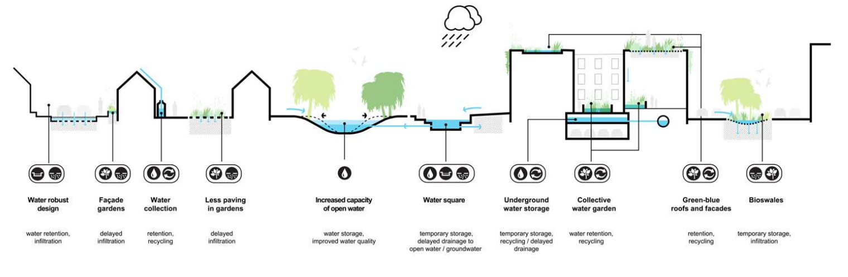
SUCCESSFUL ADAPTATION STRATEGIES – CASE STUDIES
Rotterdam, Netherlands:
Focus: flood resilience, heat stress, water retention in a low-lying city
Successfully combines infrastructure with green space and public engagement
Multi-layered flood protection: adaptive building and design, flood resilient public spaces, nature-based solutions, dikes, capturing and storing rainwater, robust infrastructure
Good example of urban water management and nature-based solutions
Source: https://static1.squarespace.com/static/5f082078d610926644d22e00/t/62b19d595f452d43febaa862/1655807334154/20121210+RAS+EN+lr+versie+4_compressed.pdf
Notes:
Other resources:
https://static1.squarespace.com/static/5f082078d610926644d22e00/t/62b19d595f452d43febaa862/1655807334154/20121210+RAS+EN+lr+versie+4_compressed.pdf
https://www.urbanisten.nl/work/rotterdam-adaptation-strategy

Slide 27

Copenhagen, Denmark:
Plan adopted in 2012 after a severe flood
Focus: Managing extreme rainfall and urban flooding through combining underground grey infrastructure drainage tunnels and large-scale blue-green infrastructure surface projects
Long-term urban planning with innovative water design
Five types of solutions:
  Cloudburst boulevards to transport water
  Pipes for underground water transportation
  Retention boulevards to delay water
  Central delays for storing water
  Green roads to transport and delay water on smaller roads
Notes:
Other resources:
https://climatefit-heu.eu/wp-content/uploads/2024/07/03_Cloudburst-Management-Plan.pdf#:~:text=Copenhagen%20was%20hit%20by%20a%201000-year%20storm%20%28cloudburst%29,offshoot%20of%20the%20city%E2%80%99s%20Climate%20Adaptation%20Plan%20%282011%29
https://www.asla.org/2016awards/171784.html

Slide 28

Melbourne, Australia:
The city declared a climate and biodiversity emergency in 2019
Key climate risks: heatwaves, sea level rise, bushfires, droughts, intense rainfall, and windstorms
Goals:
  Enhance natural environment and green spaces
  Construct buildings and urban areas to withstand future climate change impacts
  Strengthen the resilience of the community
  Protect and enhance the economy
  Continue to build adaptation capabilities and expertise
Actions:
  Increasing quantity and quality of green infrastructure
  Increasing alternative water supply
  Building to increase thermal comfort
Notes:
Other resources:
https://www.melbourne.vic.gov.au/climate-change-adaptation-strategy

Slide 29
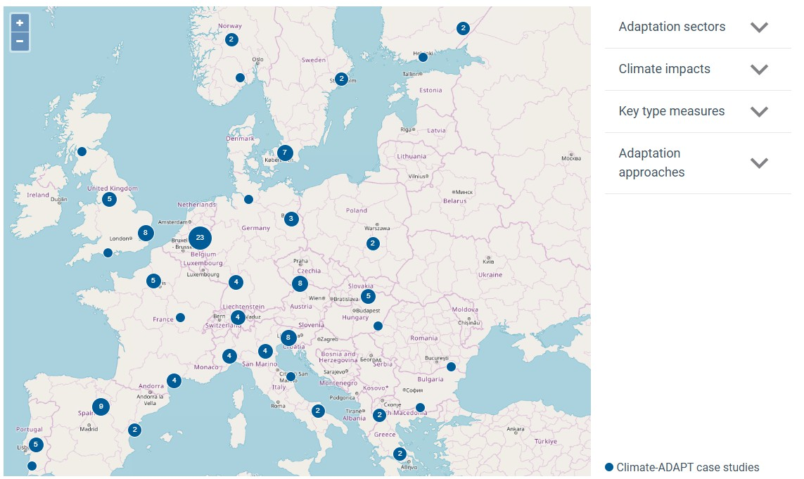
Explore other good practices:
https://climate-adapt.eea.europa.eu/en/knowledge/tools/case-study-explorer

Slide 30

FINANCIAL INCENTIVES
Public or private financial tools that aim to encourage individuals, businesses, and governments to invest in climate adaptation, resilience, and sustainability
To bridge the funding gap for costly investments
Make climate-resilient choices more attractive
Types:
  Grants and subsidies
  Tax credits and deductions
  Low-interest loans
  Insurance discounts
  Public-private partnerships
  Green bonds/climate bonds
  Market-based tools
Notes:
Additional resources:
https://www.oecd.org/en/publications/financing-green-urban-infrastructure_5k92p0c6j6r0-en.html
https://documents.worldbank.org/en/publication/documents-reports/documentdetail/247041468340183358/green-infrastructure-finance-leading-initiatives-and-research
Grants and subsidies - Direct funding for green projects, often from public agencies
Tax credits and deductions - Reduce taxes for implementing adaptation measures (e.g. stormwater systems)
Low-interest loans - Help finance infrastructure with long-term repayment plans
Insurance discounts - Lower premiums for buildings with flood/heat resilience features
Public-private partnerships (PPPs) - Joint investments in adaptation projects
Green bonds/climate bonds - Debt instruments to finance climate-resilient infrastructure
Market-based tools - Stormwater fees, development charges based on impervious surfaces

