Slide 1

SuPeRBE Training Material
Macro Area of Expertise:
SuPeRBE Training Material
AD1 Climate change and built environment
Climate change and built environment
Area of Expertise:
AD1.4 Climate adaptation strategies and solutions
Fundamentals of climate change
Level of competence: 3
Level of competence: 2
Activity 3.2
SuPeRBE Project (CE0200768)

Slide 2

INTRODUCTION
Adaptation to climate change is essential since it is already impacting the built environment
Climate adaptation strategies help communities and sectors adjust to current and expected climate impacts
Adaptation planning is complementary to climate mitigation
Tools like Risk and Vulnerability Assessments (RVAs) and Sustainable Energy and Climate Action Plans (SECAPs) support targeted and effective adaptation
Proactive adaptation saves lives and money

Slide 3
HAZARDS
“The potential occurrence of a natural or human-induced physical event or trend that may cause loss of life, injury, or other health impacts, as well as damage and loss to property, infrastructure, livelihoods, service provision, ecosystems, and environmental resources.” https://www.ipcc.ch/sr15/chapter/glossary/
Hazards can be separated into 2 different categories:
  Climate-related hazards – encompass extreme weather events and slow-onset climate processes (extreme temperatures, droughts, heavy precipitation, storms, floods, sea level rise)
  Non-climate hazards – triggered by climate hazards (wildfire, chemical change, mass movement, biological hazards)

Slide 4
Climate-related hazards
Hazard | Description
Extreme precipitation | Unusually intense or prolonged precipitation events that significantly exceed normal pattern Rainstorm, monsoon, heavy snow, fog, hail.
Flood | Overflow of water onto normally dry land. Flash/surface flood, river flood, coastal flood, groundwater flood
Extreme heat | Prolonged periods of unusually high temperatures. Heat wave, extreme hot days
Drought | Prolonged period of abnormally low precipitation, resulting in water shortages that negatively impact ecosystems, agriculture, and human activities.
Extreme wind | Unusually strong and sustained winds, often associated with storms, cyclones, hurricanes, or tornadoes.
Extreme cold | Prolonged periods of unusually low temperatures.
Sea level rise | Long-term increase in the average level of the world&apos;s seas resulting in a permanent inundation.

Slide 5
Non-climate related hazards
Hazard | Description
Wildfire | Uncontrolled fire that spreads rapidly through vegetation, forests, grasslands, or other natural landscapes.
Chemical change | Sal water intrusion, ocean acidification,
Mass movement | Landslide, avalanche, rock fall, subsidence, soil degradation, soil erosion
Biological hazards | Water borne diseases, vector-borne diseases, air-borne diseases, insect infestation

Slide 6
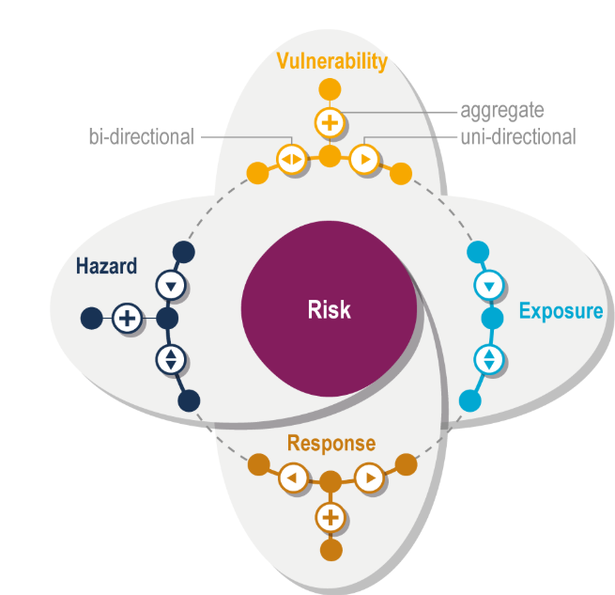
CLIMATE RISK
Potential for adverse consequences of a climate-related hazard on human or ecological systems
Results from dynamic interactions between climate-related hazards with the exposure and vulnerability of the affected human or ecological system
Risk = vulnerability + exposure + hazard + response
Risk management – plans, actions, strategies, or
policies to reduce the likelihood and/or magnitude
of adverse potential consequences, based on
assessed or perceived risks
Source: https://www.ipcc.ch/report/ar6/wg2/chapter/chapter-1/
Notes:
Additional resources:
https://www.ipcc.ch/report/ar6/wg2/chapter/chapter-1/

Slide 7
Components of risk
Hazard:
“The potential occurrence of a natural or human-induced physical event or trend that may cause loss of life, injury, or other health impacts, as well as damage and loss to property, infrastructure, livelihoods, service provision, ecosystems, and environmental resources.” (https://www.ipcc.ch/sr15/chapter/glossary/ )
Vulnerability:
“The propensity or predisposition to be adversely affected” (https://www.ipcc.ch/sr15/chapter/glossary/ )
Exposure:
“The presence of people; livelihoods; species or ecosystems; environmental functions, services, and resources; infrastructure; or economic, social, or cultural assets in places and settings that could be adversely affected” (https://www.ipcc.ch/sr15/chapter/glossary/ )
Response (Adaptive capacity):
“The ability of systems, institutions, humans and other organisms to adjust to potential damage, to take advantage of opportunities, or to respond to consequences” (https://www.ipcc.ch/sr15/chapter/glossary/ )

Slide 8
VULNERABILITY
“The propensity or predisposition to be adversely affected. Vulnerability encompasses a variety of concepts and elements, including sensitivity or susceptibility to harm and lack of capacity to cope and adapt.” https://www.ipcc.ch/sr15/chapter/glossary/
Degree to which a system is susceptible to and unable to cope with the adverse effects of climate change
Components of vulnerability:
  Sensitivity
  Adaptive capacity
  Lack of resilience
Source: https://www.ipcc.ch/report/ar6/wg2/chapter/chapter-1/
Notes:
Additional resources:
https://www.ipcc.ch/report/ar6/wg2/chapter/chapter-1/

Slide 9
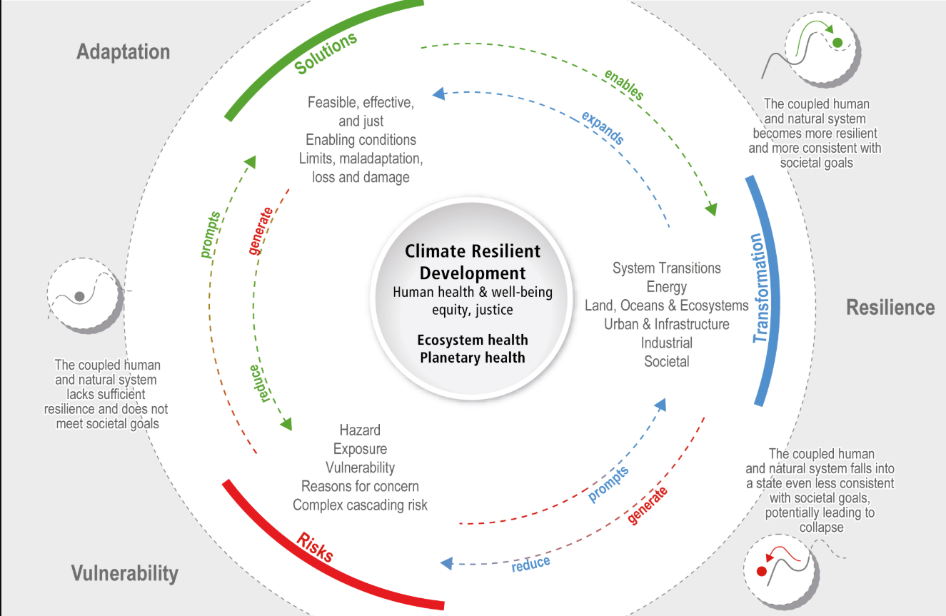
Source: https://www.ipcc.ch/report/ar6/wg2/chapter/chapter-1/

Slide 10
CLIMATE ADAPTATION SOLUTIONS
Climate adaptation solutions can be:
  Infrastructural – modifications in the built environment to protect against climate hazards
  Institutional – frameworks, regulations, and policies
  Behavioural (social) – behaviour changes of the local community
  Nature-based solutions (NBS) - use of ecosystems and natural processes to reduce vulnerability and enhance resilience
  Technological – innovative tools and technologies supporting climate adaptation efforts
2 categories:
  Structural (infrastructural, NBS)
  Non-structural (institutional, behavioural, technological)

Slide 11

Infrastructural solutions
Physical measures to reduce exposure and sensitivity to hazards
Designed to protect infrastructure, buildings and public services from direct climate threats
Offers immediate and visible protection
Large-scale and capital-intensive
Long life span
Requires maintenance

Slide 12
Hazard | Infrastructural solution | Function/benefit
Flooding | Floodwalls, levees, stormwater drainage system | Physically block or redirect excess water
Heatwaves | Cool roofs, green roofs, reflective pavements | Lower indoor/outdoor temperatures; reduce heat island effects
Drought | Rainwater harvesting systems, irrigation infrastructure | Improve water availability and reduce water stress
Storms | Wind-resistant buildings, underground power lines | Reduce damage from strong winds and falling debris
Sea-level rise | Sea walls, tidal gates, elevated infrastructure | Prevent coastal inundation and infrastructure damage

Slide 13
Institutional solutions
Strengthening governance, policy frameworks, regulatory systems, and administrative capacities to enable effective climate adaptation planning and implementation
Embeds climate adaptation into decision-making
Supports long-term systemic change
Requires cross-sectoral coordination
Addresses underlying systems and decision-making processes
Implemented by governments or inter-institutional bodies

Slide 14
Hazard | Institutional solution | Function/benefit
Flooding | Flood zone land-use regulation | Restricts development in high-risk areas
Heatwaves | Public health action plans | Prepares healthcare systems and vulnerable populations
Drought | National water governance frameworks | Coordinates fair and efficient water use
Sea level rise | Climate resilient building codes | Sets standards for safe coastal development
All hazards | Mainstreaming adaptation in urban/regional planning | Ensures all sectors consider climate resilience 6666666666666666666666
Sea-level rise | Living shorelines, coastal wetland preservation | Buffer against coastal flooding, absorb wave energy

Slide 15

Behavioural and social solutions
Changes in attitudes, practices, and behaviours of individuals and communities that help reduce vulnerability and enhance adaptive capacity
Education, training, and awareness raising
Promotes inclusive, bottom-up participation
Usually low-cost and locally driven
Depend on awareness, education and motivation
Should be used as a complement to other adaptation types

Slide 16
Hazard | Behavioural solution | Function/benefit
Flooding | Community emergency drills and flood preparedness | Improves local response capacity and evacuation readiness
Heatwaves | Public awareness campaigns on health safety | Reduces health risk, promotes self-protection
Drought | Water conservation practices in household/agriculture | Reduces water use during shortages
Storms | Mangrove planting, dune restoration, coral reef protection | Reduces property damage and injuries
Wildfires | Community-led fire prevention, promoting volunteering | Minimizes ignition risk and spread
Notes:
Nature-based solutions can act as buffers (e.g., wetlands absorbing floodwaters) or microclimate regulators (e.g., trees providing shade).

Slide 17

Nature-based solutions (NBS)
Use of natural processes and ecosystems to reduce climate risks
Co-benefits for biodiversity, human health, and quality of life
Act like buffers or microclimate regulators
Low-carbon
Cost-effective
Examples:
  Floods: wetland restoration, urban green spaces,…
  Drought: agroforestry and soil conservation, wetland conservation, drought-resilient landscaping,…
  Heatwaves: urban forests, tree planting, green roofs, green corridors, park and water body restoration,…
  Rainfall: permeable pavements, urban green spaces,…
Notes:
Nature-based solutions can act as buffers (e.g., wetlands absorbing floodwaters) or microclimate regulators (e.g., trees providing shade).

Slide 18
Hazard | Nature-based solution | Function/benefit
Flooding | Wetland restoration, riparian buffers, green urban infrastructure | Store excess water, slow runoff, reduce flood peaks
Heatwaves | Urban green paces, green roofs/walls, urban trees | Reduce urban heat islands, improve air quality
Drought | Reforestation, soil conservation, agroforestry | Increase water retention, restore soil fertility
Coastal storms | Mangrove planting, dune restoration, coral reef protection | Dissipate wave energy, reduce erosion and storm surge impacts
Landslide | Forest conservation on slopes, vegetation buffers | Stabilize soil, reduce erosion risk
Sea-level rise | Living shorelines, coastal wetland preservation | Buffer against coastal flooding, absorb wave energy
Notes:
Nature-based solutions can act as buffers (e.g., wetlands absorbing floodwaters) or microclimate regulators (e.g., trees providing shade).

Slide 19

Technical solutions
Innovative tools and technologies that support adaptation through forecasting, monitoring, infrastructure resilience, and data-driven decision making
Enables evidence-based planning and early response
Data-driven
Provides real-time insights and enables precision responses
Enhances efficiency
Supports decision making

Slide 20
Hazard | Technological solution | Function/benefit
Flooding | Early warning systems, remote sensing, flood modelling tools | Improve flood preparedness and allow for timely evacuation and disaster response
Heatwaves | Heat-health warning systems, climate dashboards | Alert authorities and citizens to upcoming heat events, enables health sector readiness
Drought | Smart irrigation systems, soil moisture sensors | Optimize water use, reduce water losses
Storms | Real-time weather radar, structural health monitoring sensors | Provide early warnings and monitor infrastructure performance during storms
Wildfires | Fire risk forecasting tools, satellite fire detection | Detect and track fires in real time, guide firefighting efforts
Sea-level rise | GIS-based coastal risk mapping | Identify and prioritize vulnerable coastal zones for planning and mitigation
All hazards | Climate information portals, decision-support tools | Provide accessible, science-based data to support local adaptation planning
Notes:
Nature-based solutions can act as buffers (e.g., wetlands absorbing floodwaters) or microclimate regulators (e.g., trees providing shade).

Slide 21
STRUCTURAL SOLUTIONS
Tangible, built interventions constructed or modified to protect against or reduce the risk of climate-related events
Capital intensive
Engineering design
Implemented by governments, urban planners, or developers
Physical infrastructure and land-use modifications
Long-term and durable
Focused on protecting assets and minimizing damage
Requires technical expertise and financial investments

Slide 22
NON-STRUCTURAL SOLUTIONS
Measures that influence human behaviour, governance, planning, and social systems to build resilience to climate change
No major physical construction
More flexible, cost-effective, and community-centered
Types:
  Regulatory/legal measures
  Institutional/planning tools
  Economic instruments
  Education and behavioural change
  Early warning systems
Notes:
Regulatory / Legal Measures
Land-use planning (e.g., prohibiting building in flood zones)
Environmental laws and climate adaptation policies
Updated building codes (that encourage but don’t require retrofitting)
Institutional / Planning Tools
Climate Risk and Vulnerability Assessments (RVA)
Sustainable Energy and Climate Action Plans (SECAPs)
Emergency response and preparedness plans
Economic Instruments
Climate insurance schemes (e.g., flood insurance)
Tax incentives for adaptation measures
Water pricing during droughts
Educational and Behavioral Change
Public awareness campaigns
Training on water and energy conservation
School and community education on climate risks
Early Warning Systems
Real-time alerts for floods, storms, or heatwaves
Mobile phone-based notification systems

Slide 23
Choosing between structural vs. non-structural solutions
 | Structural adaptation | Non-structural adaptation
Risk level | High-risk, high-impact | Moderate to low risk
Timeframe | Long-term solution | Short to medium term
Flexibility | Low-fixed structure, difficult to adapt | Easy to revise and adjust
Institutional needs | Requires technical expertise, funding, maintenance | Requires governance, awareness, community participation
Best use case | Protecting critical assets | Raising awareness, managing land use, increasing preparedness
Examples | Levees, seawalls, elevated roads, green roofs | Zoning laws, risk mapping, heatwave alerts, water-use policies
Environmental impacts | May alert ecosystems or natural processes | Lower impact, often more sustainable
Notes:
Regulatory / Legal Measures
Land-use planning (e.g., prohibiting building in flood zones)
Environmental laws and climate adaptation policies
Updated building codes (that encourage but don’t require retrofitting)
Institutional / Planning Tools
Climate Risk and Vulnerability Assessments (RVA)
Sustainable Energy and Climate Action Plans (SECAPs)
Emergency response and preparedness plans
Economic Instruments
Climate insurance schemes (e.g., flood insurance)
Tax incentives for adaptation measures
Water pricing during droughts
Educational and Behavioral Change
Public awareness campaigns
Training on water and energy conservation
School and community education on climate risks
Early Warning Systems
Real-time alerts for floods, storms, or heatwaves
Mobile phone-based notification systems

Slide 24
How to choose right solutions
Understand local climate risks
Consider local context
Match solution type to hazard
Weight cost, feasibility and maintenance
Prioritize co-benefits
Use a mix of solutions
Engage stakeholders
Check policy and legal alignment
Plan for flexibility
Monitor and evaluate
Notes:
Understand local climate risks
Identify most pressing climate hazards
Use RVA to pinpoint exposed populations, infrastructure and ecosystems
Consider local context
Account for geography, climate, land use and community needs
Urban/rural, coastal/inland, rich/poor, older population/younger population,…
Match solution type to hazard
Weight cost, feasibility and maintenance
Consider budget, technical capacity, long-term upkeep
Low-cost solutions may be more suitable in some contexts
Prioritize co-benefits
Choose solutions that also improve air quality, public health, biodiversity, or social equity
Use a mix of solutions
Combine structural, behavioural, technical and NBS
Engage stakeholders
Include local stakeholders, residents, engineers, environmental experts
Check policy and legal alignment
Ensure the chosen solution fits national or local laws, building codes and development plans
Plan for flexibility
Choose solutions that can be scaled up, adjusted or combined with others
Monitor and evaluate

Slide 25
MULTI-SECTORAL PLANNS
Comprehensive strategies that address climate risks across multiple sectors
Brings together policies and stakeholders from different sectors for coherence
Addresses interdependencies
Long-term planning
Uses risk and vulnerability assessment as a foundation
Examples: SECAPs, National Adaptation Plans (NAPs), Resilience Strategies,…
Benefits: efficiency, risk reduction, better funding opportunities, improved policy coherence
Notes:
Climate change impacts are interconnected so multi-sectoral plans are needed to coordinate action across sectors
Most popular and most commonly used: SECAP
Benefits:
Efficiency: Avoids duplication and promotes shared resources.
Risk reduction: Minimizes cascading impacts (e.g., heatwaves affecting health, energy demand, and transport).
Better funding opportunities: Attracts multi-source financing and donor support.
Improved policy coherence: Aligns climate action with other goals like housing, energy access, and biodiversity.

Slide 26
SUSTAINABLE ENERGY AND CLIMATE ACTION PLAN (SECAP)
Action plan that Covenant of Mayors (CoM) signatory cities must develop
Outline key actions that translate political commitments into practical measures and projects to tackle climate change and reach the goal of reducing GHG emissions by 55% by 2030
Long-term commitment to implement plans
Progress report every two years
Often also used by non-CoM municipalities to create plans and strategies for combating climate change
Two parts of SECAP:
  Emission inventories and plans
  Climate risk vulnerabilities and plans
Notes:
Additional resources:
https://circular-cities-and-regions.ec.europa.eu/support-materials/synergetic-local-policy-plans/sustainable-energy-and-climate-action-plans-secap
https://eu-mayors.ec.europa.eu/en/resources/reporting
https://www.ownyoursecap.eu/

Slide 27
EMISSIONS INVENTORIES
Recommended to use the approach and emission factors that are in line with the IPCC
Key sectors:
  Municipal (buildings, equipment, facilities)
  Tertiary ((non-municipal buildings, equipment, facilities)
  Residential (buildings)
  Transport
Methodology mainly focuses on CO2, but other GHGs can also be accounted for
Macro-sectors:
  Buildings, equipment, and facilities
  Transport
  Energy Supply
  Other non-energy related
Notes:
Recommended to use the approach and emission factors that are in line with the IPCC, but there is also flexibility to use LCA
Emissions from municipal activities should be reported as separate activity sectors to promote the exemplary role of the local authority
Methodology mainly focuses on CO2, but other GHGs can also be accounted for such as CH4, N2O or other
Macro-sectors are the aggregated sectors of the emission inventories, which have sub-sectors called Activity sectors
Activity sectors are the ones included in BEI/MEI inventories

Slide 28
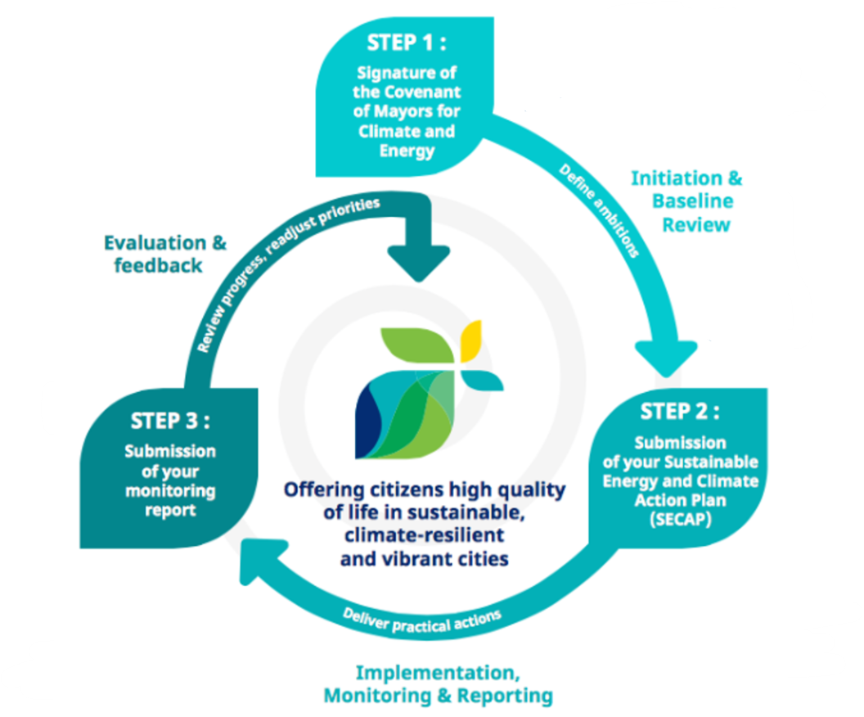
Source: https://www.globalcovenantofmayors.org/

Slide 29
REQUIREMENTS FOR EMISSION INVENTORIES :
Approved by the Municipal Council or equivalent body
Specifies mitigation, adaptation, and energy poverty commitments
Based on the results of the Baseline Emission Inventory (BEI) and Climate Risk and Vulnerability Assessment (RVA)
Mitigation requirements:
  BEI should cover at least 3 key sectors
  Mitigation actions should cover at least 2 sectors
  The action plan should list a set of actions, including at least 3 Key Mitigation Actions
Adaptation requirements:
  Should include at least one adaptation goal
  List a set of actions, including 3 Key Adaptation Actions
Energy Poverty requirements:
  One energy poverty goal
  One indicator
  At least on Key Energy Poverty Action
Notes:
Additional resources:
https://eu-mayors.ec.europa.eu/sites/default/files/2025-03/Reference%20guide%20for%20Regional%20SECAPs%20Assessment%20Framework.pdf

Slide 30
BUILDING EMISSION INVENTORY (BEI)
Methodology:
  Focus on final energy consumption
  Focus on the geographical jurisdiction of the local authority
  Allocates emissions to the consumption side
  Bottom-up collection of data
  Monitoring the progress towards the target
Relevant, flexible, and accurate
Should cover 4 key sectors
Notes:
Methodology:
Focus on final energy consumption
Focus on the geographical jurisdiction of the local authority
Allocates emissions to the consumption side
Bottom-up collection of data (whenever possible and relevant use locally sourced data instead of nationally)
Monitoring the progress towards the target
Relevant: using relevant and available data while still offering a complete assessment
Flexible: Simple to use for different contexts and sizes of municipalities
Accurate: represents reality at the local level by using locally sourced data and consistently reports on the progress
Should cover 4 key sectors: Municipal, Tertiary, Residential, Transport

Slide 31
MONITORING EMISSION INVENTORY (MEI)
Methodology is similar to BEI
Encouraged to be compiled yearly (can also be 2- or 4-year intervals)
Advantages:
  Closer monitoring
  Better understanding factors that influence the CO2 emissions
  Annual input to policy making
  Specific expertise necessary for inventories can be maintained and consolidated

Slide 32
EMISSION INVENTORY CONTENT
Definition of the local territory
Population in BEI year
BEI year
Reduction target (in %)
Reduction target type (absolute or per capita)
Emission inventory approach (standard or LCA)
Emission reporting unit (CO2 or CO2 equivalent)
Emission factors used
Responsible body/department/consultant
Detailed results per activity sector and energy carrier
Results of the estimation of the planned emission reduction per key sector
Notes:
If relevant, the following should also be included:
Population in target year (mandatory for per capita target)
Inclusion of activity sectors other than key sectors
Particular inventory method, assumptions, or tools used
Clear reference to the BEI inventory report

Slide 33
EMISSION INVENTORY STRUCTURE IN SECAP
Section A: Final energy consumption
  Reports final energy consumption data by activity sector and by energy carrier
Section B: Energy supply
  Data related to green electricity purchases and local energy production
Section C: CO2 emission tables
  Provides Emission factors

Slide 34
RISK AND VULNERABILITY ASSESSMENT (RVA) IN SECAP
Minimizing climate impacts in cities is a priority for the public and the private sectors
Assessing climate risks is one of the first steps in the adaptation cycle
The optimal level of adaptation is a balance between the cost of investment and the expected benefits in terms of reduced losses and damages
Determines the nature and extent of a risk by analysing potential hazards and assessing the vulnerability
Risk can be qualitative or quantitative
2 approaches to RVA
  Assessment based on the spatially explicit climate impact models
  Indicator-based assessment

Slide 35
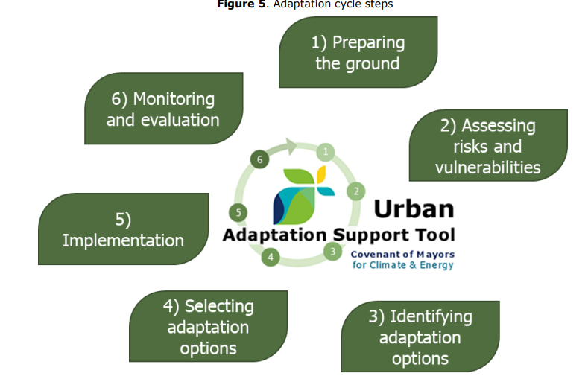
Source: https://www.globalcovenantofmayors.org/

Slide 36
INDICATOR BASED RVA
Suitable for smaller and mid-size cities
Level of aggregation depends on the general objectives of the study, technical skills of local authorities, and data availability
Steps for creating RVA:
  City exploratory analysis (stakeholder engagement, qualitative understanding)
  Identify climate hazards
  Select vulnerability indicators
  Data gathering and processing
  Assess vulnerability score for each hazard

Slide 37
STEP BY STEP RVA
Define scope and objectives (what is being assessed, why, and what time frame)
Gather relevant data
Identify climate hazards (using climate data and scenarios)
Assess exposure (who and what is at risk)
Assess sensitivity (how vulnerable and exposed systems are)
Evaluate adaptive capacity (ability to cope, respond, or recover)
Highlight key risks (who and what is most at risk
Determine adaptation priorities and set adaptation objectives
Engage relevant stakeholders in the whole process
Notes:
Additional resources:
https://climatescreeningtools.worldbank.org/
https://climate-adapt.eea.europa.eu/en/mission/knowledge-and-data/regional-adaptation-support-tool/step-2-assessing-climate-change-risks-and-vulnerabilities
https://www.ipcc.ch/report/ar6/wg2/downloads/report/IPCC_AR6_WGII_TechnicalSummary.pdf
https://climate-adapt.eea.europa.eu/en/knowledge/tools/adaptation-support-tool

