Slide 1

SuPeRBE Training Material
Macro Area of Expertise:
SuPeRBE Training Material
2 RBE Assessment System
Climate change and built environment
Area of Expertise:
2.1 RBE Method
Fundamentals of climate change
Level of competence: 3
Level of competence: 2
Activity 3.2
SuPeRBE Project (CE0200768)

Slide 2

What is the RBE Method?
The RBE Method serves as the methodological foundation of the RBE Assessment System. It is a multi-criteria analysis approach developed to evaluate climatic risk at the building and neighbourhood scale. Grounded in the impact chains conceptual model, the method generates an overall risk score for a given area, and a set of complementary indicators that detail the level of climate-related risk across specific risk categories and urban sectors.
Why is the RBE Method needed?
-Lack of assessment tools at the building and neighbourhood scale.
-Existing sustainability frameworks are not suited for climate risk assessment.
-Demand for comparable, adaptable, and decision-support-oriented tools for climate adaptation.
Notes:
The RBE Method serves as the methodological foundation of the RBE Assessment System. It is a multi-criteria analysis approach developed to evaluate climatic risk at the building and neighbourhood scales.
Grounded in the impact chains conceptual model, the method generates:
an overall risk score for a given area, and
a set of complementary indicators that detail the level of climate-related risk across specific risk categories and urban sectors.

Slide 3

Why is the RBE Method needed?
-Lack of climate risk assessment tools at the building and neighbourhood scale.
-Existing sustainability frameworks are not suited for climate risk assessment because not in line with IPCC risk approach.
-Need for comparable, adaptable, and decision-support-oriented tools for climate adaptation.
Notes:
The RBE Method serves as the methodological foundation of the RBE Assessment System. It is a multi-criteria analysis approach developed to evaluate climatic risk at the building and neighbourhood scales.
Grounded in the impact chains conceptual model, the method generates:
an overall risk score for a given area, and
a set of complementary indicators that detail the level of climate-related risk across specific risk categories and urban sectors.

Slide 4
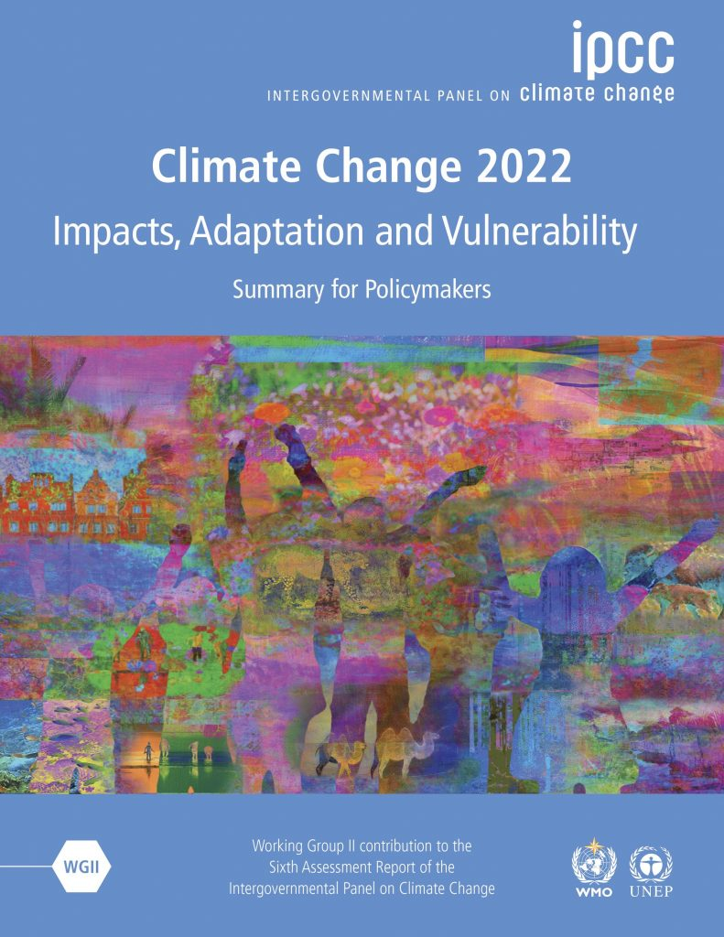
IPCC AR6
RBE Method is grounded in the IPCC AR6 Risk Concept. The IPCC AR6, or the Intergovernmental Panel on Climate Change Sixth Assessment Report, is the most recent comprehensive assessment of scientific knowledge on climate change.
IPCC AR6 provides a detailed and nuanced concept of risk as it relates to climate change. The report builds on the risk framework established in previous IPCC assessments but further refines it to account for the complex interactions between climate hazards, exposure, and vulnerability.

Slide 5

Risk to Climate Change
IPCC AR6 provides a detailed and nuanced concept of risk as it relates to climate change. The report builds on the risk framework established in previous IPCC assessments but further refines it to account for the complex interactions between climate hazards, exposure, and vulnerability.

Slide 6
RBE Method: Key Features
Cross-Scale
Measurable
Modular Structure
Urban Sectors are harmonised between RNTool and RBTool, enabling consistent data use and coordinated planning across scales. This ensures that building-level measures contribute to urban resilience goals and that neighbourhood strategies are informed by building vulnerabilities.
The RBE Method is grounded in clearly defined, measurable criteria and indicators. The method is contextualizable, allowing them to be tailored to local conditions and data availability. This ensures a more accurate and meaningful diagnosis of climate-related risks, supporting evidence-based decision-making.
The modular structure enables RBE method to be applied across diverse building types and urban areas. Users can adjust benchmarks and indicator relevance according to specific local priorities.

Slide 7
Impact Chains
HAZARD
ISSUE
RBE Method foresees the application of the impact chain conceptual model to identify the most appropriate criteria and indicators to assess the 3 key components of climatic risk (Hazard, Exposure and Vulnerability) at building and small urban scale, tracking cause-and-effect relationships and facilitate communication of the results. This approach enables the creation of an assessment system with numerical entities, where each element in the climate risk matrix (hazard, exposure, vulnerability) is assigned a value.
RISK
CATEGORY
EXPOSURE
VULNERABILITY
CRITERION
RISK LEVEL
Sensitivity
Level of
Adaptation
INDICATOR
VALUE OF THE INDICATOR

Slide 8
Three Axes of the Risk Assessment
Hazard
Exposure
Vulnerability
The RBE Method considers both climate-related and non-climate hazards. Climate-related hazards encompass extreme weather events (e.g., extreme heat, droughts, heavy precipitation) as well as slow-onset climate processes (e.g., sea-level rise). Non-climate hazards include those triggered by climatic hazards (e.g., mass movements, biological events).
Exposure describes who or what is exposed. According to the IPCC, exposure is the presence of people, livelihoods, species or ecosystems, environmental functions, services, and resources, infrastructure, or economic, social, or cultural assets in places and settings that could be adversely affected (IPCC, 2021a).
Vulnerability is the predisposition of an exposed element to be adversely affected. Vulnerability aspects refer to the criteria that influences the susceptibility of an exposed element to a climatic hazard, potentially increasing or decreasing the associated risk. This criterion may not be a direct characteristic of the exposed element itself but can impact the level of risk

Slide 9
Hazards
Hazard | Description
Heavy precipitation | A marked precipitation event occurring during a period of 1h, 3h, 6h, 12h, 24h or 48h with a total precipitation exceeding a certain threshold defined for a given location. Sub-hazards: rainstorm, monsoon, heavy snow, fog, hail
Floods | The overflowing of the normal confines of a stream or other body of water, or the temporary rise in the level of the sea or a lake which results in the inundation of dry land. Sub -hazard: Flash/surface flood, river flood, coastal flood, groundwater flood
Extreme Heat | Marked warming of the air or the invasion of very warm air, over a large area, lasting from a few days to a few weeks. Sub-Hazards: heat wave, extreme hot days.
Drought | A period of abnormally dry weather long enough to cause a serious hydrological imbalance which may result in long-term water imbalances and insufficient water resources to satisfy long-term average requirements
Storms | An atmospheric disturbance that can manifest in strong winds and accompanied by rain, snow, or other precipitation and by thunder and lightning. Sub-hazards: severe wind, tornado, cyclone, extra tropical storm, tropical storm, storm surge, lighting/thunderstorm
Extreme Cold | Marked cooling of the air or the invasion of very cold air, over a large area
Wildfire | Any uncontrolled and non-prescribed combustion or burning of plants in a natural setting such as a forest, grassland, brush land or tundra, which consumes the natural fuels and spreads based on environmental conditions. Sub-hazards: Forest fire, land fire
Sea level rise | Long-term increase in the average level of the world's seas resulting in a permanent inundation.
Chemical change | Changes in the usual chemical composition of air, water, soil, e.g. change of the CO2 atmospheric concentrations, ocean acidification, salt water intrusion
Mass movement | Any type of downslope movement of earth materials. Sub-hazards: landslide, avalanche, rock fall, subsidence, soil degradation, soil erosion
Biological hazards | Exposure to living organisms and their toxic substances or vector-borne diseases that they may carry; examples are venomous wildlife and insects, poisonous plants, mosquitoes carrying disease-causing agents

Slide 10
Urban Sectors
Urban sector | Description
1. Buildings | Refers to any (municipal/residential/tertiary, public/private) structure or groups of structures, surrounding spaces, permanently constructed or erected on its site
2. Transport | Includes road, rail, air and water transport networks and related infrastructure (e.g. roads, bridges, hubs, tunnels, ports and airports)
3. Energy | Refers to the energy supply service and related infrastructure (generation, transmission and distribution networks, all energy types).
4. Water | Refers to the water supply service and related infrastructure. It also covers water use and the (waste-, rain-) water management system that includes sewers, drainage and treatment systems
5. Waste | Includes activities related to the management (including collection, treatment and disposal)
6. Agriculture & forestry | Includes land classified / designated for agriculture & forestry use. It includes animal husbandry, aquaculture, agroforestry, beekeeping, horticulture and other agriculture & forestry management and services in the area.
7. Environment & biodiversity | Environment refers to green and blue landscapes, air quality, including urban hinterland. Biodiversity refers to the variety of life in a specific region, measurable as the variety within species, between species, and the variety of ecosystems
8. Health | Refers to the well-being of humans. It also includes the health care service and related infrastructure (e.g. hospitals)
9. Civil protection & emergency | Refers to the operation of the civil protection and emergency services by or on behalf of public authorities (e.g. civil protection authorities, police, fire-fighters, ambulance, paramedic and emergency medicine services)
10. Tourism | Refers to the activities of persons travelling to and staying in places outside their usual environment.
11. ICT | Refers to different types of communications networks and the technologies used in them.
12. Economic systems | Refers to the set of economic activities, financial infrastructures and trade networks

Slide 11
Risk Categories
HAZARD
A "Risk Category" represents the specific type of risk that arises from the interaction between a defined climatic Hazard and an Exposed Element within an Urban System. For example, the correlation between the hazard "Extreme Heat" and the Exposed Element "Population" results in the Risk Category " Health Risk for Population."
EXTREME
HEAT
EXPOSED ELEMENT
POPULATION
HEALTH RISK
FOR POPULATION
RISK CATEGORY

Slide 12
Risk Categories
By defining a specific Risk Category for each combination of hazard and Exposed Element, the RBE Assessment System enables cities to identify exactly who or what is at risk and why. This targeted approach supports the development of tailored adaptation strategies that can be implemented at different spatial scales, such as buildings, neighbourhoods, and helps to clarify which institution or department is responsible for acting.
Hazard | Urban Systems
 | Built environment |  | Health |  | Transport
 | Exposed Elements
 | Residential buildings | Public buildings | Population | Health Care Facilities | Road Network | Rail Network.
Extreme Heat | Risk Category 1 | Risk Category 2 | Risk Category 3 | Risk Category 4 | Risk Category 5 | Risk Category 6
Heavy Precipitation | Risk Category 7 | Risk Category 8 | Risk Category 9 | Risk Category 10 | Risk Category 11 | Risk Category 12

Slide 13

RBE Method in Relation to Future Conditions
RBE Method can be used to assess the level of climate risk in relation to future climatic conditions. Selecting Hazard Values that accurately reflects the anticipated changes in climate over time. This involves evaluating potential hazards based on future projections, such as temperature increases, changes in precipitation patterns, and the frequency or intensity of extreme weather events. These projections can be derived from models such as those outlined in the Intergovernmental Panel on Climate Change (IPCC) reports, specifically the Representative Concentration Pathways (RCPs).

Slide 14
Structure of the RBE Method
RBE Method organises its components into nested hierarchical levels (5):
Level 1 | Hazard
Level 2 | Urban Systems
Level 3 | Risk Categories
Level 4 | Criteria
Level 5 | Indicator

Slide 15
Structure of the RBE Method
Level 1 corresponds to the Hazards, translated into a strategic “Issue”. Issues are at top of the hierarchy and contain within them Macro Categories corresponding to the 12 Urban Systems. At the “Issue” level the Hazards are classified based on letters . For example, A. Heavy Precipitation, B. Floods, C, Extreme Heat, D. Drought, etc.
A | ISSUE (Hazard)
Hazard
A-H1 | Hazard Criterion
 | Hazard Indicator
A-H2 | Hazard Criterion
 | Hazard Indicator
A-Hn | Hazard Criterion
 | Hazard Indicator
Level 2 corresponds to Urban Systems, translated into “Macro Categories”. Macro Categories contain within them the Risk Categories and are classified following a numerical order. For example: A1 Buildings, A2 Transport, A3 Energy, etc.
A | ISSUE (Hazard)
A1 | MACRO CATEGORY (Urban System)
Hazard
A-H1 | Hazard Criterion
 | Hazard Indicator
A-H2 | Hazard Criterion
 | Hazard Indicator
A-Hn | Hazard Criterion
 | Hazard Indicator
Notes:
Based on alphabetical →Based on Letters.
level 2: are organized based in numerical order

Slide 16
Structure of the RBE Method
Level 3 corresponds to Risk Categories. Risk Categories contains within them vulnerability and exposure criteria and are classified based in numerical order. For example: A1.1 Damage Risk for Residential Buildings, A1.2 Damage Risk for Public Buildings, A1.3 Damage Risk for Commercial Buildings, etc.
A | ISSUE (Hazard)
A1 | MACRO CATEGORY (Urban System)
A1.1 | RISK CATEGORY (Exposed Element)
Hazard
A-H1 | Hazard Criterion
 | Hazard Indicator
A-H2 | Hazard Criterion
 | Hazard Indicator
A-Hn | Hazard Criterion
 | Hazard Indicator
A | ISSUE (Hazard)
A1 | MACRO CATEGORY (Urban System)
A1.1 | RISK CATEGORY (Exposed Element)
VULNERABILITY
A1.1.1 | Vulnerability Criterion
EXPOSURE
A1.1-E1 | Exposure Criterion
Hazard
A-H1 | Hazard Criterion
 | Hazard Indicator
A-H2 | Hazard Criterion
 | Hazard Indicator
A-Hn | Hazard Criterion
 | Hazard Indicator
Level 4 correspond to assessment Criteria. The RBE Method includes three types of criteria: Vulnerability and Exposure criteria, which are associated with Risk Categories, and Hazard criteria, which are associated with Issues.

Slide 17
Structure of the RBE Method
Level 5 corresponds to Indicators. Each indicator is associated with a specific criterion (hazard, exposure or vulnerability) and is used to quantify performance with respect to that criterion. Indicators can be both quantitative and qualitative. A Criterion can be associated to only one indicator.
A | ISSUE (Hazard)
A1 | MACRO CATEGORY (Urban System)
A1.1 | RISK CATEGORY (Exposed Element)
VULNERABILITY
A1.1.1 | Vulnerability Criterion
 | Vulnerability Indicator
EXPOSURE
A1.1-E1 | Exposure Criterion
 | Exposure Indicator
Hazard
A-H1 | Hazard Criterion
 | Hazard Indicator
A-H2 | Hazard Criterion
 | Hazard Indicator
A-Hn | Hazard Criterion
 | Hazard Indicator

Slide 18
Structure of the RBE Method
Example:
A | EXTREME TEMPERATURES (Hazard)
A1 | BUILDINGS (Urban System)
A1.1 | Damage risk for residential buildings (Exposed Element)
VULNERABILITY
A1.1.1 | Surface infiltration capacity
 | Share of permeable vs impermeable surfaces
EXPOSURE
A1.1-E1 | Building Density
 | Number of buildings per km2
Extreme Temperatures
A-H1 | R20
 | Number of Days with Precipitation ≥ 20 mm
A-H2 | SDII
 | Simple Daily Intensity Index
A-Hn | RX1DAY
 | Maximum total precipitation that falls in a single day

Slide 19
RBE Method Assessment Process
The RBE Method assessment process consists of the following steps:
1. Calculation of the Vulnerability Value (VV) for each Risk Category
2. Calculation of the Exposure Value (EV) for each Risk Category
3. Calculation of the Hazard Value (HV) for each Issue
4. Calculation of the Risk Value for each Risk Category
5. Aggregation of Risk Category Values to Calculate the Risk Value of Macro-Categories (Urban Systems)
6. Aggregation of Macro Categories Values to calculate the Risk Value of Issues (Hazards)
7. Aggregation of Issues Values to calculate the Overall Risk Value

Slide 20
RBE Method Assessment Process
Step 1: Calculation of the Vulnerability Value (VV) for Risk Categories
To calculate the Vulnerability Value of a Risk Category:
-The values of the quantitative indicators are calculated
-The calculated values are normalised in the interval (0,1)
-A normalised score (0,1) is assigned to qualitative indicators
-The scores of quantitative and qualitative indicators are aggregated through a weighted sum.

Slide 21
RBE Method Assessment Process
Step 1: Calculation of the Vulnerability Value (VV) for Risk Categories
-Calculation of quantitative indicators
The values of the quantitative vulnerability indicators linked to the criteria associated to the Risk Category are calculated. The output consists of a set of quantities expressed in different units of measurement.
Hazard | Extreme Heat
Risk Category | Health Risk for Population
Vulnerability Criterion | Indicator | Calculated Value
Capacity of paved surfaces to reflect solar radiation | mean Solar Reflectance Index of paved surfaces in the area | 76
Availability of Green Areas | Percentage of green spaces on total urban area surface | 15 %
Shading of Paved Surfaces | Percentage of paved surfaces shaded on June 21st at 12:00 PM | 5 %

Slide 22
RBE Method Assessment Process
Step 1: Calculation of the Vulnerability Value (VV) for Risk Categories
-Normalisation of quantitative indicators’ values
The calculated values of quantitative indicators are normalised in the interval (0,1). The term “normalisation” refers to the transformation of indicator values measured in different units into unit-less values on a common scale. The normalisation interval used in RBE Method is a value range from 0 to 1, the most applied in climate risk studies in general. A zero value is defined as “optimal”, no improvement necessary or possible and 1 as “critical”.
Normalisation values | Description
0-0.2 | Optimal (No improvement necessary)
>0.2-0.4 | Rather positive
>0.4-0.6 | Neutral
>0.6-0.8 | Rather negative
>0.8-1 | Critical (Could lead to severe consequences)

Slide 23
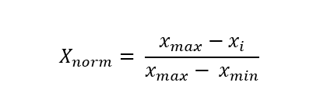
RBE Method Assessment Process
Step 1: Calculation of the Vulnerability Value (VV) for Risk Categories
-Normalisation of quantitative indicators’ values
For the “higher is better” indicators (higher the numerical value of the indicator, the higher the performance level), the value is normalised applying the following formula:
Where:
Xi: value of the indicator
X_{min} = critical indicator’s value (corresponding to score 1)
X_{max} = optimal indicator’s value (corresponding to score 0)
Indicator values worse than X_{min} will be allocated to the value X_{min} and indicator values exceeding X_{max} will be allocated to the value X_{max}:
For example, if the value (Xi) of the indicator "mean Solar Reflectance Index of paved surfaces in the area" is 14, with the following benchmarks:
X_{max} (Optimal performance) = 58, benchmark associated to score 0
X_{min} (Critical performance) = 0, benchmark associated to score 1
The resulting normalised value will be: X_{norm} = 0,76 (rather negative)

Slide 24
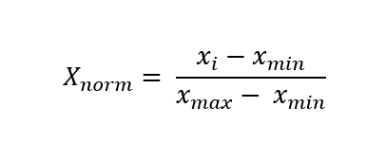
RBE Method Assessment Process
Step 1: Calculation of the Vulnerability Value (VV) for Risk Categories
-Normalisation of quantitative indicators’ values
For the “lower is better” indicators (lower the numerical value of the indicator, the higher the performance level.), the value is normalised applying the following formula:
where:
Xi: value of the indicator
Xmin = optimal indicator’s value (corresponding to score 0)
Xmax = critical indicator’s value (corresponding to score 1)

Slide 25
RBE Method Assessment Process
Step 1: Calculation of the Vulnerability Value (VV) for Risk Categories
Example: Normalisation of quantitative indicators
If the value (Xi) of the indicator of the indicator “Share of non-permeable surfaces in the area” is 85%, with the following benchmarks:
-Xmin (optimal performance) = 50 %, benchmark associated to score 0
-Xmax (critical performance) = 100 %, benchmark associated to score 1
The resulting normalised value will be: Xnorm = 0,7 (rather negative)

Slide 26
RBE Method Assessment Process
Step 1: Calculation of the Vulnerability Value (VV) for Risk Categories
-Normalisation of qualitative indicators
Qualitative indicators specified by categorical values (scenarios) are normalised using a five-level rating scheme
Normalisation values | Description
0.1 | Optimal (No improvement necessary)
0.3 | Rather positive
0.5 | Neutral
0.7 | Rather negative
0.9 | Critical (Could lead to severe consequences)

Slide 27
RBE Method Assessment Process
Step 1: Calculation of the Vulnerability Value (VV) for Risk Categories
Example: Normalisation of qualitative indicators
Normalisation values | Description | Scenario
0.1 | Optimal (No improvement necessary) | Exemplary climate governance, with a consolidated and inclusive adaptation strategy integrated into all urban policies. High collaboration between institutions, citizens, private organizations, and the scientific community.
0.3 | Rather positive | Well-organized and integrated climate governance in urban planning processes. Strong coordination between all departments and stakeholders. Active participation from the community and stakeholders in planning and implementing adaptation strategies.
0.5 | Neutral | Climate plans are present and implemented with a decent level of coordination. Collaboration between different entities exists, but some critical sectors remain neglected. Community and stakeholder involvement occurs only in certain decisions.
0.7 | Rather negative | Formal climate plans exist, but with poor coordination between various departments and stakeholders. Little clarity on who is responsible for managing climate risks. Limited or absent community and stakeholder involvement.
0.9 | Critical (Could lead to severe consequences) | Fragmented and ineffective climate governance. Lack of clear climate plans or adaptation strategies. Poor collaboration between different entities and absence of citizen involvement.
The Table shows the normalised values in relation to the scenarios of the qualitative indicator “Quality of the urban governance”.
During the normalisation phase, the scenario that reflects the actual situation has to be selected and the relative score assigned to the indicator

Slide 28
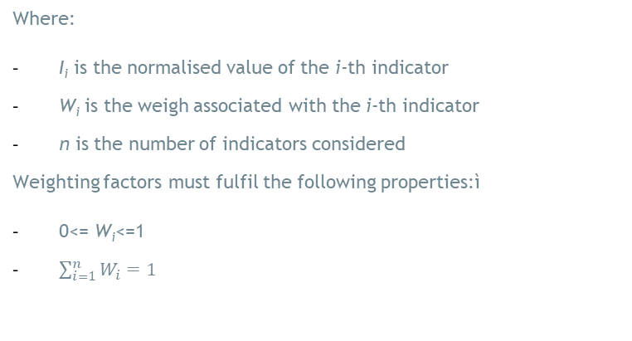
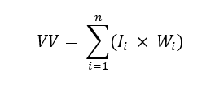
RBE Method Assessment Process
Step 1: Calculation of the Vulnerability Value (VV) for Risk Categories
-Aggregation of normalised values to calculate the Vulnerability Value of the Risk Category
To calculate the Vulnerability Value (VV) of the Risk Category, the normalized values of the indicators are aggregated using an arithmetic mean. This results in the total Vulnerability Value for the Risk Category:

Slide 29

RBE Method Assessment Process
Step 1: Calculation of the Vulnerability Value (VV) for Risk Categories
-Example: Aggregation of normalised values to calculate the Vulnerability Value of the Risk Category
The Risk Category “Health Risk for Population” belonging to the Hazard “Extreme heat” contains 3 criteria. The criterion “Capacity of paved surfaces to reflect solar radiation” has been considered more relevant than the other 2 in the following Table
Hazard | Extreme Heat
Risk Category | Health Risk for Population
Vulnerability Criterion | Indicator | Normalised value | Weight
Capacity of paved surfaces to reflect solar radiation | mean Solar Reflectance Index of paved surfaces in the area | 0.65 | 0.5
Availability of Green Areas | Percentage of green spaces on total urban area surface | 0.70 | 0.25
Shading of Paved Surfaces | Percentage of paved surfaces shaded on June 21st at 12:00 PM | 0.40 | 0.25
The output of this step is a set of Vulnerability Values (VV), one per Risk Category.

Slide 30
RBE Method Assessment Process
Step 2: Calculation of the Exposure Value (EV) for Risk Categories
The RBE Method foresees the assignment of an Exposure Value (EV) to each Risk Category included in the assessment. This value represents the magnitude of the exposed elements, as outlined in the following Table:
Extend of the exposure | Exposure value (EV)
Minor | 0,01-0,10
Low | 0,11-0,20
Moderate | 0,21-0,30
Critical | 0,31-0,50
Major | 0,51-1

Slide 31
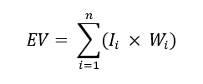
RBE Method Assessment Process
Step 2: Calculation of the Exposure Value (EV) for Risk Categories
-Normalisation of quantitative indicators
The determine the EV of a Risk Category, firstly the value of the associated exposure indicators shall be calculated and normalised in the interval (0,1) applying the procedure indicated below.
Then, EV is calculated using the following formula:
Where:
I_{i} is the normalised value of the i-th exposure indicator
W_{i} is the weight associates with the i-th exposure indicator
n is the number of exposure indicators considered.
The various weights assigned to exposure indicators may be derived from existing literature, stakeholder information, or experts’ weighting. To normalize the indicator, it is necessary to determine the values corresponding to the optimal (0) and critical (1) levels of exposure.

Slide 32
RBE Method Assessment Process
Step 2: Calculation of the Exposure Value (EV) for Risk Categories
-Normalisation of quantitative indicators’ values
For the “lower is better” indicators (lower the numerical value of the indicator, the higher the performance level.), the value is normalised applying the following formula:
where:
Xi: value of the indicator
Xmin = optimal indicator’s value (corresponding to score 0)
Xmax = critical indicator’s value (corresponding to score 1)

Slide 33
RBE Method Assessment Process
Step 2: Calculation of the Exposure Value (EV) for Risk Categories
Example
Table below illustrates the Exposure Values assigned to Risk Categories, considering one exposure indicator associated to each Risk Category.
Hazard | Risk Category | Exposed element | Exposure indicator | Exposure value
Extreme Heat | Health risk for population | Population | Population density (n/Km2) | 0,32 (critical)
 | Damage risk for residential buildings | Residential buildings | Percentage of residential buildings over 50 years old (%) | 0,7 (major)
Heavy precipitation | Drainage capacity of road networks | Road network | Total length of roads in flood prone zones (Km) | 0,18(Low)
The output of this step is a set of Exposure Values (EV), one per Risk Category.

Slide 34
RBE Method Assessment Process
Step 3: Calculation of the Hazard Value (HV) for Issues
The RBE Method foresees the assignment of a Hazard Value (HV) to each Issue (Hazard) included in the assessment. This value represents the relevance of the hazard in relation to the local context, as defined in the Table below.
Hazards event |  | Hazard Value (HV)
Frequent | Likely to occur in a lifetime (every 0-10 years) | Very likely | 1-0,9
Probable | Likely to occur several times in a lifetime (every 0-25 year) | Likely | 0,89-0,66
Occasional | Likely to occur sometime in a lifetime (every 0-50 years) | As like as not | 0,65-0,33
Remote | Unlikely but still possible to occur in a lifetime (0-100 years) | Unlikely | 0,32-0,0

Slide 35
RBE Method Assessment Process
Step 3: Calculation of the Hazard Value (HV) for Issues
The Hazard Value shall be assigned using the information provided in the SECAPs. If information is not available:
-the Hazard Value (HV) is assigned by experts
-the Hazard Value (HV) is assigned through the calculation, normalisation and aggregation of specific Hazard criteria.
Regarding the second option, the Table shows an example of Hazard Criteria for the Issue “Extreme Heat”.
Issue | Extreme heat
Hazard criteria | Indicators
SU25(summer days) | Number of days per year with a daily maximum temperature greater than 25ºC
SU30 (warm days) | Number of days per year with a daily maximum temperature greater than 30ºC
TMAX | Daily maximum temperature ºC
TR20 (tropical nights) | Number of days per year with a daily minimum temperature greater than 20ºC
HW | Number of days per year with a daily maximum temperature greater than 30ºC

Slide 36
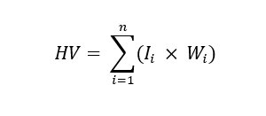
RBE Method Assessment Process
Step 3: Calculation of the Hazard Value (HV) for Issues
The determine the HV for an Issue, the value of the associated hazard indicators shall be calculated and normalised in the interval (0,1). Then HV is calculated using the following formula:
Where:
I_{i} is the normalised value of the i-th hazard indicator
W_{i} is the weight associates with the i-th hazard indicator
n is the number of hazard indicators considered
The various weights assigned to hazard indicators may be derived from existing literature, stakeholder information, or experts’ weighting.

Slide 37
RBE Method Assessment Process
Step 3: Calculation of the Hazard Value (HV) for Issues
Example
Supposing to conduct the risk assessment evaluation for a Central European city, the Table below reports the Hazard Values assigned after the consultation of its SECAP.
Hazard | Hazard value (HV)
Extreme heath | 0,8(High)
Heavy precipitation | 0,6 (Moderate)
Storms | 0,5(Moderate)
The output of this step is a set of Hazard Values (EV), one per Issue.

Slide 38
RBE Method Assessment Process
Step 4: Calculation of the Category Risk Value
At this point of the process, each Risk Category is characterised by:
-a Hazard Value (HV)
-an Exposure Value (EV)
-a Vulnerability Value (VV)
The last step consists in the aggregation of these 3 risk components using a weighted geometric mean to calculate the value of risk of each Risks Category

Slide 39


RBE Method Assessment Process
Step 4: Calculation of the Category Risk Value
Category Risk value =
Where:
-HV is the hazard value
-EV is the exposure value
-VV is the vulnerability value
Whv is the weighted associated to HV
Wev is the weighted associated to EV
Wv is the weighted associated to VV
Assuming that the weighting fulfills the following properties:
Category Risk value =

Slide 40

RBE Method Assessment Process
Step 4: Calculation of the Category Risk Value
Example
To calculate the risk value of the risk category “health risk for inhabitants” the following values are used:
Hazard value (HV) = 0,68
Whv = 0,25
Exposure value (EV) = 0,35
Wev = 0,25
Vulnerability value (VV) = 0,6
Wv = 0,5
The value of the risk category “Health risk for inhabitants” results to be:
Category risk value =

Slide 41
RBE Method Assessment Process
Step 5:Aggregation of Risk Category Values to Calculate the Risk Value of Macro-Categories (Urban Systems)
In this step the risk value of Risk Categories calculated in the previous step are aggregated to produce a risk value at Macro Category level. This value represents the specific risk of Urban Systems in relation to the Hazards.

Slide 42

RBE Method Assessment Process
Step 5:Aggregation of Risk Category Values to Calculate the Risk Value of Macro-Categories (Urban Systems)
Being a multi-risk approach, the aggregation of the risk categories scores take place through an arithmetical mean.
Macro category risk value =
Where:
-Ci is the risk value of the i-th risk category
-Wi is the weight associated with the i-th risk category
-n = total number of risk categories considered
Weighting factors must fulfil the following properties:

Slide 43
RBE Method Assessment Process
Step 5:Aggregation of Risk Category Values to Calculate the Risk Value of Macro-Categories (Urban Systems)
Being a multi-risk approach, the aggregation of the risk categories scores take place through an arithmetical mean.
Macro category risk value =
Where:
-Ci is the risk value of the i-th risk category
-Wi is the weight associated with the i-th risk category
-n = total number of risk categories considered
Weighting factors must fulfil the following properties:

Slide 44
RBE Method Assessment Process
Step 5:Aggregation of Risk Category Values to Calculate the Risk Value of Macro-Categories (Urban Systems)
Example
The Macro-category “Health” has 2 risk categories. In the next table there are the risk values for each one of them and their respectively weight.
Risk Category | Risk Value | Weight
Health of inhabitants | 0,61 | 0,60
Rischio di efficienza per le strutture sanitarie | 0,28 | 0,20
The score for the Macro-Category in relation to the Hazard “Extreme Temperatures” is = (0,61*0,60)+(0,28*0,40)= 0,48 (neutral)

Slide 45
RBE Method Assessment Process
Step 6:Aggregation of Macro Category Values to calculate the Risk Value of Issues (Hazards)
In this step the risk values of Macro Categories are further aggregated to produce a risk value for issues (Hazards).
Being a multi-risk approach, the aggregation of the Macro Categories’ scores take place through an arithmetical mean.

Slide 46
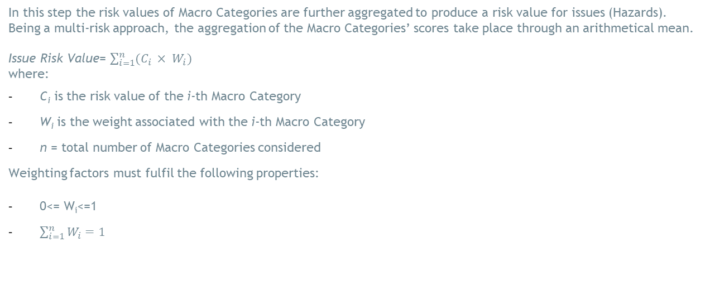
RBE Method Assessment Process
Step 6:Aggregation of Macro Category Values to calculate the Risk Value of Issues (Hazards)

Slide 47
RBE Method Assessment Process
Step 6:Aggregation of Macro Category Values to calculate the Risk Value of Issues (Hazards)
Example
The Issue “Extreme Heat” includes 3 Macro Categories. In the following Table is reported the risk value of each and the relative weight.
Macro category | Risk value | Weight
Health | 0,54 | 0,7
Energy | 0,32 | 0,15
Transports | 0,23 | 0,15
The Issue score in relation to the hazard “Extreme heat” results to be:
Hazard risk level= (0,54*0,7)+(0,32*0,15)+(0,23*0,15)= 0,46 (neutral)

Slide 48
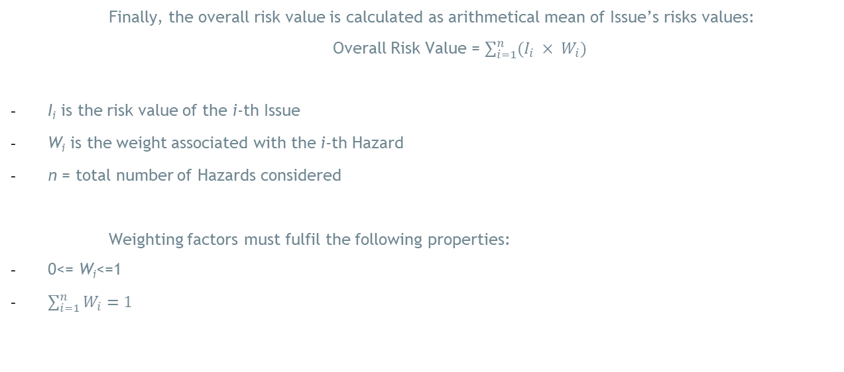
RBE Method Assessment Process
Step 7:Aggregation of Issues Values to calculate the Overall Risk Value

Slide 49
RBE Method Assessment Process
Step 7:Aggregation of Issues Values to calculate the Overall Risk Value
Example of risk values and weight factors associated to issues
Issue | Risk value | Weight
Extreme heath | 0,46 | 0,5
Heavy precipitation | 0,73 | 0,2
Storms | 0,65 | 0,1
The overall risk value results to be:
Overall risk value= (0,46*0,5)+(0,73*0,2)+(0,65*0,1)= 0,44 (neutral)

Slide 50
Assessment Results
Risk Categories
Macro Categories
The risk values of Risk Categories provide a clear understanding of which elements within the urban systems are most at risk and highlight areas that require priority in adaptation strategies.
The risk values (0,1) of Macro Categories provide a clear understanding of which urban sectors are most at risk and highlight areas that require priority in adaptation strategies.
Issues
Overall Risk
RBE Method
Results
The RBE Method allows for an aggregated view of how each hazard affects the overall risk profile. Hazards with higher risk values indicate a greater vulnerability to climate impacts and thus require immediate and sustained efforts to mitigate these risks.
RBE method provides a clear metric to gauge the effectiveness of current adaptation measures and the urgency for additional interventions. The interpretation of results is crucial for informing climate adaptation strategies and underscore the importance of integrating these findings into broader urban planning and policy frameworks.

