Slide 1

SuPeRBE Training Material
Macro Area of Expertise:
SuPeRBE Training Material
AD2 RBE Assessment System
Climate change and built environment
Area of Expertise:
AD2.2 RBTool
Fundamentals of climate change
Level of competence: 1/2/3
Level of competence: 2
Activity 3.2
SuPeRBE Project (CE0200768)

Slide 2

What is RBTool?
RBTool (Resilient Building Tool) is a framework that applies the RBE Method at the building scale. It enables the assessment of climate risk for individual buildings, both new and existing, by analysing the vulnerability of their components. The tool structures this analysis into two main macro-categories: building components (such as materials, technical systems, and structural elements) and exposed elements (including occupants, functions, and location-specific factors). Through this approach, RBTool integrates hazards, exposure, and vulnerability to provide an accurate risk profile of a building. The results support building-level adaptation strategies, renovation planning, and climate-resilient design.
Notes:
The RBE Method serves as the methodological foundation of the RBE Assessment System. It is a multi-criteria analysis approach developed to evaluate climatic risk at the building and neighbourhood scales.
Grounded in the impact chains conceptual model, the method generates:
an overall risk score for a given area, and
a set of complementary indicators that detail the level of climate-related risk across specific risk categories and urban sectors.

Slide 3

RBTOOL IMPLEMENTS THE RBE Method
RBTool is a generic frameworks that implements the RBE Method.
The RBE Method is a multi-criteria analysis approach developed to evaluate climatic risk at the building and neighbourhood scale.
RBTool generates an overall risk score for a given building, and a set of complementary indicators that detail the level of climate-related risk across specific risk categories and building components.
The RBE Method is grounded in the IPCC AR6 Risk Concept. The IPCC AR6, or the Intergovernmental Panel on Climate Change Sixth Assessment Report, is the most recent comprehensive assessment of scientific knowledge on climate change. It defines climate risk as the interaction of hazard, exposure, and vulnerability.
.

Slide 4
STRUCTURE OF RBTOOL
The RBTool Central European version supports climate risk assessment based of the following structure:
1.Issues (Hazards
2.Macro-Categories (Building components)
3.Risk Categories (Hazard x Exposed element)
4.Criteria (Indicators)

Slide 5
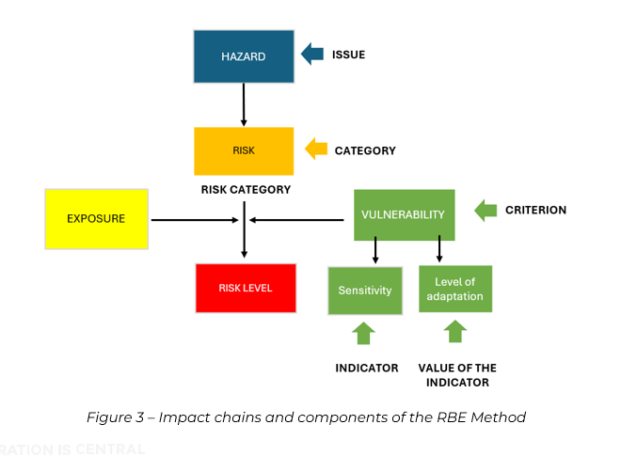
RBTool Structure
The RNTool is divided into:
1. Issues: Most significant climate-related hazards for buildings in Central Europe.
2. Macro-Categories: Building Systems/components
3.Exposed Elements: Physical subcomponents within each macro-category.
4.Risk Categories: Specific hazard x exposed element pairs
5. Indicators: Qualitative and quantitative

Slide 6






Structure of RBTool
ISSUES
The RBTool Central European version supports climate risk assessment in relation to the following 7 Issues:
A Heavy precipitation
D Droughts
G Mass Movement
B Floods
E Storms
C Extreme heat
F Wild-fire
3

Slide 7












Structure of RBTool
Macro categories
Representing key Building Components (12), addressed in RBTool for Central Europe are:
Foundations
Ventilation System
Landscaping
Load Bearing Structural Frame
Sanitary Systems
Occupants
Other Systems
Location
Non-load Bearing Elements
Energy System
Community
Utilities

Slide 8
Structure of RBTool
Risk categories
A Risk Category represents the specific risk arising from the interaction between an issue and an Exposed Element within a particular Building Component (Macro Category).
Category: A4.2Damage risk for facade openings
Issue:
Heavy precipitation
Exposed element:External Wall Systems
Represents the interaction between
within a particular
Building Component: Facade
Risk Categories have been defined in the Central European version of the RBTool. These categories cover all seven Issues addressed in the tool and span across the key Urban Sectors most relevant for neighbourhood-scale climate adaptation.
5

Slide 9
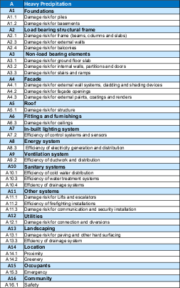
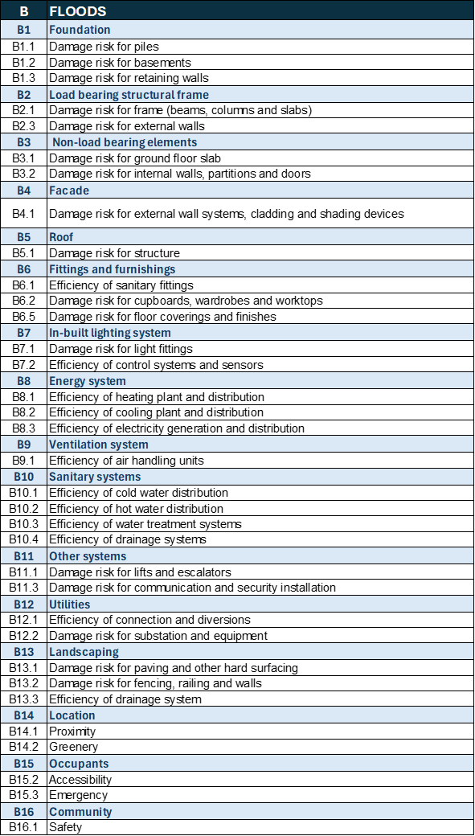
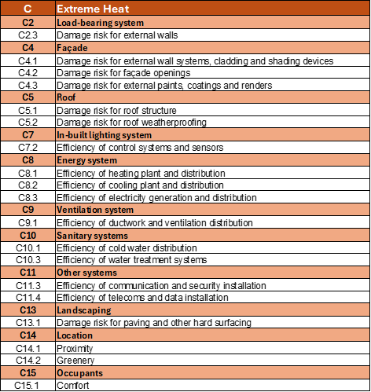
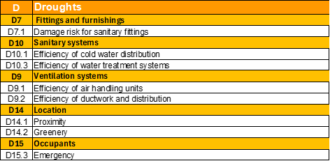
Structure of the Tool
Hazard

Slide 10
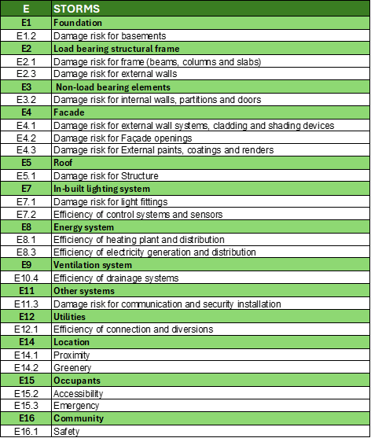
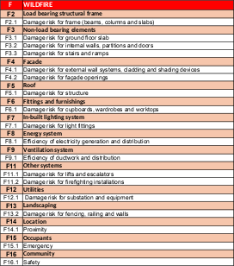
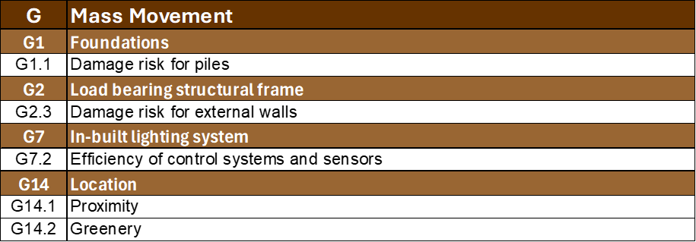
Structure of the Tool
Hazard

Slide 11

Criteria and Indicators
As for RNTool, each Risk Category in RBTool is assessed through a structured set of vulnerability, exposure and hazard criteria, which are operationalised via indicators.
Each indicator is documented with:
-a description and unit of measure (if applicable)
-performance direction (Higher is Better, Lower is Better, or Qualitative)
-benchmarks:
-value 0 = optimal condition (score = 0)
-value 1 = critical condition (score = 1)
-assessment method
-data sources
-references

Slide 12
Exposure Criteria
Concerning exposure, RBTool adopts a unique qualitative criterion called “Exposure Magnitude”, associated with the qualitative indicator “Exposure Level”. This indicator is used to express the extent to which a specific Exposed Element (see Table 20) is present, and thus potentially affected by a given climate hazard. The Exposure Level answers the question: 'How many elements are exposed?', focusing on the quantity or prevalence of Exposed Elements within the building.
Exposure Level Normalised Value | Scenario
0,1 | Very few isolated Exposed Elements or total surface area <5% of the related building component (Macro-category)
0,3 | Few Exposed Elements or total surface area less than 15% of the corresponding building component )Macro-category)
0,5 | Moderate number of Exposed Elements or total surface area between 15% and 30% of the corresponding building component (Macro-category)
0,7 | Numerous Exposed Elements or total surface are between 30% and 60% of the corresponding building component (Macro Category)
0,9 | Exposed Elements dominate the relevant building component (Macro category) or total surface area >60% of the related building component (Macro category)

Slide 13

Contextualisation
To be used effectively, the RBTool requires contextualisation, which transforms the generic framework into a local operational assessment tool tailored to specific buildings and territorial needs.
It ensures:
-Relevance of indicators
-Use of applicable benchmarks
-Meaningful risk values
-Efficient assessment focused on what really matters

Slide 14
Overview of the Contextualisation Process
Main Steps:
1.Selection of relevant Hazards
2.Selection of Macro-Categories and Risk Categories
3.Benchmark definition
4.Weight assessment
5.Local data and indicator validation

Slide 15

Step 1: Selection of Relevant Hazards
Not all climate hazards are equally relevant in all territories. Therefore, the first contextualisation step is to select the most significant Issues (Hazards) for the local building stock. This selection may be based on:
-local or regional climate vulnerability assessments
-SECAPs or national adaptation strategies
-historical damage data to buildings
-stakeholder consultation (e.g., local engineers, facility managers)
Hazards with negligible probability or impact may be excluded from the local RBTool version.

Slide 16
Step 2: Selection of Macro-Categories and Risk Categories
Macro Categories
Risk Categories
Each Macro Category corresponds to building components, spaces, or users that may or may not be present depending on the building’s design, function, and context. The inclusion of a Macro Category in the assessment process should reflect its actual relevance and presence in the specific building
The Risk Categories linked to each Macro Category must be selected considering the building's typology and use. A hospital and a residential apartment block, for example, may require different sets of Risk Categories due to differing vulnerability profiles and critical functions

Slide 17
Step 3: Benchmarks Definition
For the Vulnerability criteria and the Hazard criteria, the contextualisation process requires:
When localising benchmarks and methods, the following hierarchy of sources should be respected:
-Assigning local benchmarks (value 0 for optimal performance and value 1 for critical performance).
-Defining or adapting the assessment method for calculating the indicator value.
-Binding regulations (e.g., building codes, laws).
-Recognised technical standards (e.g., ISO, CEN, national standards).
-Authoritative guidelines (e.g., national planning documents, EU reports).
-Peer-reviewed scientific literature and other technical references.

Slide 18

Step 4:Assignment of weights
In RBTool, the assignment of weights to Risk Categories and Macro Categories should be based on their relative importance in the specific context of the assessment. The weighting process should consider:
-Functional relevance.
-Vulnerability sensitivity.
-Potential consequences of damage or disruption.
-Expert judgement and participatory methods

Slide 19

Step 5: Indicator Validation and Data Sources
1.Validate local data depending on:
-Availability and accuracy of the information.
-Compatibility of the data with the assessment method.
2.Adjust indicators if needed.
3.Document data sources like energy audits, BIM, on-site inspections.

Slide 20
Practical Example of RBTool
Step 1 Assignment of Hazard Values to Issues
Option 1
1.1 The value of likelihood of Hazard is assigned (HV)
Code | Hazard | HV
A | Heavy Precipitation | 0,8
C | Extreme Temperatures | 0,9
HV value ranges from 0 to 1. HV answers the question: how severe is the hazard ?

Slide 21
Practical Example of RNTool
Step 1
Option 2
In alternative, climatic indicators can be used to determine HV. The following is an example for Hazard A Heavy Precipitation
Code | Hazard criteria | Hazard indicator | Unit of measure | Value
H.A1 | R20 | Number of Days with Precipitation ≥ 20 mm | number | 2
H.A2 | SDII | Simple Daily Intensity Index | mm/day | 8
H.A3 | RX1DAY | Maximum total precipitation that falls in a single day | mm | 60

Slide 22
Practical Example of RBTool
Step 1
Option 2
The value of climatic hazards is normalised in the interval (0-1) - Example for H.A3
Code | Hazard criteria | Hazard indicator | Unit of measure | Value
H.A3 | RX1DAY | Maximum total precipitation that falls in a single day | mm | 60
Type: Lower is better
Benchmark 1 - Critical | Xmax | 100
Benchmark 0- Optimal | Xmin | 20
Value of the indicator | Xi | 60
Normalised Value |  | 0,5
Nv = Xi - Xmin
Xmax - Xmin

Slide 23
Practical Example of RBTool
Step 1
Option 2
The value of climatic hazards is normalised in the interval (0-1) - Example for H.A3
Code | Hazard criteria | Hazard indicator | Normalised Value | Weight | Weighted value
H.A1 | R20 | Number of Days with Precipitation ≥ 20 mm | 0,7 | 0,33 | 0,23
H.A2 | SDII | Simple Daily Intensity Index | 0,7 | 0,33 | 0,23
H.A3 | RX1DAY | Maximum total precipitation that falls in a single day | 0,5 | 0,33 | 0,17
Note: Weighted value = normalised value * weight
HV: 0,63

Slide 24
Practical Example of RBTool
Exposure Value (EV) calculation for Risk Categories
The value of the Exposure Indicators associated with the Risk Categories is calculated
A | Heavy Precipitation
A4 | Facade | Exposure Criteria |  | Exposure Indicator | Unit | Value
A4.2 | Facade openings | E.4.2.1 | Extension of the glazed envelope | Total area of glazed elements in the envelope of the building | m² of glazing/m² total envelope surface | 60%
Type: Lower is better
Benchmark 1 - Critical | Xmax | 100%
Benchmark 0- Optimal | Xmin | 0%
Value of the indicator | Xi | 60%
Normalised Value |  | 0,6
Nv = Xi - Xmin
Xmax - Xmin

Slide 25
Practical Example of RBTool
Vulnerability Values calculation for Risk Categories
The value of the Vulnerability Indicators of Risk Categories is calculated (example for the Risk Category C8.1)
A4.2 | Facades | Criterion | Indicator | Unit | Value
 | A4.2.1 | Safe Windows and Shutters | Share of windows protected against hail | % | 25
 | A4.2.2 | Sealing Effectiveness | Share of openings with effective water/air infiltration protection | % | 30
 | A4.2.3 | Glass Strength Against Water Pressure | Share of windows rated for pressure resistance | % | 15
 | A4.2.4 | Ease of Disassembly & Material Change | Share of materials that can be replaced easily | % | 40

Slide 26
Practical Example of RBTool
Step 3/4/5 Vulnerability Values calculation for Risk Categories
The value of the Vulnerability Indicators of Risk Categories is normalised in the interval 0-1 (Example for criterion A4.2.1)
Criterion | Indicator | Unit | Value
Safe Windows and Shutters | Share of windows protected against hail | % | 25
Type: Higher is better
Benchmark 1 - Critical | Xmax | 0
Benchmark 0- Optimal | Xmin | 100
Value of the indicator | Xi | 25
Normalised Value |  | 0,75
Nv = Xi - Xmin
Xmax - Xmin

Slide 27
Practical Example of RBTool
Step 3/4/5 Vulnerability Values calculation for Risk Categories
To calculate the Vulnerability Value (VV) for Risk Categories a weight shall be assigned to Vulnerability Indicators (Example for Risk Category C8)
A4.2 | Facades | Criterion | Normalized Value
 | A4.2.1 | Safe Windows and Shutters | 0.75
 | A4.2.2 | Sealing Effectiveness | 0.70
 | A4.2.3 | Glass Strength Against Water Pressure | 0.85
 | A4.2.4 | Ease of Disassembly & Material Change | 0.60

Slide 28
Practical Example of RBTool
Step 3/4/5 Vulnerability Values calculation for Risk Categories
The value of the Vulnerability Indicators of Risk Categories is calculated (example for the Risk Category C8.1)
A4.2 | Facades | Criterion | Normalized Value | Weight
 | A4.2.1 | Safe Windows and Shutters | 0.75 | 0.30
 | A4.2.2 | Sealing Effectiveness | 0.70 | 0.20
 | A4.2.3 | Glass Strength Against Water Pressure | 0.85 | 0.25
 | A4.2.4 | Ease of Disassembly & Material Change | 0.60 | 0.25

Slide 29
Practical Example of RBTool
Step 3/4/5 Vulnerability Values calculation for Risk Categories
The value of the Vulnerability Indicators of Risk Categories is calculated (example for the Risk Category C8.1)
A4.2 | Facades | Criterion | Normalized Value | Weight | Weight Value
 | A4.2.1 | Safe Windows and Shutters | 0.75 | 0.30 | 0.22
 | A4.2.2 | Sealing Effectiveness | 0.70 | 0.20 | 0.14
 | A4.2.3 | Glass Strength Against Water Pressure | 0.85 | 0.25 | 0.21
 | A4.2.4 | Ease of Disassembly & Material Change | 0.60 | 0.25 | 0.15
0,72

Slide 30
Practical Example of RBTool
Calculation of the Risk Value for Risk Categories
Risk Value of Risk Categories is calculated as a weighted geometrical mean of HV, EV and VV (Example for Risk Category A4)
A4 | Facades | Weight
Hazard (HV) | 0,63 | 0,25
Exposure (EV) | 0,6 | 0,25
Vulnerability (VV) | 0,68 | 0,5
Category risk value |  | 0,61
Note: Weights are assigned by the user, Total value must be 1

Slide 31
Practical Example of RBTool
Calculation of Risk Value for the Building Element(Macro-Category)
Risk Value of Macro Categories is calculated as a weighted sum of Risk Values of the Categories
A4 | Facades | Category risk level | Weight | Weighted value
A4.1 | Damage risk for external wall systems, claddings and shading devices | 0,67 | 0,5 | 0,33
A4.2 | Damage risk for facade openings | 0,71 | 0,25 | 0,18
A4.3 | Damage risk for external paints, coatings and renders | 0,81 | 0,25 | 0,2
Macro category risk value |  |  |  | 0,71
Note: Weights are assigned by the user, Total value must be 1

Slide 32
Practical Example of RBTool
Calculation of Risk Value for a Hazard
Risk Value in relation to the Hazard calculated as a weighted sum of Risk Values of the Macro Categories (Example for Hazard A)
A | Heavy precipitation | Macro category risk level | Weight | Weighted value
A4 | Facade | 0,71 | 0,5 | 0,35
A5 | Roof | 0,65 | 0,5 | 0,32
Hazard risk value |  |  |  | 0,68
Note: Weights are assigned by the user, Total value must be 1

Slide 33
Practical Example of RBTool
Calculation of overall Risk Value
Overall Risk Value calculated as a weighted sum of Risk Values of Hazards
Code | Hazard | Hazard risk value | Weight | Weighted value
A | Heavy precipitation | 0,68 | 0,4 | 0,27
C | Extreme temperatures | 0,75 | 0,6 | 0,45
Overall risk value |  |  |  | 0,72
Note: Weights are assigned by the user, Total value must be 1

Slide 34
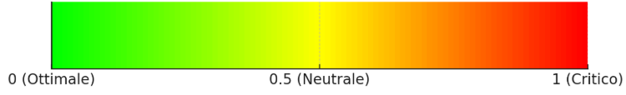
RISK ASSESSMENT RESULTS BY CATEGORY
Building Component: Facades
RISK 0,67
Damage risk for external wall systems, claddings and shading devices
The rating system also produces results at the level of the Exposed Elements within a building.
RISK 0,71
Damage risk for facade openings
RISK 0,82
Damage risk for external paints, coatings and renders
Risk Category

Slide 35
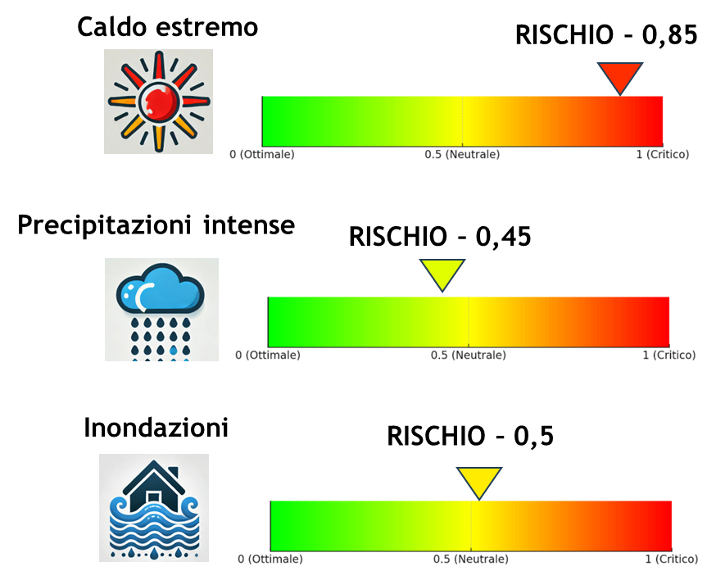
RISK ASSESSMENT RESULTS BY BUILDING COMPONENT
Hazard: Heavy precipitation
RISK 0,71
For each climate hazard, the rating system produces a score that indicates the risk level of the Building Components included in the assessment.
Facades
RISK 0,65
Roofs
Building Component

Slide 36
RISK ASSESSMENT RESULTS BY HAZARD AND OVERALL
RISK PER HAZARD
Extreme Temperatures
RISK 0,75
The application of the assessment system produces scores (0,1) that represent:
the overall risk level of the Building
the risk associated with each individual Issue
the risk by Building Component
the risk concerning specific Exposed Elements
Heavy Precipitation
RISK 0,68
OVERALL RISK – 0,72

Slide 37
RISK ASSESSMENT RESULTS
OVERALL RISK – 0,72
CCC
The application of the assessment system produces scores (0,1) that represent:
the overall risk level of the building
the risk associated with each individual hazard
the risk by Building Element
the risk concerning specific exposed elements
RISK PER HAZARD
Extreme Temperatures
RISK 0,75
Heavy Precipitation
RISK 0,68

Slide 38
Cross Scale Assessment
Macro Category | Urban Sector
Foundations | Buildings
Load Bearing Structural Frame | Buildings
Non-load Bearing Elements | Buildings
Facade | Buildings
Roof | Buildings
Fitting and Furnishings | Buildings, Water
In-built Lighting Systems | Energy, Health
Energy System | Energy, Health
Ventilation System | Energy, Health
Sanitary Systems | Energy, Health
Other Systems | Energy, Health
Utilities | Energy, Health
Landscaping | Environment and Biodiversity
Occupants | Health
Location | Buildings
Community | Civil Protection and Emergency
Urban Sectors are harmonised between RNTool and RBTool, enabling consistent data use and coordinated planning across scales. This ensures that building-level measures contribute to urban resilience goals and that neighbourhood strategies are informed by building vulnerabilities.

Slide 39

Specificity of RBTool Indicators
The Vulnerability and Hazard Criteria are similar to the ones in RNTool: guaranteeing a cross-scale assessment- that the same sector (e.g., Water, Energy, Transport) can be analysed in its entirety, from its origin in buildings up to its management at neighbourhood level.
-The exposure is assessed via single qualitative criterion:
Exposure Level: How many elements are exposed.
Normalised scale: from 0.1 being very few to 0.9 being a dominant presence.

Slide 40
Outputs and Their Use
Risk values provided at multiple levels:
-By Risk Category: Enables a detailed understanding of the specific types of climate-related risks affecting the building (e.g., flood risk, heat stress, wind damage).
-By Macro-Category (e.g., façade, roof): Facilitates targeted assessments of building components, helping to identify which structural elements are most vulnerable.
-Overall Building Risk: Aggregates all categories into a single metric, offering a comprehensive view of the building’s overall climate risk profile.
Supports decision-making for:
-Climate-resilient building renovation: Guides the design and implementation of adaptation measures to increase the building’s resilience against projected climate hazards.
-Prioritisation of interventions: Helps stakeholders allocate resources efficiently by identifying the most urgent and impactful actions.
-Integration with neighbourhood-level RNTool results: Ensures consistency between building-scale assessments and wider neighbourhood-scale resilience strategies, fostering coordinated climate adaptation planning.

