Slide 1

SuPeRBE Training Material
SuPeRBE Training Material
Macro Area of Expertise:
AD2 RBE Assessment System - RNTool - RBTool
Climate change and built environment
Area of Expertise:
AD2.3 RNTool-CE
Fundamentals of climate change
Level of competence: 1/2/3
Level of competence: 2
Activity 3.2
SuPeRBE Project (CE0200768)
Area of Expertise: AD2.3 according
to the CEN Workshop Agreement 17939

Slide 2
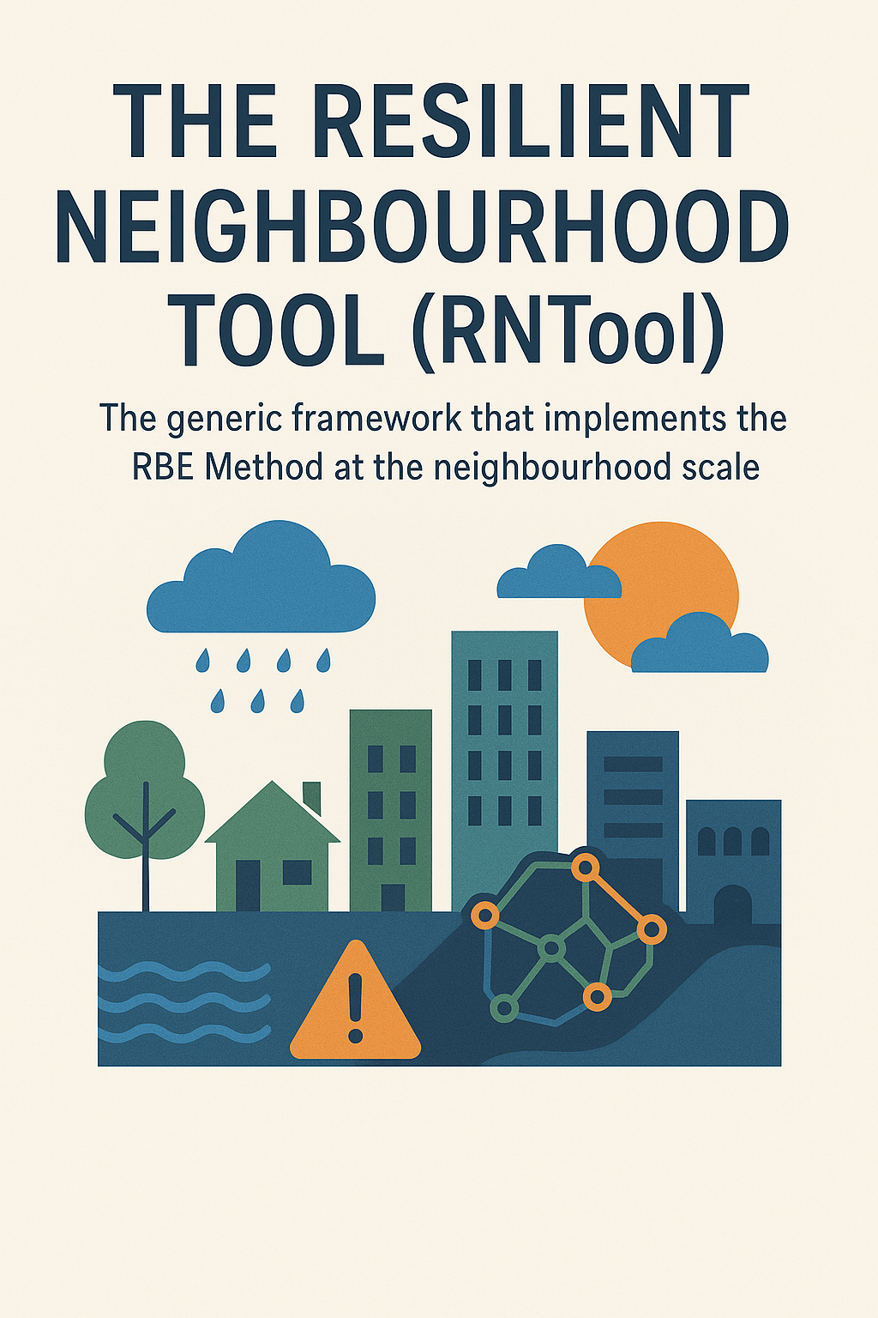
What is the RNTool?
The Resilient Neighbourhood Tool (RNTool) is the generic framework that implements the RBE Method at the neighbourhood scale. It translates the methodological structure of the RBE Method into a tool capable of assessing the overall level of climate risk across hazards, urban sectors, and exposed elements.
Key points RNTool
-Modular and adaptable structure.
-7 Hazards, 84 Risk Categories, >1000 assessment criteria.
-Goal: provide cities with a customisable and operational tool for climate adaptation.
2

Slide 3






Structure of RNTool
ISSUES
The RNTool Central European version supports climate risk assessment in relation to the following 7 Issues:
A Heavy precipitation
D Droughts
B Floods
E Storms
G Mass Movement
C Extreme heat
F Wild-fire
3

Slide 4

Structure of RNTool
Macro categories
Representing key Urban Sectors (8), addressed in RNTool for Central Europe are:
Buildings (Heavy precipitation, Floods, Extreme Heat, Storms, Mass Movement)
Water (Floods, Drought)
Emergency Services (Heavy precipitation, Floods, Extreme Heat, Drought, Storms, Wild-Fire, Mass Movement)
Energy (Heavy precipitation, Extreme Heat, Storms)
Environment and Biodiversity (Extreme Heat, Drought)
Tourism (Heavy precipitation, Extreme Heat, Mass Movement)
Transport (Heavy precipitation, Floods, Extreme Heat, Storms, Wild-fire, Mass Movement)
Health (Heavy precipitation, Floods, Extreme Heat, Drought, Storms)
4

Slide 5
Structure of RNTool
Risk categories
A Risk Category represents the specific risk arising from the interaction between a Hazard (Issue) and an Exposed Element within a particular Urban Sector (Macro Category).
Category: A4.2 Damage risk Water supply network
Hazard:
Heavy precipitation
Exposed element: Impervious Surface Coverage
Represents the interaction between
within a particular
Urban sector:
Water
84 Risk Categories have been defined in the Central European version of the RNTool. These categories cover all seven Issues (Hazards) addressed in the tool and span across the key Urban Sectors most relevant for neighbourhood-scale climate adaptation.
5

Slide 6
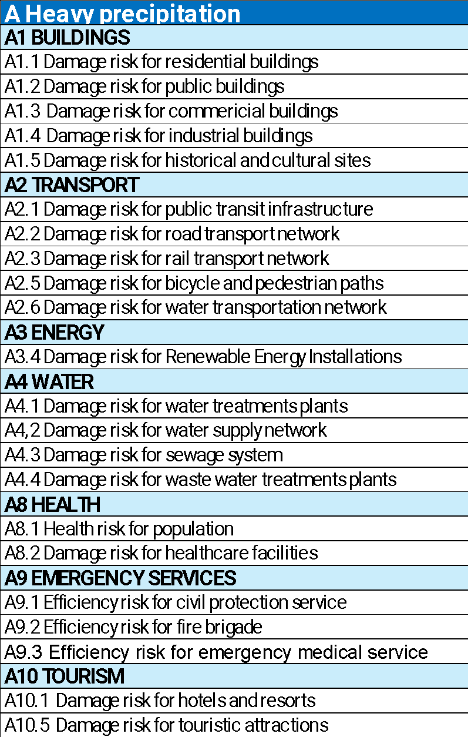
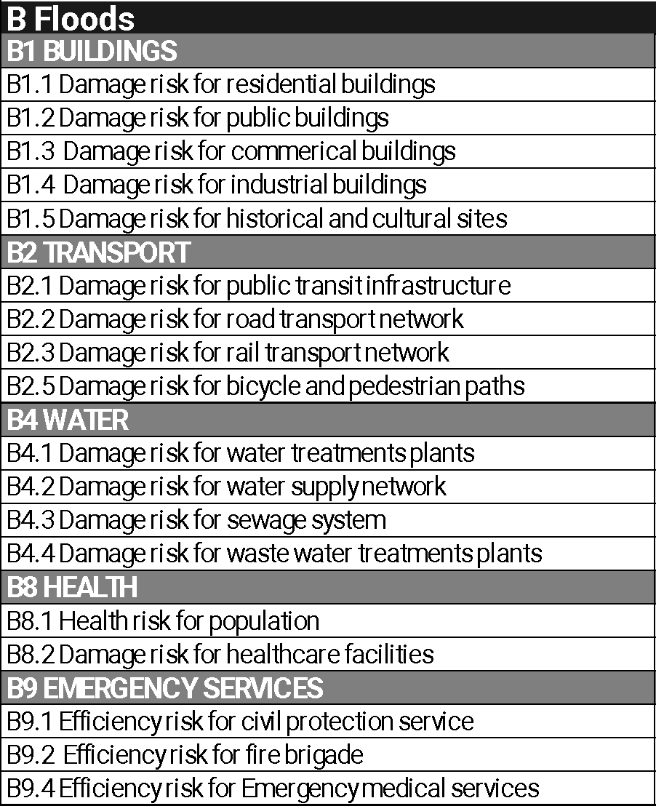
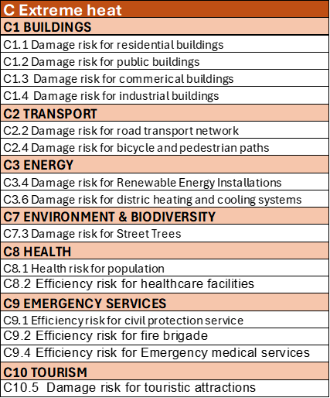
6

Slide 7
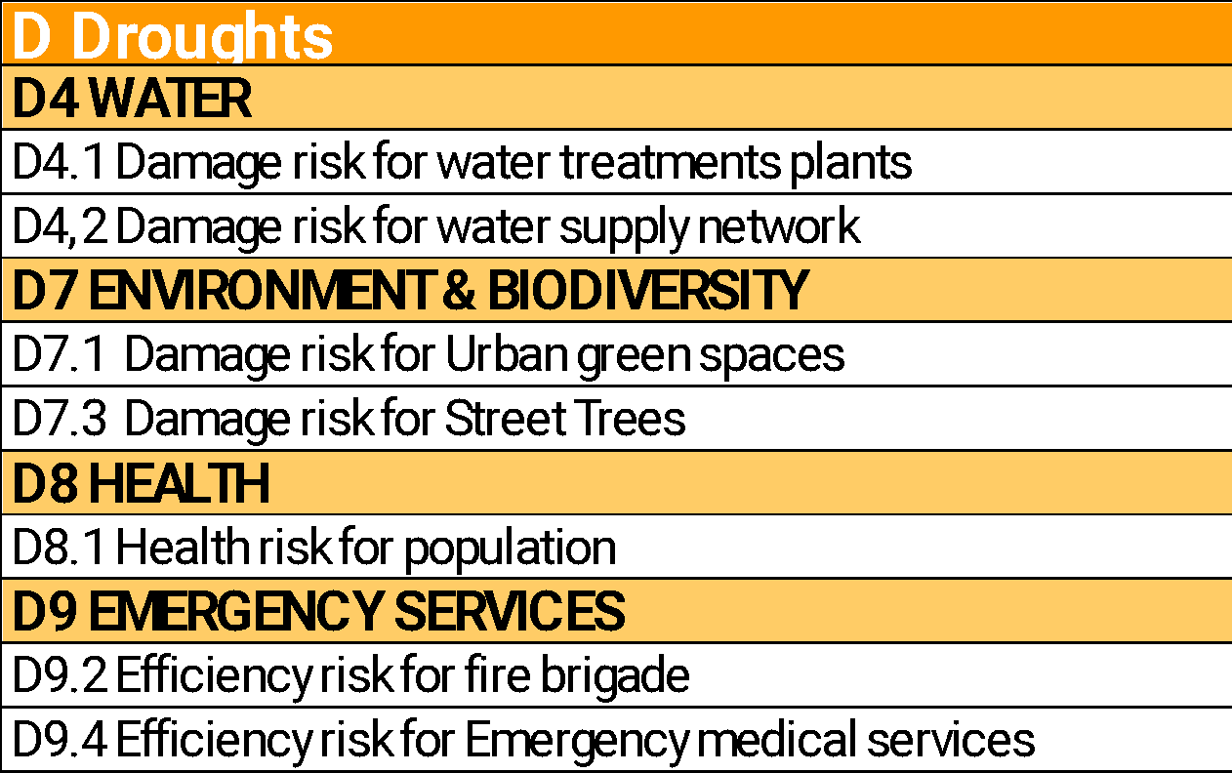
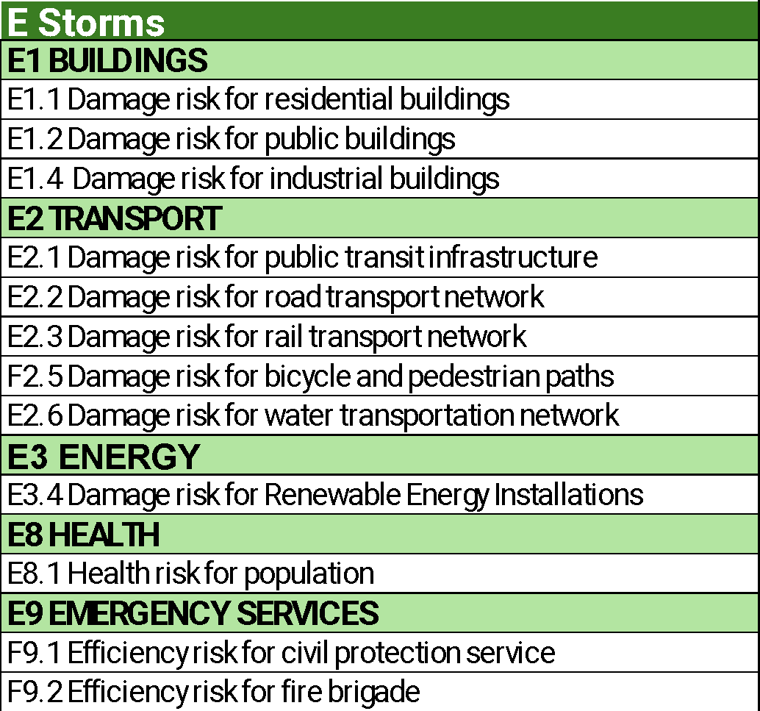
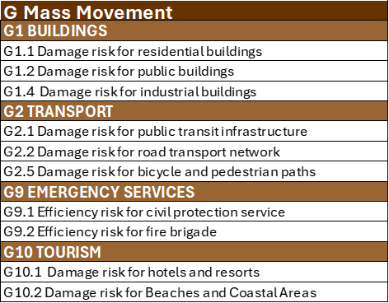
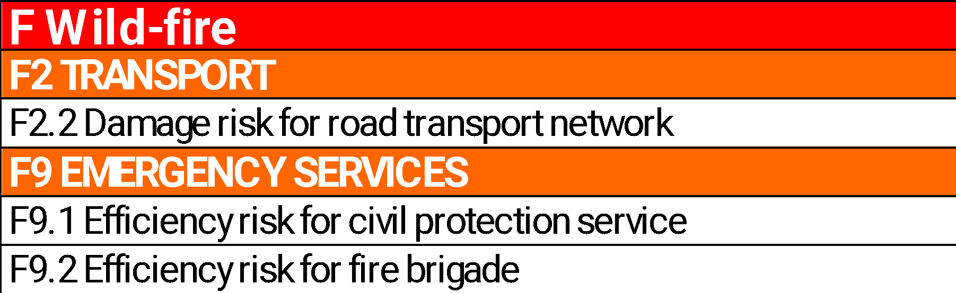
7

Slide 8
Structure of RNTool
Criteria and indicators
Each Risk Category in the RNTool is assessed through a structured set of criteria, which are operationalised via indicators. These indicators serve as the fundamental units for measuring the level of vulnerability, exposure, and hazard at the neighbourhood scale.
The RNTool Central European version includes a total of 1,022 assessment criteria, distributed as follows:
952 vulnerability and exposure criteria (directly associated with Risk Categories)
70 hazard criteria (associated with the Issues).
The number of vulnerability and exposure criteria per Hazard (Issue) is:
Heavy Precipitation: 240
Floods: 300
Extreme Heat: 157
Droughts: 36
Storms: 124
Wildfire: 15
Mass Movement: 80
8

Slide 9
Structure of RNTool
Criteria and indicators examples
G10 | TOURISM
G10.1 | Damage risk for hotels and resorts
VULNERABILITY
Code | Criterion | Indicator | Unit
G10.1.1 | Slope crest or toe | Distance from Slope Crest or Toe | Meters (m)
G10.1.2 | Drainage Systems on Site | Presence of drainage system within the area | Capacity in liters per second (L/s); Condition (Good/Fair/Poor)
G10.1.3 | Retaining Structures | Presence of Retaining Structures or Slope Stabilization Systems | (Yes/No)
EXPOSURE
G10.1-E1 | Hotels and resorts density | Total built volume of hotels and resorts divided by the extension of the urban area | m3/m2
9

Slide 10
Structure of RNTool
For each indicator, the RNTool provides:
1
Description of the indicator and its unit of measure (if applicable)
2
Direction of performance: Higher is Better (HiB), Lower is Better (LiB), or Qualitative
3
Benchmark values:
benchmark 0, optimal condition (normalized score = 0)
benchmark 1, critical condition (normalized score = 1)
4
The assessment method, a guideline on how the indicator value should be calculated or determined
5
Data sources, suggestions on where to find or how to collect the data required
6
References: scientific literature, technical standards, or institutional sources that validate the indicator.
Note: Benchmarks are defined in the RNTool but are intended to be adapted to local contexts for effective use.
10

Slide 11
Contextualisation of RNTool
The RNTool is a generic assessment framework, providing a comprehensive structure for evaluating climate risks at the neighbourhood scale.
However, to become an operational tool the RNTool must undergo a contextualisation process. This process transforms the generic framework into an operational assessment tool.
The contextualisation process includes several key steps, each of which contributes to tailoring the RNTool to the unique characteristics of the local context.
Key Steps:
Selection of Relevant Issues (Hazards)
Selection of Macro-Categories (Urban Sectors)
Selection of Risk Categories
Benchmarking of criterio
Assignment of Weights
11

Slide 12
Contextualisation of RNTool
5.2.1 Selection of Relevant Issues (Hazards)
To become an operational tool the RNTool must undergo a contextualisation process. This process transforms the generic framework into an operational assessment tool. The contextualisation process includes several key steps, each of which contributes to tailoring the RNTool to the unique characteristics of the local context.
First step:
The selection of relevant Issues (Hazards) most pertinent to the specific context of the municipality. This selection can be guided by:
Existing SECAPs (Sustainable Energy and Climate Action Plans)
Regional or national climate adaptation plans and strategies
Historical data on extreme weather events
Consultation with local experts and stakeholders.
12

Slide 13
Contextualisation of RNTool
5.2.2 Selection of Macro-Categories (Urban Sectors)
Second step:
For each selected Issue (Hazard), the next step is to identify the Urban Sectors (Macro-Categories) that are exposed and potentially affected. This selection is based on:
The presence and criticality of urban functions in the municipality (e.g., Mobility, Health, Water)
The dependency of services on exposed infrastructure. If the proper functioning of a sector (e.g., Health)
relies on infrastructure that is at risk from a certain hazard, then that infrastructure’s sector (e.g., Energy, Water, Mobility) should be included in the assessment even if it’s not the primary target of the hazard.
The institutional capacity to implement adaptation measures within each sector.
13

Slide 14
Contextualisation of RNTool
5.2.3 Selection of risk categories
Third step:
Once the relevant Urban Sectors are selected, the next step is to determine the Risk Categories representing the specific interactions between hazards and exposed elements that represent tangible and assessable climate risks. Only the most relevant and assessable Risk Categories should be retained, based on:
Availability of data
Strategic relevance for local planning
Stakeholder priorities
14

Slide 15
Contextualisation of RNTool
5.2.4 Benchmarking of criteria
Fourth step:
Each Risk Category is assessed through a set of criteria (hazard, exposure, and vulnerability), each linked to a specific indicator. The contextualisation process requires:
Assigning local benchmarks (value 0 for optimal performance and value 1 for critical performance)
Defining or adapting the assessment method for calculating the indicator value.
When localising benchmarks and methods, the following hierarchy of sources should be respected:
Authoritative guidelines (e.g., national planning documents, EU reports)
Peer-reviewed scientific literature and other technical references.
Binding regulations (e.g., building codes, laws)
Recognised technical standards (e.g., ISO, CEN, national standards)
1
2
3
4
15

Slide 16
Contextualisation of RNTool
5.2.5 Assignment of Weights
Fifth step:
Assignment of weights at multiple levels of the risk calculation process. Weights influence the relative importance of different criteria and risk components, affecting how final risk values are calculated and interpreted. To ensure transparency, consistency, and relevance, the following general principles should be followed when assigning weights in the RNTool:
Purpose driven. Weights should reflect local policy priorities, the perceived severity of impacts, and the reliability of available data.
Participatory. Weights should ideally be defined through consultation with local experts, stakeholders, and cross-sectoral teams (e.g. urban planners, emergency services, environmental agencies).
Transparent: The rationale for each weight must be documented to allow future updates or audits.
16

Slide 17
Assessment Outputs of RNTool
Applications
Risk values provided for
Categories
Adaptation plans
EU or national funding (e.g., PNRR)
Integrated urban strategies
Urban
Sectors
Hazards
Overall Risk
17

Slide 18
Practical Example of RNTool
Step 1 Assignment of Hazard Values to Issues
Option 1
1.1 The value of likelihood of Hazard is assigned (HV)
Code | Hazard | HV
A | Heavy Precipitation | 0,8
C | Extreme Temperatures | 0,9
HV value ranges from 0 to 1. HV answers the question: how severe is the hazard ?
18

Slide 19
Practical Example of RNTool
Step 1
Option 2
In alternative, climatic indicators can be used to determine HV. The following is an example for Hazard A Heavy Precipitation
Code | Hazard criteria | Hazard indicator | Unit of measure | Value
H.A1 | R20 | Number of Days with Precipitation ≥ 20 mm | number | 2
H.A2 | SDII | Simple Daily Intensity Index | mm/day | 8
H.A3 | RX1DAY | Maximum total precipitation that falls in a single day | mm | 60
19

Slide 20
Practical Example of RNTool
Step 1
Option 2
The value of climatic hazards is normalised in the interval (0-1) - Example for H.A3
Code | Hazard criteria | Hazard indicator | Unit of measure | Value
H.A3 | RX1DAY | Maximum total precipitation that falls in a single day | mm | 60
Type: Lower is better
Benchmark 1 - Critical | Xmax | 100
Benchmark 0- Optimal | Xmin | 20
Value of the indicator | Xi | 60
Normalised Value |  | 0,5
Nv = Xi - Xmin
Xmax - Xmin
20

Slide 21
Practical Example of RNTool
Step 1
Option 2
The value of climatic hazards is normalised in the interval (0-1) - Example for H.A3
Code | Hazard criteria | Hazard indicator | Normalised Value | Weight | Weighted value
H.A1 | R20 | Number of Days with Precipitation ≥ 20 mm | 0,7 | 0,33 | 0,23
H.A2 | SDII | Simple Daily Intensity Index | 0,7 | 0,33 | 0,23
H.A3 | RX1DAY | Maximum total precipitation that falls in a single day | 0,5 | 0,33 | 0,17
HV: 0,63
Note: Weighted value = normalised value * weight
21

Slide 22
Practical Example of RNTool
Step 2 Exposure Value (EV) calculation for Risk Categories
The value of the Exposure Indicators associated with Risk Categories is calculated
A | Heavy Precipitation
A2 | Transports | Exposure Criteria |  | Exposure Indicator | Unit | Value
A2.1 | Damage risk for public transit infrastructure | E.A2.1 | Public transport density | Total length of public transport routes per unit area of the urban area. | km/km² | 2
A2.3 | Damage risk for bicycle and pedestrian paths | E.A2.3 | Extention of bicycle and pedestrian paths | Meters of bicycle and pedestrian paths per inhabitant | m/inhabitant | 0,8
A2.4 | Damage risk for road network | E.A2.4 | Road density | Total road length divided by the urban area. | km/km² | 2,8
A3 | Energy | Exposure Criteria |  | Exposure Indicator | Unit | Value
A3.1 | Damage Risk for Power Lines | E.A3.1 | Exposed power lines | Share of exposed power lines | % | 90
22

Slide 23
Practical Example of RNTool
Step 2
The value of the Exposure Indicators associated with Risk Categories is calculated
C | Extreme Heat
C3 | Energy | Exposure Criteria |  | Exposure Indicator | Unit | Value
C3.1 | Damage risk for Electrical Grid Infrastructure | E.C3.1 | Grid Density | Total length of transmission and distribution lines per unit area. | km/km² | 5,2
C3.2 | Damage risk for Renewable Energy Installations (PV) | E.C3.2 | Photovoltaic power density | Photovoltaic power density per unit area | kWp/km2 | 50
C8 | Health | Exposure Criteria |  | Exposure Indicator | Unit | Value
C8.1 | Health risk for inhabitants | E.C8.1 | Population density | total number of inhabitants divided by the total area of the urban zone | n/km2 | 6590
23

Slide 24
Practical Example of RNTool
Step 2
The value of the Exposure Indicators is normalised in the interval 0-1 to calculate the Exposure Value (EV)
C8 | Health | Exposure criterion | Exposure indicator | Unit | Value
C8.1 | Health risk for inhabitants | Population density | total number of inhabitants divided by the total area of the urban zone | n/km2 | 6590
Type: Lower is better
Benchmark 1 - Critical | Xmax | 10000
Benchmark 0- Optimal | Xmin | 1000
Value of the indicator | Xi | 6590
Normalised Value |  | 0,6
Nv = Xi - Xmin
Xmax - Xmin
24

Slide 25
Practical Example of RNTool
Step 2
Table with the Exposure Values calculated for all Risk Categories
A | Heavy precipitation
A2 | Transports | EV
A2.1 | Damage risk for public transit infrastructure | 0,8
A2.3 | Damage risk for bicycle and pedestrian paths | 0,6
A2.4 | Damage risk for road network | 0,7
A3 | Energy | EV
A3.1 | Damage Risk for Power Lines | 0,8
25

Slide 26
Practical Example of RNTool
Step 2
Table with the Exposure Values calculated for all Risk Categories
C | Extreme temperatures
C3 | Energy | EV
C3.1 | Damage risk for Electrical Grid Infrastructure | 0,9
C3.2 | Damage risk for Renewable Energy Installations | 0,7
C8 | Health | EV
C8.1 | Health risk for inhabitants | 0,6
26

Slide 27
Practical Example of RNTool
Step 3/4/5 Vulnerability Values calculation for Risk Categories
The value of the Vulnerability Indicators of Risk Categories is calculated (example for the Risk Category C8.1)
C8.1 Health risk for inhabitants |  | Code | Criterion | Indicator | Unit | Value
 |  | C8.1.1 | Capacity of paved surfaces to reflect solar radiation | mean SRI | n | 16
 |  | C8.1.2 | Capacity of roofs to reflect solar radiation | mean SRI | n | 37
 |  | C8.1.3 | Urban Area Reflectivity | mean albedo | n | 0,27
 |  | C8.1.4 | Shading of paved surfaces | Share of shaded paved areas | % | 20
 |  | C8.1.5 | Visibility of the Sky | mean Sky View Factor | n | 0,74
 |  | C8.1.6 | Availability of green areas | Share of green areas of total urban zone area | % | 19
27

Slide 28
Practical Example of RNTool
Step 3/4/5 Vulnerability Values calculation for Risk Categories
The value of the Vulnerability Indicators of Risk Categories is normalised in the interval 0-1 (Example for criterion C8.1.1)
Criterion | Indicator | Unit | Value
Capacity of paved surfaces to reflect solar radiation | mean SRI | n | 16
Type: Higher is better
Benchmark 1 - Critical | Xmax | 58
Benchmark 0- Optimal | Xmin | 0
Value of the indicator | Xi | 16
Normalised Value |  | 0,7
Nv = Xi - Xmin
Xmax - Xmin
28

Slide 29
Practical Example of RNTool
Step 3/4/5 Vulnerability Values calculation for Risk Categories
To calculate the Vulnerability Value (VV) for Risk Categories a weight shall be assigned to Vulnerability Indicators (Example for Risk Category C8)
C8.1 Health risk for inhabitants |  | Code | Criterion | Normalised value
 |  | C8.1.1 | Capacity of paved surfaces to reflect solar radiation | 0,7
 |  | C8.1.2 | Capacity of roofs to reflect solar radiation | 0,36
 |  | C8.1.3 | Urban Area Reflectivity | 0,66
 |  | C8.1.4 | Shading of paved surfaces | 0,6
 |  | C8.1.5 | Visibility of the Sky | 0,26
 |  | C8.1.6 | Availability of green areas | 0,74
29

Slide 30
Practical Example of RNTool
Step 3/4/5 Vulnerability Values calculation for Risk Categories
The value of the Vulnerability Indicators of Risk Categories is calculated (example for the Risk Category C8.1)
C8.1 Health risk for inhabitants |  | Code | Criterion | Normalised value | Weight
 |  | C8.1.1 | Capacity of paved surfaces to reflect solar radiation | 0,7 | 0,25
 |  | C8.1.2 | Capacity of roofs to reflect solar radiation | 0,36 | 0,15
 |  | C8.1.3 | Urban Area Reflectivity | 0,66 | 0,2
 |  | C8.1.4 | Shading of paved surfaces | 0,6 | 0,1
 |  | C8.1.5 | Visibility of the Sky | 0,26 | 0,1
 |  | C8.1.6 | Availability of green areas | 0,74 | 0,2
30

Slide 31
Practical Example of RNTool
Step 3/4/5 Vulnerability Values calculation for Risk Categories
The value of the Vulnerability Indicators of Risk Categories is calculated (example for the Risk Category C8.1)
C8.1 Health risk for inhabitants |  | Code | Criterion | Normalised value | Weight | Weight value
 |  | C8.1.1 | Capacity of paved surfaces to reflect solar radiation | 0,7 | 0,25 | 0,2
 |  | C8.1.2 | Capacity of roofs to reflect solar radiation | 0,36 | 0,15 | 0,1
 |  | C8.1.3 | Urban Area Reflectivity | 0,66 | 0,2 | 0,1
 |  | C8.1.4 | Shading of paved surfaces | 0,6 | 0,1 | 0,1
 |  | C8.1.5 | Visibility of the Sky | 0,26 | 0,1 | 0,02
 |  | C8.1.6 | Availability of green areas | 0,74 | 0,2 | 0,1
0,6
31

Slide 32
Practical Example of RNTool
Step 6 Calculation of the Risk Value for Risk Categories
Risk Value of Risk Categories is calculated as a weighted geometrical mean of HV, EV and VV (Example for Risk Category C8)
C8 | Health | Weight
Hazard (HV) | 0,9 | 0,25
Exposure (EV) | 0,6 | 0,25
Vulnerability (VV) | 0,6 | 0,5
Category risk value |  | 0,67
Note: Weights are assigned by the user, Total value must be 1
32

Slide 33
Practical Example of RNTool
Step 7 Calculation of Risk Value for the Urban Sector (Macro-Category)
Risk Value of Macro Categories is calculated as a weighted sum of Risk Values of the Categories
A2 | Transports | Category risk level | Weight | Weighted value
A2.1 | Damage risk for public transit infrastructure | 0,67 | 0,5 | 0,3
A2.3 | Damage risk for bicycle and pedestrian paths | 0,82 | 0,25 | 0,2
A2.4 | Damage risk for road network | 0,65 | 0,25 | 0,2
Macro category risk value |  |  |  | 0,7
Note: Weights are assigned by the user, Total value must be 1
33

Slide 34
Practical Example of RNTool
Step 8 Calculation of Risk Value for a Hazard
Risk Value in relation to the Hazard calculated as a weighted sum of Risk Values of the Macro Categories (Example for Hazard A)
A | Heavy precipitation | Macro category risk level | Weight | Weighted value
A2 | Transports | 0,70 | 0,5 | 0,35
A3 | Energy | 0,82 | 0,5 | 0,41
Hazard risk value |  |  |  | 0,76
Note: Weights are assigned by the user, Total value must be 1
34

Slide 35
Practical Example of RNTool
Step 9 Calculation of overall Risk Value
Overall Risk Value calculated as a weighted sum of Risk Values of Hazards
Code | Hazard | Hazard risk value | Weight | Weighted value
A | Heavy precipitation | 0,76 | 0,4 | 0,3
C | Extreme temperatures | 0,82 | 0,6 | 0,5
Overall risk value |  |  |  | 0,8
Note: Weights are assigned by the user, Total value must be 1
35

Slide 36
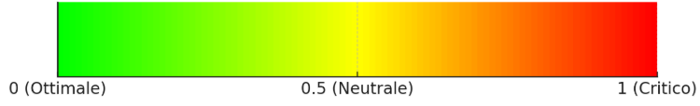
RISK ASSESSMENT RESULTS BY CATEGORY
Urban sector: Transport
RISK 0,67
Damage risk for public transit infrastructure
The rating system also produces results at the level of the Exposed Elements within an Urban Sector.
RISK 0,82
Damage risk for bicycle and pedestrian paths
RISK 0,65
Damage risk for road network
Risk Category
36

Slide 37
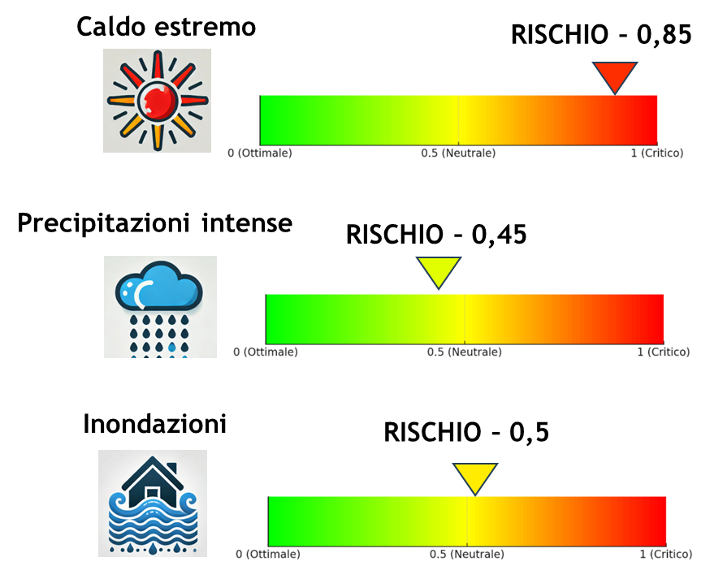
RISK ASSESSMENT RESULTS BY URBAN SECTOR
Hazard: Heavy precipitation
RISK 0,70
For each climate hazard, the rating system produces a score that indicates the risk level of the urban sectors included in the assessment.
Transports
RISK 0,82
Energy
Urban Sectors
37

Slide 38
RISK ASSESSMENT RESULTS BY HAZARD AND OVERALL
RISK PER HAZARD
Extreme Temperatures
RISK 0,76
The application of the assessment system produces scores (0,1) that represent:
the overall risk level of the urban area
the risk associated with each individual hazard
the risk by Urban Sector
the risk concerning specific exposed elements
Heavy Precipitation
RISK 0,82
OVERALL RISK – 0,80
38

