Slide 1

SuPeRBE Training Material
Macro Area of Expertise:
SuPeRBE Training Material
Risk Assessment At Small Urban Scale
Hazard: Extreme Heat (C)
Climate change and built environment
Area of Expertise:
Urban Sector: Health (C8)
Fundamentals of climate change
Risk Category: Health Risk For Population (C8.1)
Level of competence: 2
Level of competence: 3
Activity 3.2
SuPeRBE Project (CE0200768)
Area of Expertise: AD5.5 according
to the CEN Workshop Agreement 17939

Slide 2
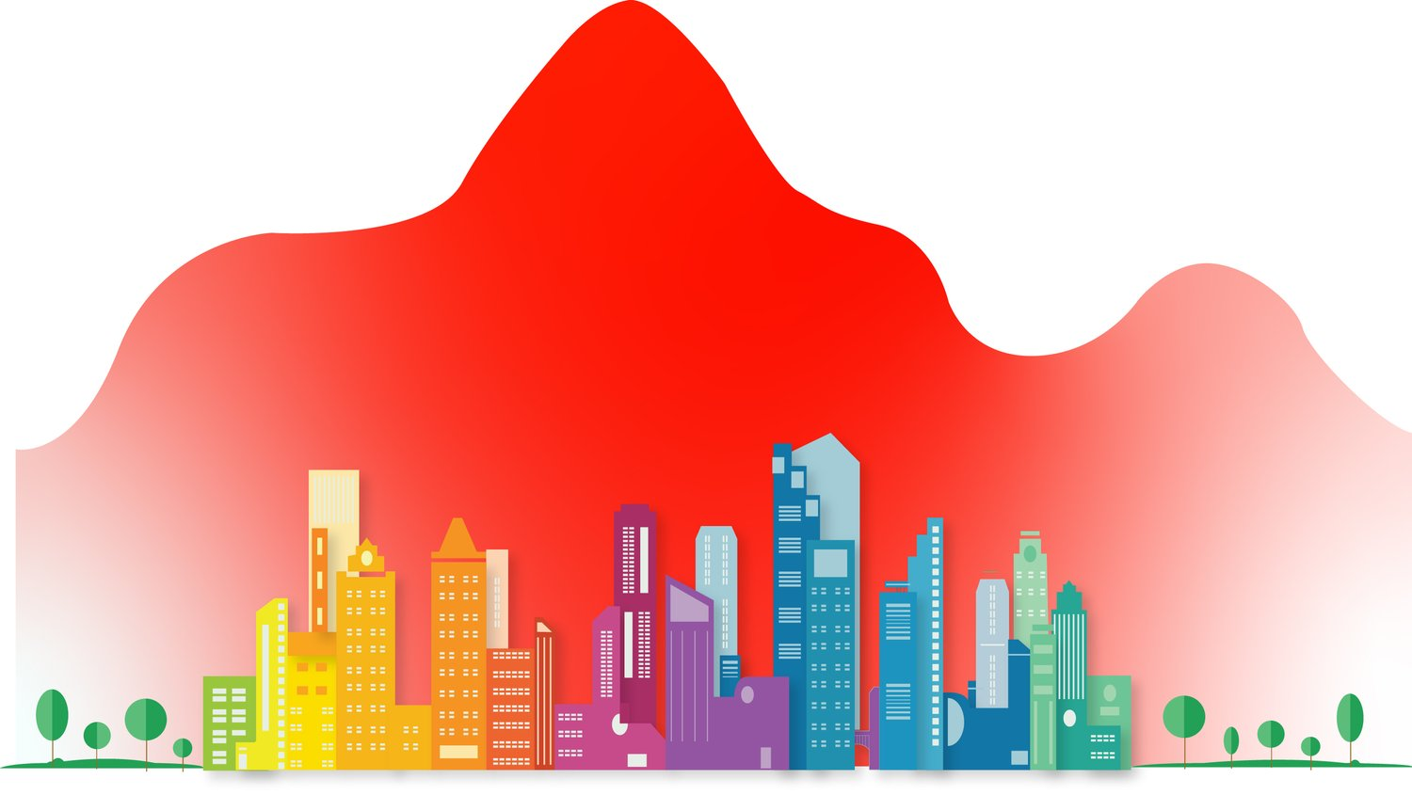
URBAN HEAT ISLANDS (UHIs)
General Information
Urban heat islands are areas within a city that become hotter than surrounding rural regions, especially during the summer and at night.
Why does it happen?
Cities have more concrete, asphalt, and buildings that absorb and hold heat.
Less greenery means less cooling from shade and evaporation.
Cars, air conditioners, and industry add even more heat.
How much hotter?
Urban areas can be 1 to 7°C warmer than their surroundings.
Real-World Impact:
More heat in cities can lead to health problems,
Higher energy use, and worse air quality.

Slide 3
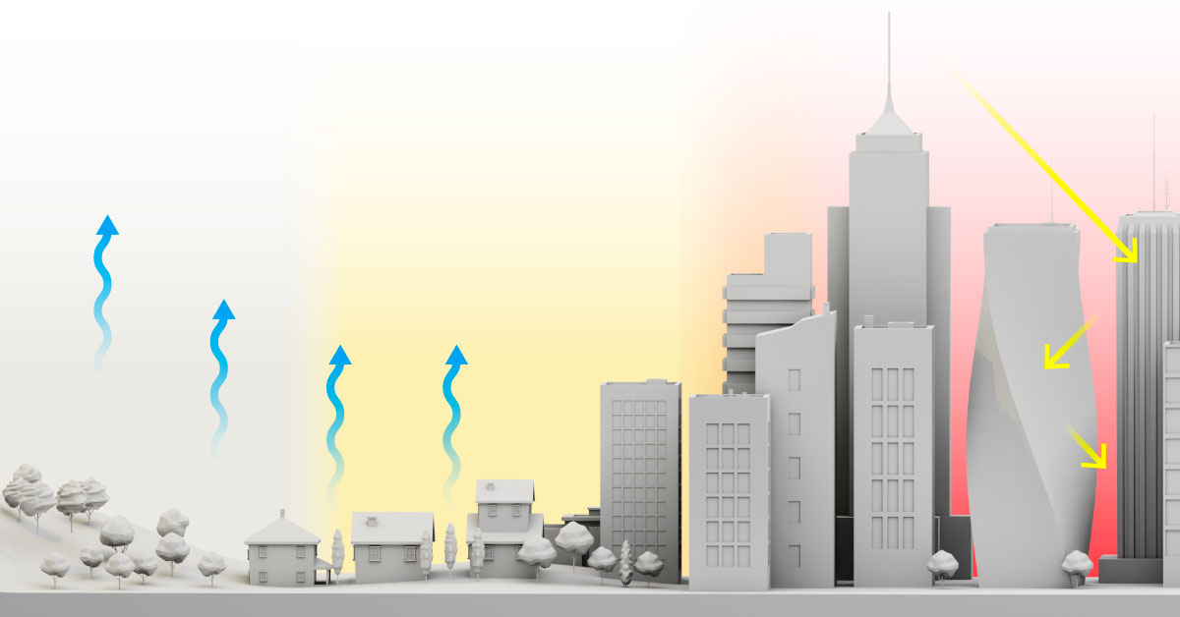
PHYSICAL DRIVERS OF UHIs
1. Urban Material Properties
Low albedo (reflectivity): Dark surfaces like asphalt absorb more solar radiation.
High heat capacity and conductivity: Materials like concrete and brick store heat during the day and release it at night.
2. Loss of Vegetation and Evapotranspiration
Reduction in vegetative cover reduces latent heat flux, which cools surfaces through moisture evaporation.
3. Urban Geometry
Tall buildings and narrow streets (urban canyons) increase longwave radiation trapping, reduce wind speed, and decrease convective cooling.
4. Anthropogenic Heat Emissions
Heat from vehicles, HVAC systems, industrial activities contributes directly to warming.
Particularly significant in high-density zones and during nighttime.
Note: The UHI effect is amplified during clear, calm nights due to reduced convective mixing.

Slide 4

UHIs AND HEALTH
Urban Heat Islands (UHIs) contribute to elevated temperatures in cities, particularly during summer and nighttime hours, increasing the risk of adverse health outcomes.
Vulnerable populations including older adults, young children, are disproportionately affected due to limited access to cooling, healthcare, and other protective resources.
Exposure to extreme urban heat can lead to:
Heat-related illnesses, such as dehydration and heat exhaustion
Exacerbation of chronic medical conditions
Higher rates of hospitalization and mortality during heat events
The Urban Heat Island effect intensifies existing health disparities and poses a growing public health challenge, especially in the context of climate change.

Slide 5
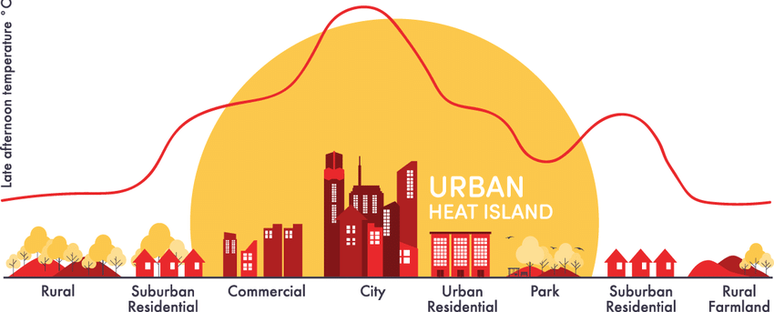
WHEN AND WHERE DO UHIs HAPPEN?
When:
Most noticeable during summer and at night
Heat builds up during the day and stays trapped in city materials overnight.
Where:
Strongest in downtown areas, dense neighborhoods, and places with few trees.
Cities in warmer climates or with little green space tend to have stronger UHIs.
Looking Ahead:
As cities grow and the climate warms, UHIs are expected to get more intense — unless cities take action to reduce them.

Slide 6
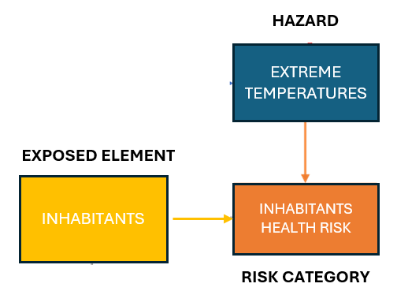
RISK ASSESSMENT FOR THE HEALTH OF INHABITANTS
Hazard: Extreme Temperatures
Exposed Element: Inhabitants

Slide 7
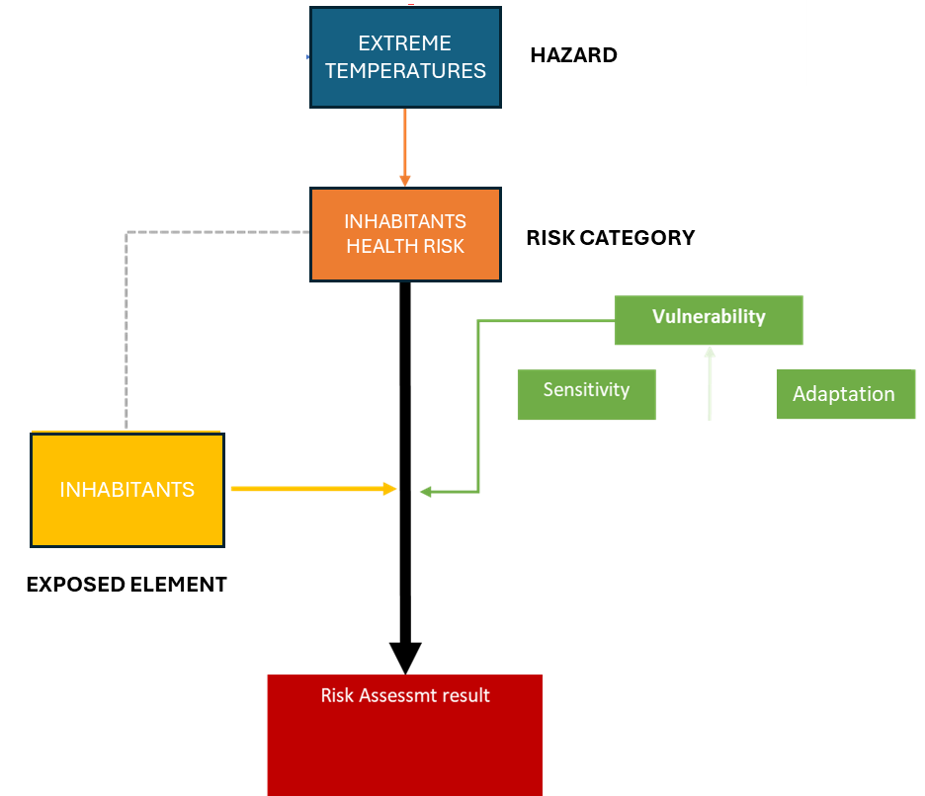
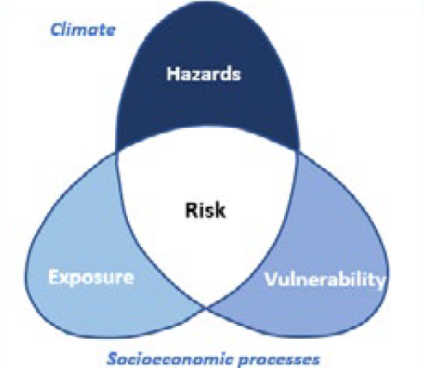
IMPACT CHAIN
Sensitivity
Capacity to adapt

Slide 8
NORMALIZATION
Normalization is a crucial step in this process, as it transforms diverse indicator values into a common scale, typically ranging from 0 to 1. This ensures that each indicator contributes proportionately and comparably to the overall resilience score, regardless of its original unit or magnitude. By applying normalization, we enable meaningful synthesis of data, facilitate benchmarking across different contexts, and support more transparent and objective decision-making in resilience evaluations.
NORMALISATION INTERVAL
Normalisation values | Description
0.9 | Optimal (No improvement necessary)
0.7 | Rather positive
0.5 | Neutral
0.3 | Rather negative
0.1 | Critical (Could lead to severe consequences)

Slide 9
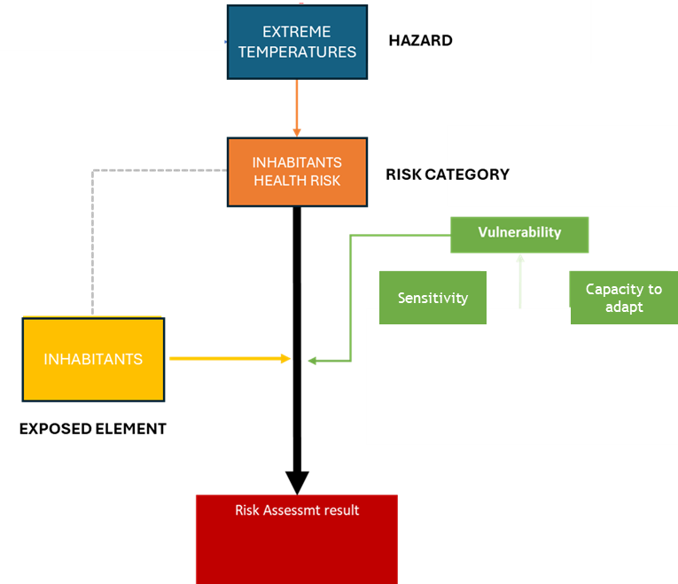
VULNERABILITY CRITERIA
Vulnerability Criteria
Capacity of paved surfaces to reflect solar radiation
Capacity of roofs to reflect solar radiation
Urban Area Reflectivity
Availability of green areas
Shading of paved surfaces
Visibility of the sky

Slide 10
VULNERABILITY ASSESSMENT
CRITERION | INDICATOR
Capacity of paved surfaces to reflect solar radiation | Solar Reflectance Index
Capacity of roofs to reflect solar radiation | Solar Reflectance Index
Urban Area Reflectivity | Average albedo in the Urban Area
Availability of green areas | % Green Areas on Urban Area Surface
Shading of paved surfaces | % Shaded Paved Areas on Urban Area Surface (June 21st – 12.00 PM)
Visibility of the sky | Mean Sky View Factor

Slide 11
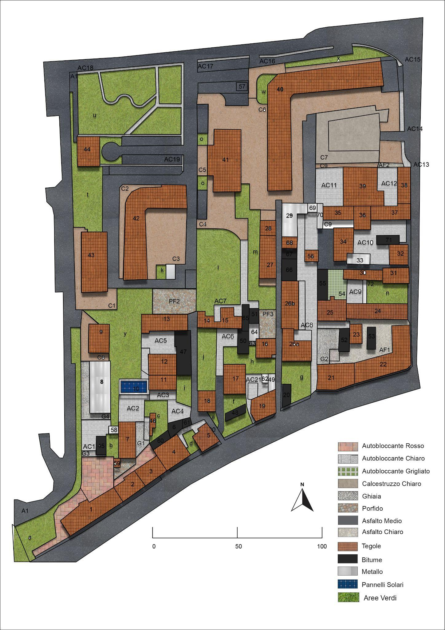
Example:
URBAN AREA AT HIGHER RISK
Chivasso, Italy

Slide 12
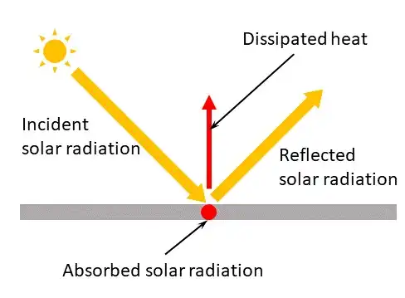
C8.1.1 CAPACITY OF PAVED SURFACES TO REFLECT SOLAR RADIATION
Description:
This criterion uses the average value of the Solar Reflectance Index (SRI) calculated for all horizontal paved surfaces in an urban area to estimate the overall effectiveness in reducing heat accumulation.
Objective:
To assess the urban area's ability to reflect solar radiation and dissipate accumulated heat, thereby mitigating the urban heat island effect. The higher the average SRI value, the more efficient the urban area will be in managing solar energy.
Relevance:
Improve the livability of urban spaces and helping to reduce the environmental impacts associated with heat accumulation at ground level.

Slide 13
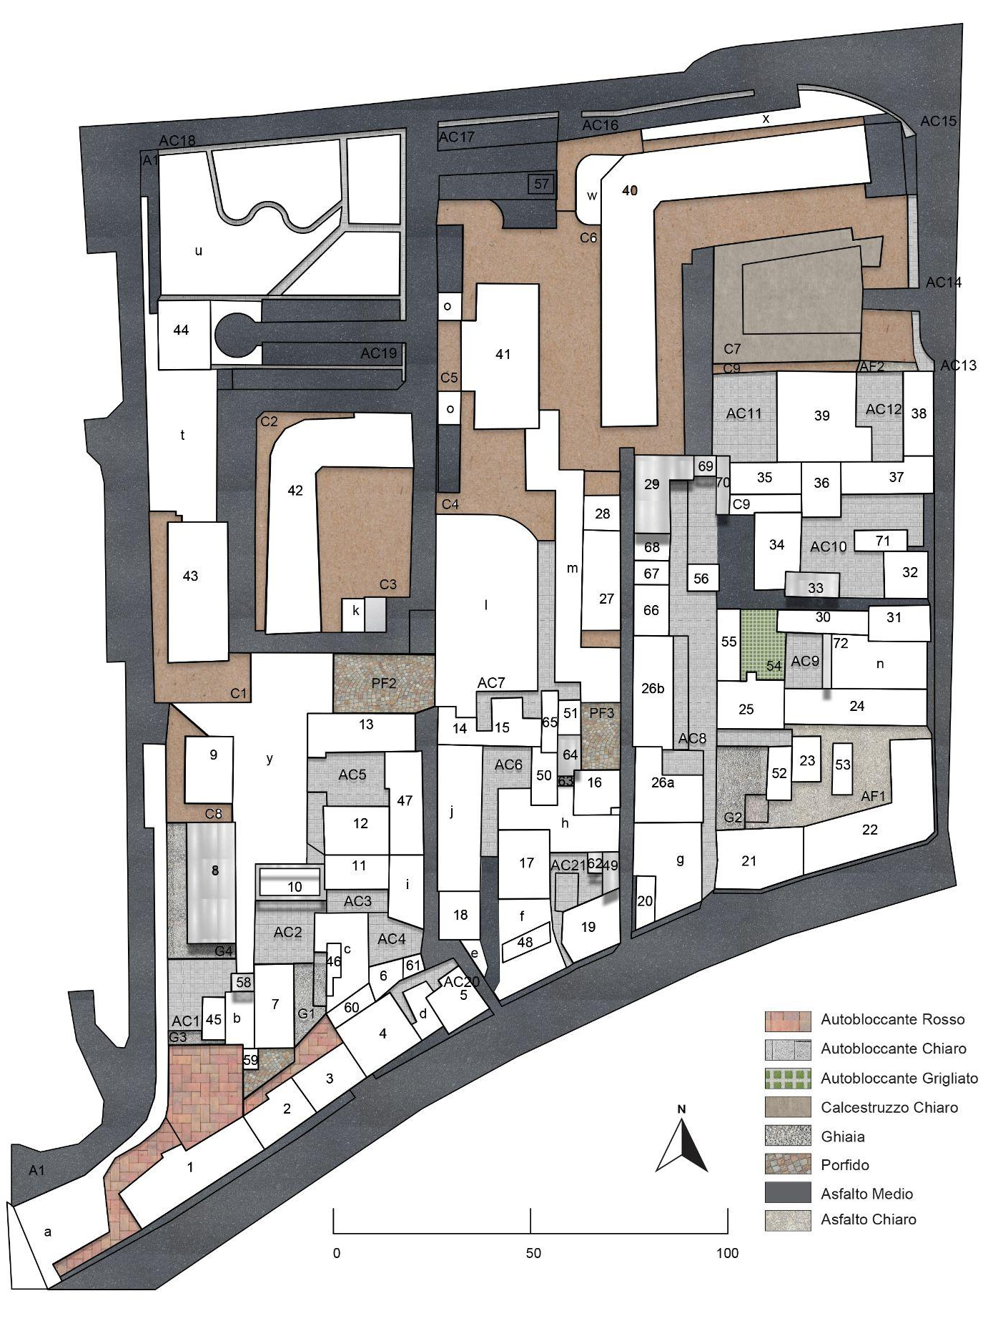
C8.1.1 CAPACITY OF PAVED SURFACES TO REFLECT SOLAR RADIATION
INDICATOR
Average Solar Reflectance Index (SRI): 16
Critical value (1) = 0
Neutral value (0,5) = 29
Optimal value (0) = 58
Normalised value: 0.72
Vulnerability Level: RATHER NEGATIVE

Slide 14
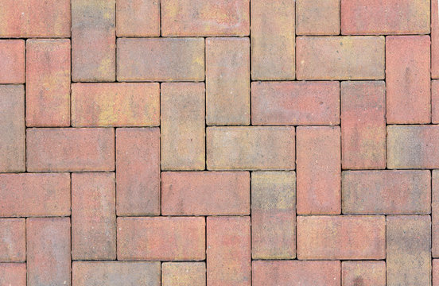
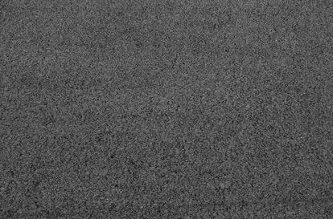
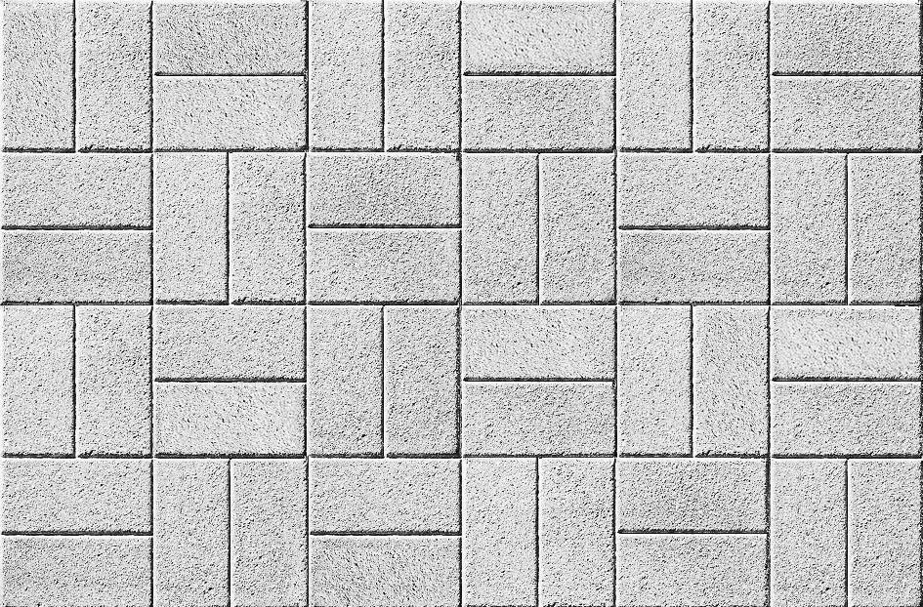

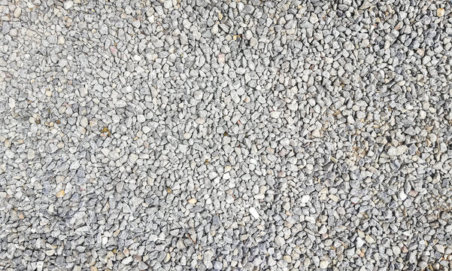
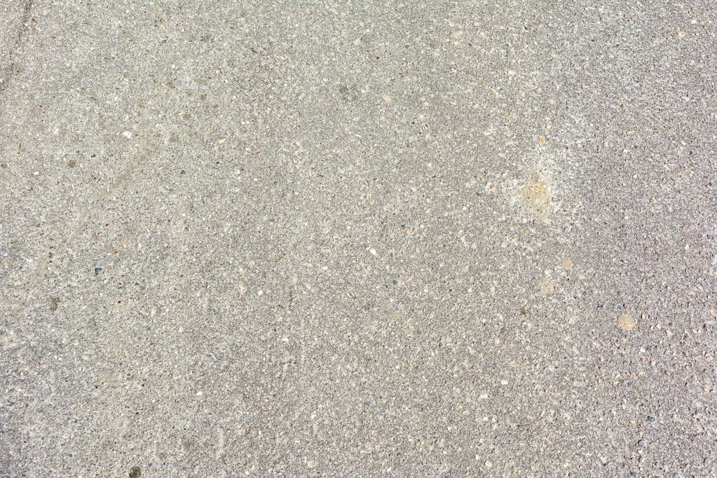
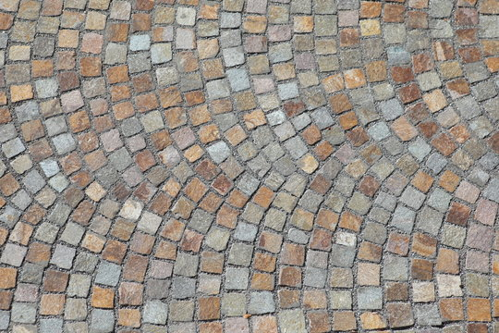
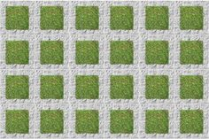
C8.1.1 CAPACITY OF PAVED SURFACES TO REFLECT SOLAR RADIATION
CALCULATION: STEP BY STEP
Step 1: Identify the types of materials of the paved surfaces (streets, sidewalks, parking lots, squares, etc.) present in the urban area.
Step 2: Denote each material type with the index 𝑖, where 𝑖 = 1,2,3…, n, and n represents the total number of identified paved material types.
Red interlocking pavers
Asphalt
1
5
Light-colored interlocking pavers
Light-colored concrete
2
6
Gravel
Light-colored asphalt
3
7
Porphyry (stone paving)
Permeable grid pavers
4
8

Slide 15
C8.1.1 CAPACITY OF PAVED SURFACES TO REFLECT SOLAR RADIATION
CALCULATION: STEP BY STEP
Step 3: For each material type 𝑖, assign a Solar Reflectance Index value (SRIᵢ)
Step 4: Calculate the total area (Aᵢ) of each material type 𝑖.
SRI: 25
SRI: 6
Area: 842
Area: 14258
SRI: 37
SRI: 21
Area: 4480
Area: 5738
SRI: 27
SRI: 27
Area: 584
Area: 621
SRI: 15
SRI: 40
Area: 639
Area: 187

Slide 16

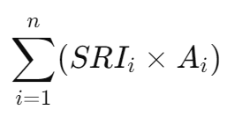
C8.1.1 CAPACITY OF PAVED SURFACES TO REFLECT SOLAR RADIATION
CALCULATION: STEP BY STEP
Step 5: Calculate the weighted value for each material type by multiplying the SRI value by the corresponding area:
Step 6: Sum the weighted values of all material types
SRIp,1: 21.050
SRIp,5: 85.548
21.050
165.760
15.768
9.585
85.548
120.498
16.767
7.480
=442.456
SRIp,6: 120.498
SRIp,2: 165.760
SRIp,3: 15.768
SRIp,7: 16.767
SRIp,4: 9.585
SRIp,8: 7.480

Slide 17
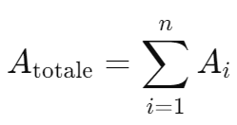
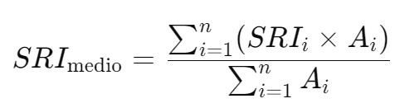
C8.1.1 CAPACITY OF PAVED SURFACES TO REFLECT SOLAR RADIATION
CALCULATION: STEP BY STEP
Step 7: Calculate the total surface area of all material types.
Step 8: Calculate the average SRI value.
842
4480
584
639
14258
5738
621
187
=27.348
442.456
SRI medio =
27.348
SRI medio = 16,17

Slide 18
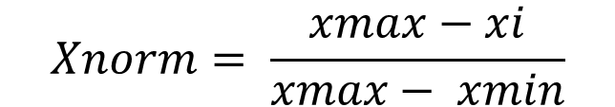
C8.1.1 CAPACITY OF PAVED SURFACES TO REFLECT SOLAR RADIATION
CALCULATION: STEP BY STEP
Step 9: Normalize the result:
The value is normalised applying the following formula:
Normalisation values | Description
0.1 | Optimal (No improvement necessary)
0.3 | Rather positive
0.5 | Neutral
0.7 | Rather negative
0.9 | Critical (Could lead to severe consequences)
where:
Xi: value of the indicator
X_{min} = optimal indicator’s value (corresponding to score 1)
X_{max} = critical indicator’s value (corresponding to score 0)

Slide 19



C8.1.1 CAPACITY OF PAVED SURFACES TO REFLECT SOLAR RADIATION
CALCULATION: STEP BY STEP
Step 7: Normalize the result:
For the “higher is better” indicators (higher the numerical value of the indicator, the higher the performance level.), the value is normalised applying the following formula:
Normalisation values | Description
0.1 | Optimal (No improvement necessary)
0.3 | Rather positive
0.5 | Neutral
0.7 | Rather negative
0.9 | Critical (Could lead to severe consequences)
Rather Negative

Slide 20
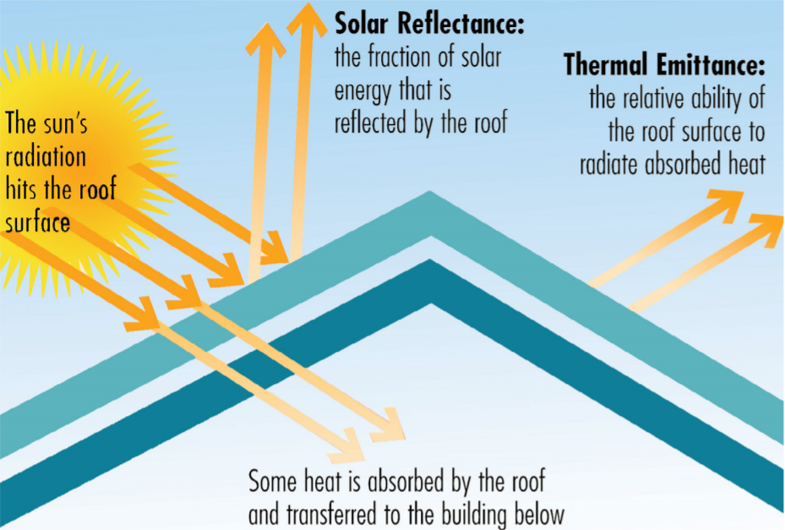
C8.1.2 CAPACITY OF ROOFS TO REFLECT SOLAR RADIATION
Description:
This criterion uses the average value of the Solar Reflectance Index (SRI) calculated for all the roofs in an urban area to estimate the overall effectiveness in reducing heat accumulation.
Objective:
To assess the urban area's ability to reflect solar radiation and dissipate accumulated heat, thereby mitigating the urban heat island effect. The higher the average SRI value, the more efficient the urban area will be in managing solar energy.
Relevance:
Improve the livability of urban spaces and helping to reduce the environmental impacts associated with heat accumulation in roofs.

Slide 21
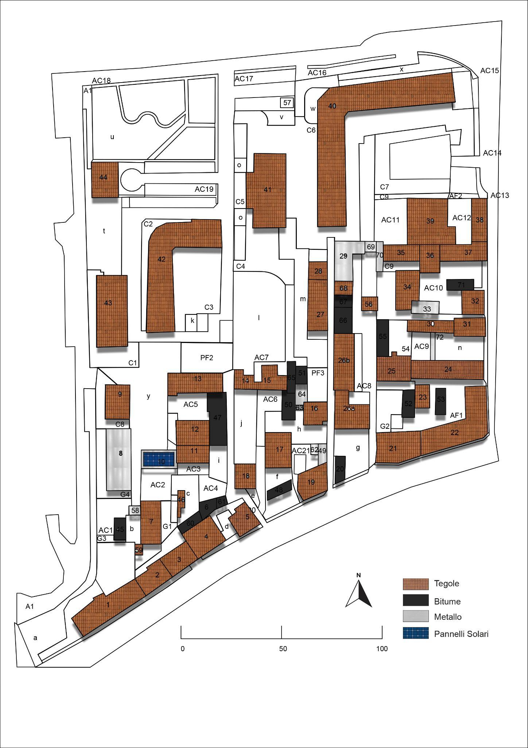
C8.1.2 CAPACITY OF ROOFS TO REFLECT SOLAR RADIATION
FLAT ROOFS
(Slope equal to or less than 15°)
Indicator
Average Solar Reflectance Index: 1
Normalized Value: 1
Vulnerability Level: CRITICAL
SLOPED ROOFS
(Slope greater than 15°)
Indicator
Average Solar Reflectance Index: 37
Normalized Value: 0.36
Vulnerability Level: RATHER POSITIVE

Slide 22
C8.1.2 CAPACITY OF ROOFS TO REFLECT SOLAR RADIATION
CALCULATION: STEP BY STEP
Step 1: Calculate the total surface area of existing roofs, categorized by roofing material and by roof type (flat or pitched).
Step 2: Multiply each area by the material’s SRI coefficient (Surface Radiance Index). And finally, average the values to obtain the mean SRI value of the area.
Roof pitch | Material | Surface (m2) | SRI | Average SRI
Greater than 15° | Red tiles | 11676,5 | 36 | 37
 | Metal | 944,5 | 56
 | Solar panerls | 203 | 10
Lower or equal to 15° | Bitumen | 1305 | 1 | 1

Slide 23
C8.1.2 CAPACITY OF ROOFS TO REFLECT SOLAR RADIATION
CALCULATION: STEP BY STEP
Step 3: Normalize the result:
The value is normalised applying the following formula:
Normalisation values | Description
0.1 | Optimal (No improvement necessary)
0.3 | Rather positive
0.5 | Neutral
0.7 | Rather negative
0.9 | Critical (Could lead to severe consequences)
where:
Xi: value of the indicator
X_{min} = optimal indicator’s value (corresponding to score 1)
X_{max} = critical indicator’s value (corresponding to score 0)

Slide 24







C8.1.2 CAPACITY OF ROOFS TO REFLECT SOLAR RADIATION
CALCULATION: STEP BY STEP
Step 3: Normalize the result:
For the “higher is better” indicators (higher the numerical value of the indicator, the higher the performance level.), the value is normalised applying the following formula:
FLAT ROOFS:
INCLINED ROOFS:
CRITICAL
RATHER POSITIVE

Slide 25
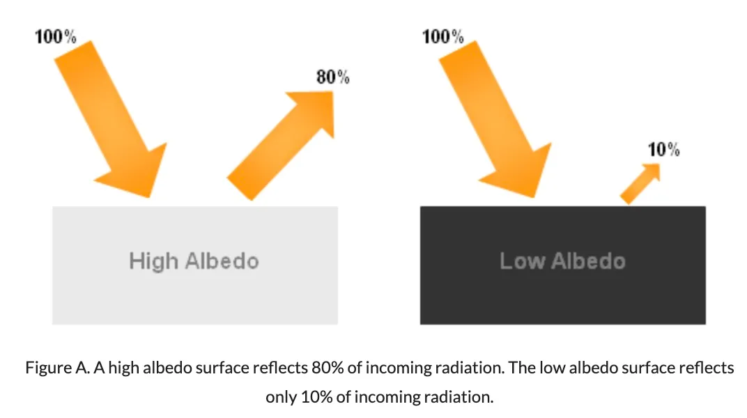
C8.1.3 URBAN AREA REFLECTIVITY: ALBEDO
Description:
The reflectivity of the urban area is measured through albedo. Albedo refers to the fraction of sunlight that is diffusely reflected by a surface and is defined as the ratio between the radiosity and the irradiance received by a surface. Therefore, when considering the differences between various materials, it can be observed that the more reflective a surface is, the higher its albedo value.
Objective:
To maximize the reflection of solar radiation in order to prevent the formation of urban heat islands between buildings.
Relevance:
it’s a practical tool for shaping healthier, more energy-efficient, and climate-resilient cities.

Slide 26
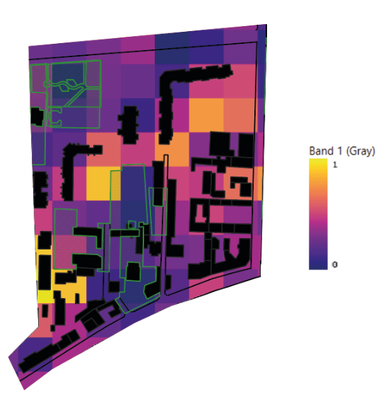
C8.1.3 URBAN AREA REFLECTIVITY: ALBEDO
INDICATOR
Average albedo of the urban area: 0.27
Critical value (1) = 0.1
Optimal value (0) = 0.6
Normalised value: 0.66
Vulnerability Level: RATHER NEGATIVE

Slide 27
C8.1.3 URBAN AREA REFLECTIVITY: ALBEDO
CALCULATION: STEP BY STEP
In QGIS, you can calculate the albedo of a surface based on satellite data by using the reflectance values of different bands in a multispectral image. Albedo is typically calculated as the fraction of solar energy reflected by a surface to the total incoming solar energy. Data can be obtained for free from Landsat 8 satellite. the elaboration in QGIS is:
Step 1: Load Data into QGIS
Unzip your Landsat 8 folder.
Load bands 2, 4, 5, 6, and 7 into QGIS:
  Band 2 (Blue)
  Band 4 (Red)
  Band 5 (Near-Infrared)
  Band 6 (Shortwave Infrared 1)
  Band 7 (Shortwave Infrared 2)
Step 2: Get Metadata Values
Open the MTL.txt metadata file included with the Landsat 8 data.
Extract the following values:
  REFLECTANCE_MULT_BAND_x and REFLECTANCE_ADD_BAND_x for each band
  SUN_ELEVATION
Example:
REFLECTANCE_MULT_BAND_2 = 2.0000E-05
REFLECTANCE_ADD_BAND_2 = -0.100000
SUN_ELEVATION = 45.123456

Slide 28
C8.1.3 URBAN AREA REFLECTIVITY: ALBEDO
CALCULATION: STEP BY STEP
Step 3: Convert Radiance to Reflectance
In the QGIS Raster Calculator, use the following formula for each band:
((M * "BandX@1") + A) / cos(radians(90 - SUN_ELEVATION))
Example for Band 2:
((2.0000e-05 * "LC08_B2@1") - 0.1) / cos(radians(90 - 45.123456))
Repeat for Bands 4, 5, 6, and 7, and name the outputs as:
Refl_B2
Refl_B4
Refl_B5
Refl_B6
Refl_B7
Step 4: Calculate Albedo
Use the following broadband albedo formula (Liang, 2001):
Albedo = 0.356 * Refl_B2 + 0.130 * Refl_B4 + 0.373 * Refl_B5 +
0.085 * Refl_B6 + 0.072 * Refl_B7 - 0.0018
In QGIS Raster Calculator:
0.356 * "Refl_B2@1" + 0.130 * "Refl_B4@1" + 0.373 * "Refl_B5@1" +
0.085 * "Refl_B6@1" + 0.072 * "Refl_B7@1" - 0.0018
Save the output as your final albedo layer.

Slide 29
C8.1.3 URBAN AREA REFLECTIVITY: ALBEDO
CALCULATION: STEP BY STEP
Step 5: Normalize the result:
The value is normalised applying the following formula:
Normalisation values | Description
0.1 | Optimal (No improvement necessary)
0.3 | Rather positive
0.5 | Neutral
0.7 | Rather negative
0.9 | Critical (Could lead to severe consequences)
where:
Xi: value of the indicator
X_{min} = optimal indicator’s value (corresponding to score 1)
X_{max} = critical indicator’s value (corresponding to score 0)

Slide 30




C8.1.3 URBAN AREA REFLECTIVITY: ALBEDO
CALCULATION: STEP BY STEP
Step 5: Normalize the result:
For the “Higher is better” indicators (higher the numerical value of the indicator, the higher the performance level.), the value is normalised applying the following formula:
Normalisation values | Description
0.1 | Optimal (No improvement necessary)
0.3 | Rather positive
0.5 | Neutral
0.7 | Rather negative
0.9 | Critical (Could lead to severe consequences)
Rather Negative

Slide 31
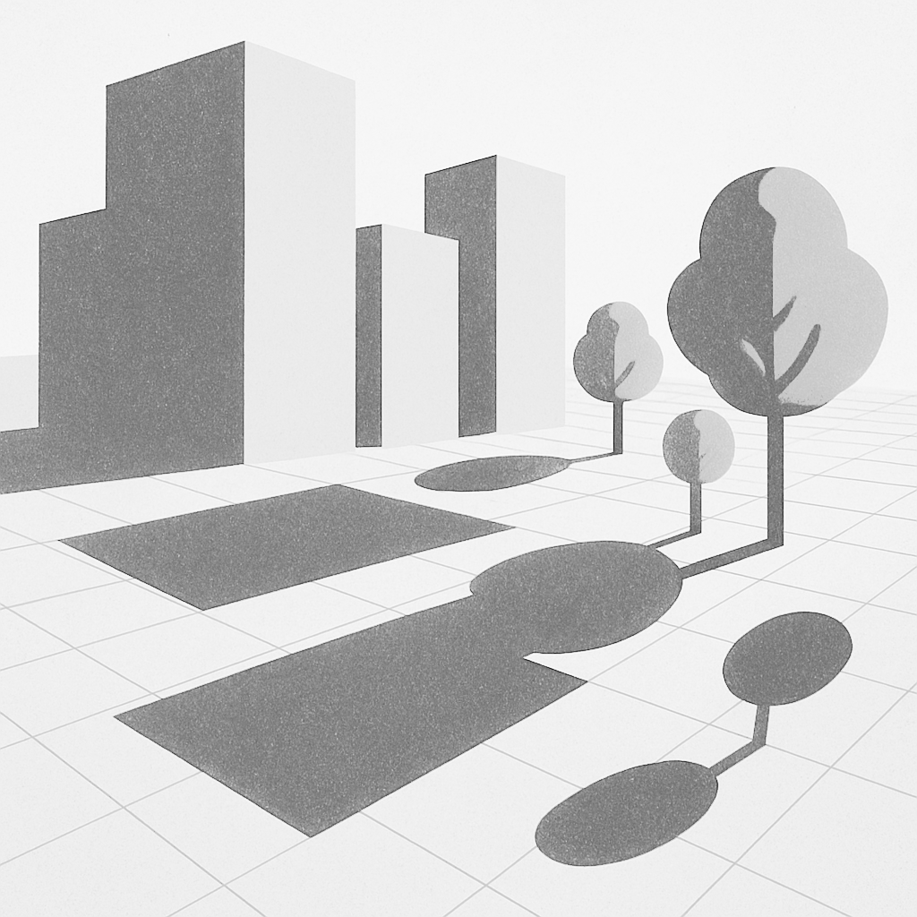
C8.1.4 SHADING OF PAVED SURFACES
Description:
This criterion evaluates the amount of urban surface covered by shade at a specific time, namely at 12:00 p.m. on June 21 (the summer solstice).
Objective:
Allow for the assessment of urban planning effectiveness in generating natural or artificial shade and reducing excessive surface heating.
Relevance:
This data becomes useful for guiding policies and interventions, such as increasing green areas, planting trees in strategic locations, or creating shading structures at critical points.

Slide 32
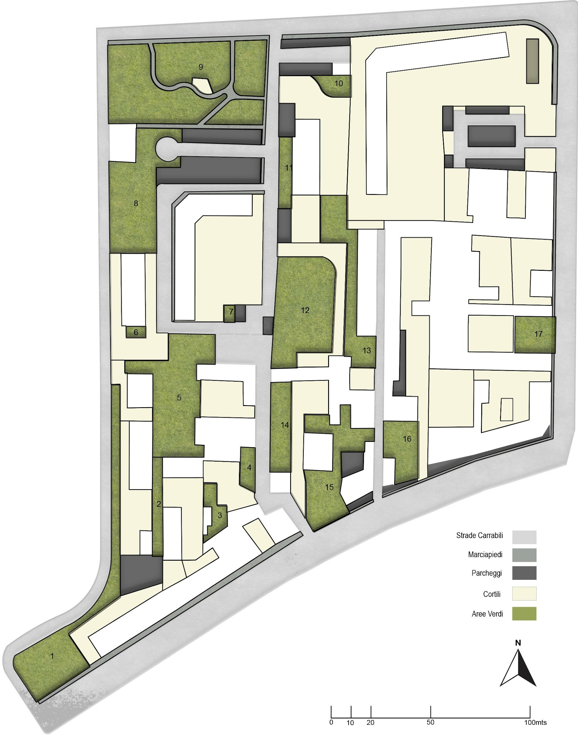
C8.1.4 SHADING OF PAVED SURFACES
INDICATOR
% Shaded Paved Areas on Urban Area Surface (June 21st – 12.00 PM) : 18 %
Critical value (1) – 0%
Optimal value (0) – 100%
Normalised value: 0,82
Vulnerability Level: CRITICAL

Slide 33
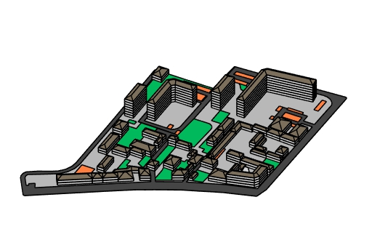
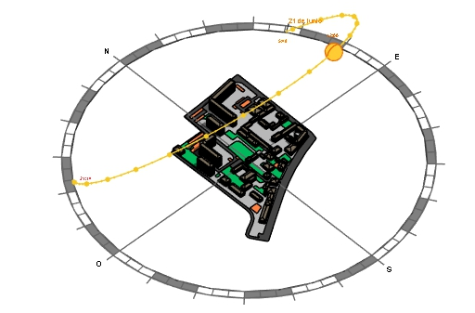
C8.1.4 SHADING OF PAVED SURFACES
CALCULATION: STEP BY STEP
Step 2: Simulate the shade present in the context in a certain moment of the day during summer time, we recommend an hour frame with the highest solar incidence.
Step 1: Use any tool that let you model the urban area in 3D and simulate the sun behaviour in relation with the context.

Slide 34
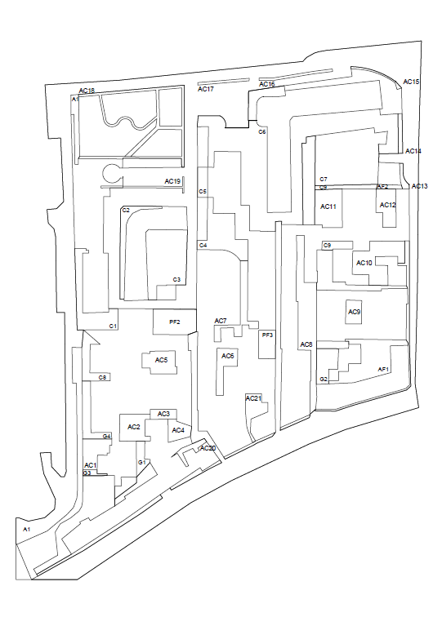
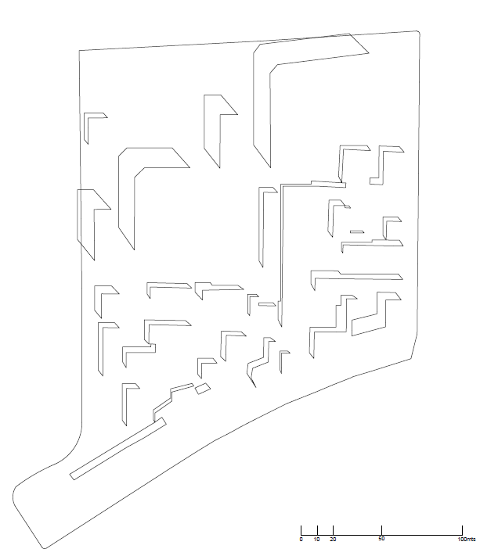
C8.1.4 SHADING OF PAVED SURFACES
CALCULATION: STEP BY STEP
Step 3: Calculate the total paved area of the urban area.
Step 4: Calculate the total extent of shaded paved area.
Area: 27.348 m2
Area: 5.374 m2

Slide 35
C8.1.4 SHADING OF PAVED SURFACES
CALCULATION: STEP BY STEP
Step 5: Calculate the value of the indicator by applying the formula:
Total surface of shaded paved areas
* 100
Total surface of urban area

Slide 36
C8.1.4 SHADING OF PAVED SURFACES
CALCULATION: STEP BY STEP
Step 6: Normalize the result:
The value is normalised applying the following formula:
Normalisation values | Description
0.1 | Optimal (No improvement necessary)
0.3 | Rather positive
0.5 | Neutral
0.7 | Rather negative
0.9 | Critical (Could lead to severe consequences)
where:
Xi: value of the indicator
X_{min} = optimal indicator’s value (corresponding to score 1)
X_{max} = critical indicator’s value (corresponding to score 0)

Slide 37



C8.1.4 SHADING OF PAVED SURFACES
CALCULATION: STEP BY STEP
Step 6 : Normalize the result:
For the “Higher is better” indicators (higher the numerical value of the indicator, the higher the performance level.), the value is normalised applying the following formula:
Normalisation values | Description
0.1 | Optimal (No improvement necessary)
0.3 | Rather positive
0.5 | Neutral
0.7 | Rather negative
0.9 | Critical (Could lead to severe consequences)
Rather Negative

Slide 38
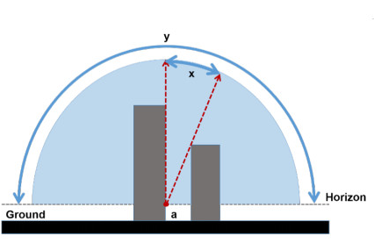
C8.1.5 VISIBILITY OF THE SKY (Sky View Factor)
Description:
The Sky View Factor, or simply abbreviated as SVF, measures the portion of the sky visible from a specific point, influencing temperature conditions and radiation levels in urban spaces.
Objective:
To maximize the dispersion of heat accumulated by paved surfaces during the day through nighttime radiative cooling.
Relevance:
The SVF is essential for describing urban climatology at scales smaller than about 100 meters; this proxy for net radiation depends on the height of obstacles in its surroundings.

Slide 39
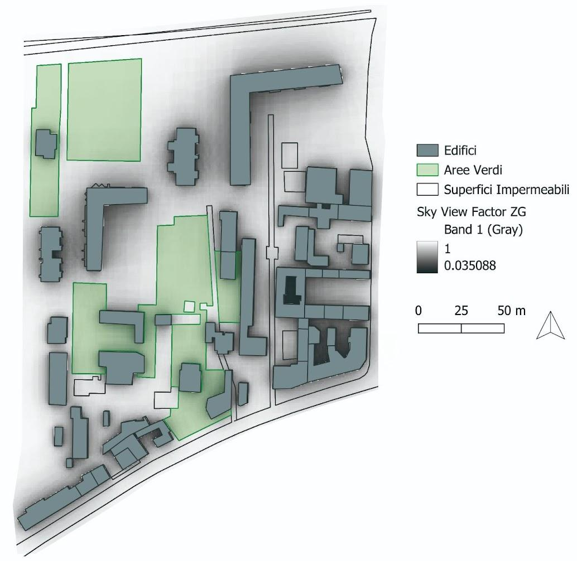
C8.1.5 VISIBILITY OF THE SKY (Sky View Factor)
INDICATOR
Mean Sky View Factor: 0.74
Critical value (1) = 0
Optimal value (0) = 1
Normalised value: 0,26
Vulnerability Level: RATHER POSITIVE

Slide 40
C8.1.5 VISIBILITY OF THE SKY (Sky View Factor)
CALCULATION: STEP BY STEP
SVF is a key metric in urban and environmental studies that helps measure the visible sky from a point, impacting temperature and radiation levels in urban spaces. Calculating the Sky View Factor (SVF) in QGIS requires the use of the UMEP (Urban Multi-scale Environmental Predictor) plugin.
Step 1: Set Up QGIS Environment
Install the UMEP plugin: In QGIS, go to Plugins > Manage and Install Plugins, search for "UMEP," and install it.
Load a Digital Surface Model (DSM) or Digital Elevation Model (DEM) that represents surface heights of buildings, vegetation, and terrain.
Set the project’s coordinate reference system (CRS) to match the area of study, as the CRS affects measurement accuracy.
Step 2: Open the Sky View Factor Tool
In the main QGIS toolbar, navigate to UMEP > Pre-Processor > Sky View Factor (SVF) Calculator.

Slide 41
C8.1.5 VISIBILITY OF THE SKY (Sky View Factor)
CALCULATION: STEP BY STEP
Step 3: Configure the SVF Parameters
The SVF Calculator will prompt you to configure several parameters:
Raster DSM: Select the DSM or DEM raster layer that represents the surface elevations.
Resolution (meters): Set the spatial resolution of the output in meters. Ideally, this should match or be close to the resolution of your DSM/DEM.
Height of Viewpoint: Define the height of the observation point above ground level (e.g., 1.5 meters for pedestrian-level analysis).
Maximum Search Distance: Specify the maximum distance in meters to consider for visibility calculations. Higher distances increase processing time.
Azimuth and Zenith Divisions: These control the precision of SVF calculations:
  Azimuth divisions: Typically, values range from 16 to 32 (higher values increase precision).
  Zenith divisions: Usually set between 8 and 16.
Output directory: Specify where to save the SVF results.

Slide 42
C8.1.5 VISIBILITY OF THE SKY (Sky View Factor)
CALCULATION: STEP BY STEP
Step 5: Run the SVF Calculation
Click Run to begin the calculation. The time required will depend on the extent and resolution of the DSM, as well as the chosen azimuth and zenith divisions.Upon completion, UMEP saves the SVF output in the specified directory and adds it to your QGIS project as a raster layer.
Step 6 Visualize and Interpret the Results
The SVF layer displays values from 0 to 1:
  0 indicates a fully obstructed sky view.
  1 means the sky is completely visible.
Adjust the color symbology to better visualize variations in SVF across your study area. This can help identify areas with significant urban shading or open spaces.

Slide 43
C8.1.5 VISIBILITY OF THE SKY (Sky View Factor)
CALCULATION: STEP BY STEP
Step 7: Normalize the result:
The value is normalised applying the following formula:
Normalisation values | Description
0.1 | Optimal (No improvement necessary)
0.3 | Rather positive
0.5 | Neutral
0.7 | Rather negative
0.9 | Critical (Could lead to severe consequences)
where:
Xi: value of the indicator
X_{min} = optimal indicator’s value (corresponding to score 1)
X_{max} = critical indicator’s value (corresponding to score 0)

Slide 44



C8.1.5 VISIBILITY OF THE SKY (Sky View Factor)
CALCULATION: STEP BY STEP
Step 7: Normalize the result:
For the “higher is better” indicators (higher the numerical value of the indicator, the higher the performance level.), the value is normalised applying the following formula:
Normalisation values | Description
0.1 | Optimal (No improvement necessary)
0.3 | Rather positive
0.5 | Neutral
0.7 | Rather negative
0.9 | Critical (Could lead to severe consequences)
Optimal

Slide 45

C8.1.6 AVAILABILITY OF GREEN AREAS
Description:
The criterion assesses the ability of an urban area to mitigate the heat island effect through the presence and distribution of green areas
Objective:
Increase the percentage of green spaces relative to the total urban surface. Green areas include parks, public gardens, urban forests, green roofs, and other vegetated surfaces.
Relevance:
This indicator is crucial for promoting natural cooling and improving the urban microclimate, reducing local temperatures and enhancing thermal comfort.

Slide 46
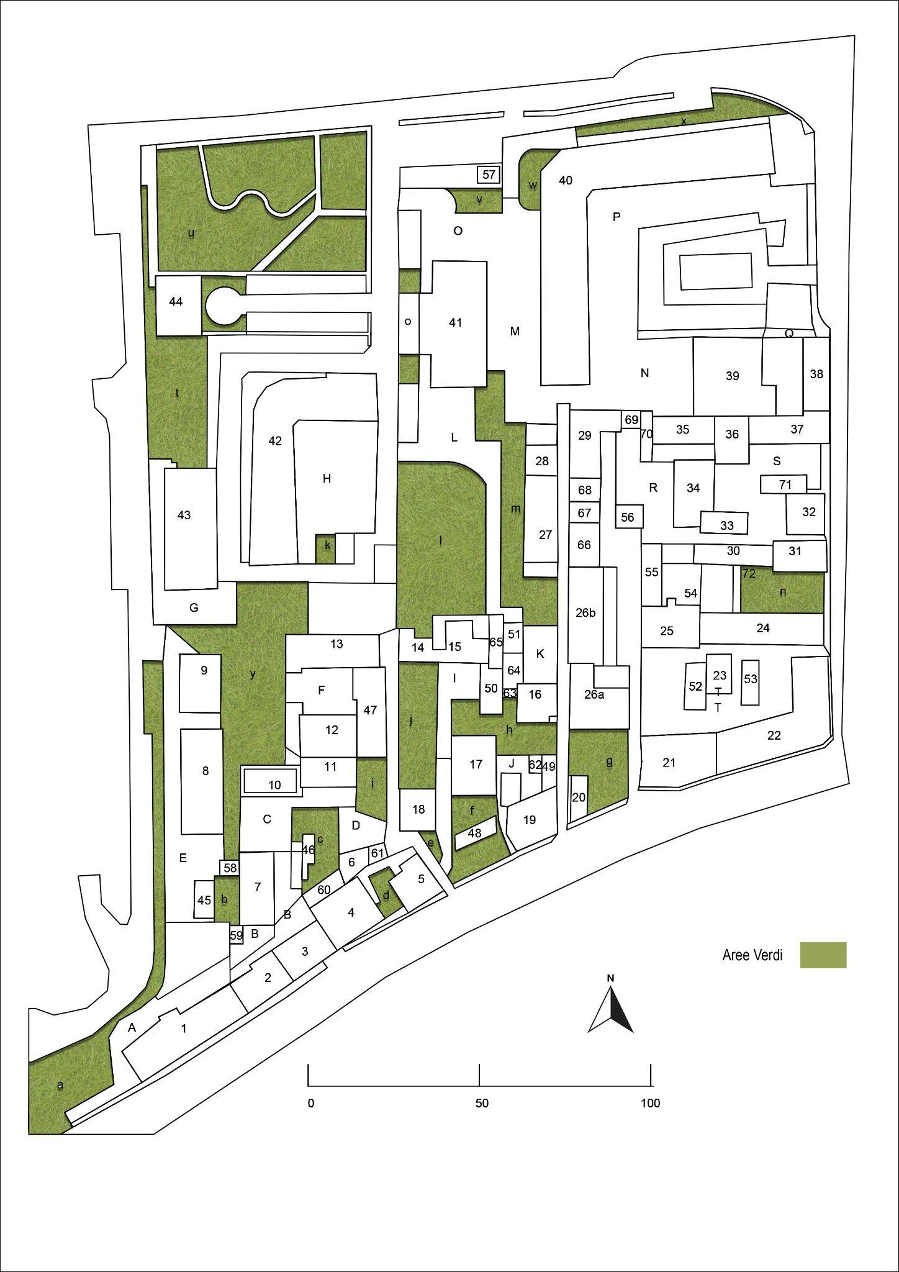
C8.1.6 AVAILABILITY OF GREEN AREAS
INDICATOR
Share of Green Areas on Urban Area Surface: 22.6 %
Critical value (1) – 0%
Optimal value (0) – 60%
Normalised value: 0.63
Vulnerability Level: RATHER NEGATIVE

Slide 47
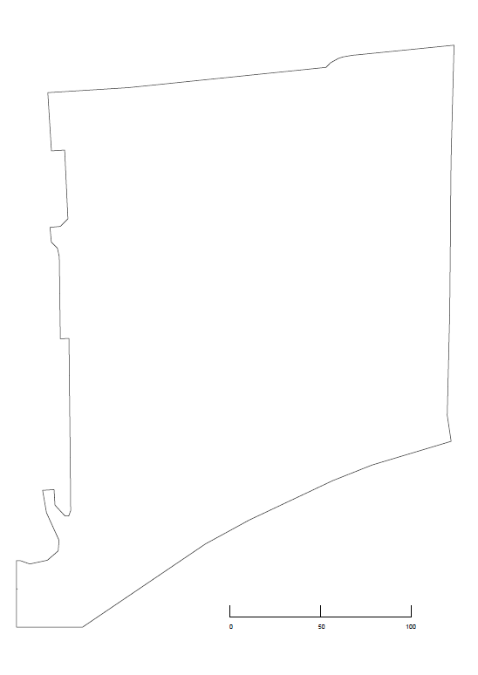
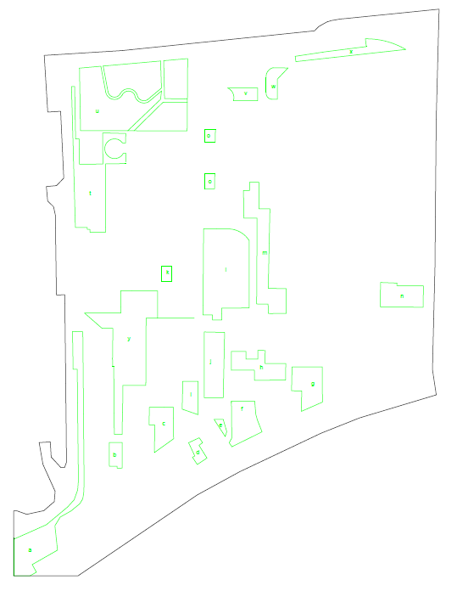
C8.1.6 AVAILABILITY OF GREEN AREAS
CALCULATION: STEP BY STEP
Step 1: Calculate the extent of the urban area.
Step 2: Measure the total extent of green areas within the urban area. Use high-resolution maps or satellite images.
Area: 54.492 m2
Area: 10.260 m2

Slide 48
C8.1.6 AVAILABILITY OF GREEN AREAS
CALCULATION: STEP BY STEP
Step 3: Calculate the value of the indicator by applying the following formula
Total surface of green areas
Percentage of green areas =
* 100
Total surface of urban area
10.260
Percentage of green areas =
* 100
54.492
Percentage of green areas =
19%

Slide 49
C8.1.6 AVAILABILITY OF GREEN AREAS
CALCULATION: STEP BY STEP
Step 7: Normalize the result:
The value is normalised applying the following formula:
Normalisation values | Description
0.1 | Optimal (No improvement necessary)
0.3 | Rather positive
0.5 | Neutral
0.7 | Rather negative
0.9 | Critical (Could lead to severe consequences)
where:
Xi: value of the indicator
X_{min} = optimal indicator’s value (corresponding to score 1)
X_{max} = critical indicator’s value (corresponding to score 0)

Slide 50



C8.1.6 AVAILABILITY OF GREEN AREAS
CALCULATION: STEP BY STEP
Step 7: Normalize the result:
For the “higher is better” indicators (higher the numerical value of the indicator, the higher the performance level.), the value is normalised applying the following formula:
Normalisation values | Description
0.1 | Optimal (No improvement necessary)
0.3 | Rather positive
0.5 | Neutral
0.7 | Rather negative
0.9 | Critical (Could lead to severe consequences)
Rather Negative

Slide 51
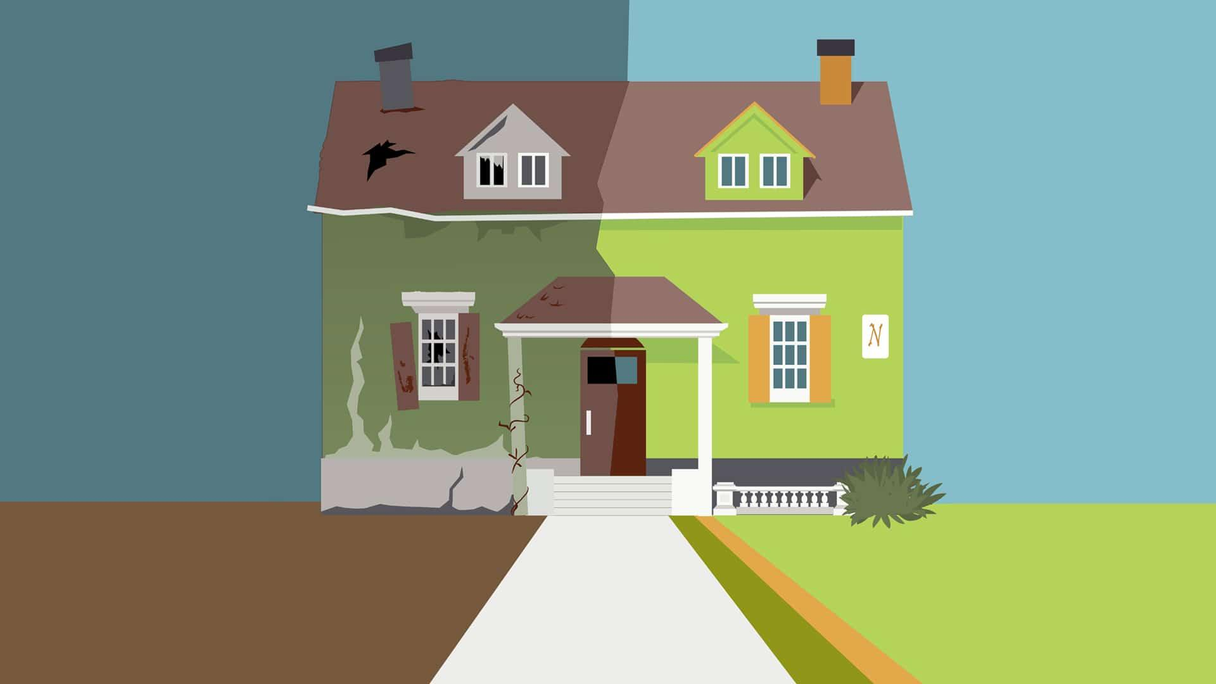
C8.1.7 PRESENCE OF HOUSEHOLDS IN BAD CONDITIONS
Description:
The criterion evaluates the presence of households living in inadequate conditions that increase their vulnerability to extreme temperatures. Such conditions may include poor thermal insulation and lack of access to cooling systems.
Objective:
Improve households conditions to ensure thermal insulation and availability of cooling systems.
Relevance:
This indicator is crucial for promoting sustainable living environments and achieving indoor thermal comfort.

Slide 52
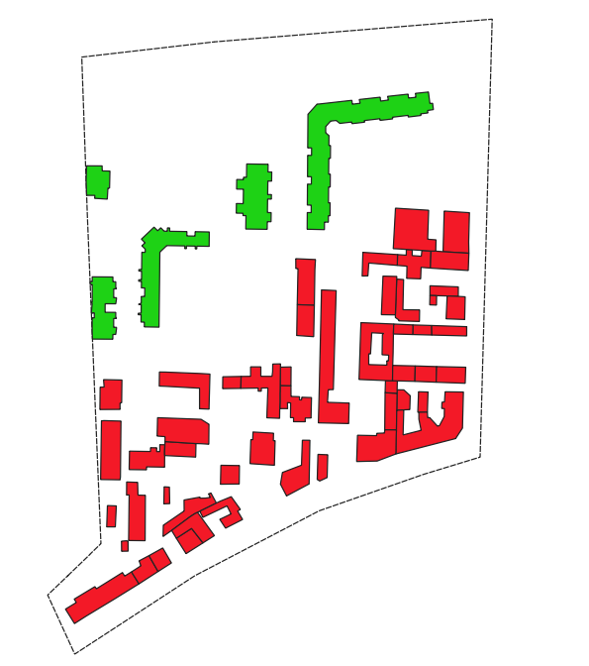
C8.1.7 PRESENCE OF HOUSEHOLDS IN BAD CONDITIONS
INDICATOR
Mean age of residential buildings in the area: 45.4
Critical value (1) – 50 years
Optimal value (0) – 30 years
Normalised value: 0.77
Vulnerability Level: RATHER NEGATIVE
30 years
50 years
Notes:
FALTA MAPA GIS DE BUILDING AGE

Slide 53

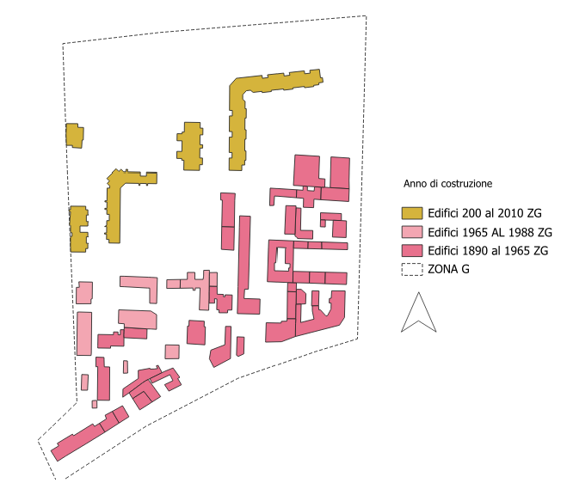
C8.1.7 PRESENCE OF HOUSEHOLDS IN BAD CONDITIONS
CALCULATION: STEP BY STEP
Step 1: Collect year-built data for each residential building (from cadastral records, municipal GIS, or building registries).
Step 2: Calculate the building’s age
Step 4:Calculate the average age for all the buildings in the urban area (Aggregate)
5 buildings built in -2010 → 25 years
11 Buildings built in -1988 → 40 years
37 buildings built in -1965 → more than 50 years
Notes:
FALTA MAPA GIS DE YEAR BUILT

Slide 54
C8.1.7 PRESENCE OF HOUSEHOLDS IN BAD CONDITIONS
CALCULATION: STEP BY STEP
Step 5: Normalize the result:
The value is normalised applying the following formula:
Normalisation values | Description
0.1 | Optimal (No improvement necessary)
0.3 | Rather positive
0.5 | Neutral
0.7 | Rather negative
0.9 | Critical (Could lead to severe consequences)
where:
Xi: value of the indicator
X_{min} = optimal indicator’s value (corresponding to score 0)
X_{max} = critical indicator’s value (corresponding to score 1)

Slide 55




C8.1.7 PRESENCE OF HOUSEHOLDS IN BAD CONDITIONS
CALCULATION: STEP BY STEP
Step 5: Normalize the result:
For the “lower is better” indicators (lower the numerical value of the indicator, the higher the performance level.), the value is normalised applying the following formula:
Normalisation values | Description
0.1 | Optimal (No improvement necessary)
0.3 | Rather positive
0.5 | Neutral
0.7 | Rather negative
0.9 | Critical (Could lead to severe consequences)
Rather Negative

Slide 56
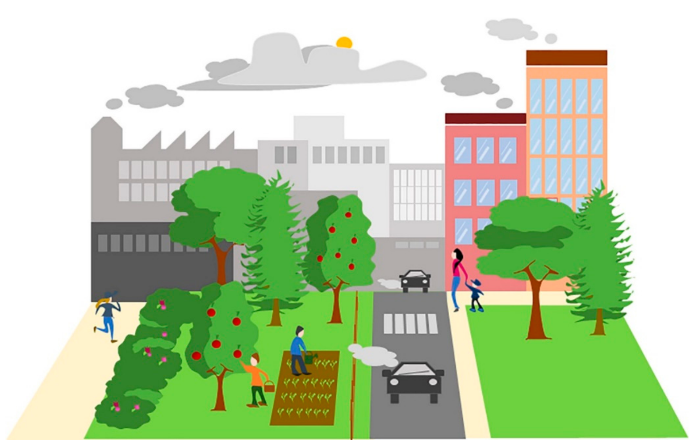
C8.1.8 GREEN SPACE DENSITY
Description:
Measures the number of green space patches (parks, gardens, tree-lined streets, green roofs) per unit area, indicating availability and distribution of vegetation in cities.
Objective:
To assess the presence and accessibility of urban green infrastructure and guide planning actions that strengthen resilience to heat.
Relevance:
Green spaces reduce the urban heat island effect through shading and evapotranspiration, improving thermal comfort and equity. Low density signals higher vulnerability to extreme heat, especially for exposed groups.

Slide 57

C8.1.8 GREEN SPACE DENSITY
:
INDICATOR
Number of green spaces patches per unit area: 3.72
Critical value (1): 3
Optimal value (0): 5
Normalised value: 0.64
Vulnerability Level: Rather negative

Slide 58
C8.1.8 GREEN SPACE DENSITY
CALCULATION: STEP BY STEP
Step 1: Calculate the extent of the urban area.
Step 2: Count the number of existing green area units within the urban area. Use high-resolution maps or satellite images.
Area: 54.492
Area: 10.260m2

Slide 59

C8.1.8 GREEN SPACE DENSITY
CALCULATION: STEP BY STEP
Step 3: Define a standard reference to identify the number of green spaces. Based on environmental standards or local environmental plans:
European Environment Agency (EEA) – Urban green spaces and health (2022): defines small green spaces or pocket parks inside the range of 0.01–0.5 ha.
URBACT / EU Urban Agenda for Green Cities (2020): Defines pocket parks as green areas from 0.05–0.4 ha.
Reference area value: 0.05 Ha 🡪 500m2 (Piano del Verde di Torino, 2020)
Step 4: Divide the total green area within the urban area by the reference area value to identify the number of green units.
Step 5: Calculate the density taking into account the number of green units

Slide 60
C8.1.8 GREEN SPACE DENSITY
CALCULATION: STEP BY STEP
Step 7: Normalize the result:
The value is normalised applying the following formula:
Normalisation values | Description
0.1 | Optimal (No improvement necessary)
0.3 | Rather positive
0.5 | Neutral
0.7 | Rather negative
0.9 | Critical (Could lead to severe consequences)
where:
Xi: value of the indicator
X_{min} = optimal indicator’s value (corresponding to score 1)
X_{max} = critical indicator’s value (corresponding to score 0)

Slide 61




C8.1.8 GREEN SPACE DENSITY
CALCULATION: STEP BY STEP
Step 7: Normalize the result:
For the “higher is better” indicators (higher the numerical value of the indicator, the higher the performance level.), the value is normalised applying the following formula:
Normalisation values | Description
0.1 | Optimal (No improvement necessary)
0.3 | Rather positive
0.5 | Neutral
0.7 | Rather negative
0.9 | Critical (Could lead to severe consequences)
Rather negative

Slide 62
OVERALL VULNERABILITY
Criterion | Normalised Value
Capacity of paved surfaces to reflect solar radiation | 0,71
Capacity of roofs to reflect solar radiation | 0,42
Urban Area Reflectivity | 0,66
Availability of green areas | 0,63
Shading of paved surfaces | 0,82
Visibility of the sky | 0,26

Slide 63
OVERALL VULNERABILITY
Criterion | Normalised value | Weight
Capacity of paved surfaces to reflect solar radiation | 0,71 | 0,25
Capacity of roofs to reflect solar radiation | 0,42 | 0,15
Urban Area Reflectivity | 0,66 | 0,15
Availability of green areas | 0,63 | 0,25
Shading of paved surfaces | 0,82 | 0,10
Visibility of the sky | 0,26 | 0,10
TOTAL = 1 (100%)

Slide 64
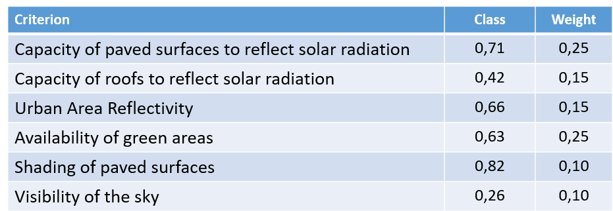
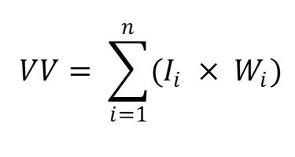
OVERALL VULNERABILITY (VULNERABILITY VALUE – VV)
Normalised score
Weight
VV = 0.71 x 0.25 + 0.42 x 0.15 + 0,66 x 0,15 + 0,63 x 0.25 + 0,82 x 0.10 + 0.26 x 0.1 = 0,61
Vulnerability Value (VV) = 0,61
Vulnerability Level = RATHER NEGATIVE

Slide 65
AFTER ASSESSING VULNERABILITY, IT IS NECESSARY TO QUANTIFY TWO ADDITIONAL FACTORS TO DETERMINE THE LEVEL OF RISK:
-HAZARD
-EXPOSURE

Slide 66
EXPOSURE OF INHABITANTS
C8.1 Health Risk for Population
Code | Criterion | Indicator
C8.1 E1 | Population Density | Total number of inhabitants divided by the total area of the urban area
C8.1 E2 | Age of population | Amount of population older than 64 years in the investigated area.

Slide 67

C8.1 - E1 POPULATION DENSITY
Description:
Population Density measures the total number of inhabitants per unit of urban area (inhabitants/km²), reflecting how concentrated a population is within a defined boundary such as a municipality or built-up
Objective:
The purpose of this indicator is to quantify population exposure to health risks, providing a basis for assessing how densely populated environments may influence vulnerability to communicable diseases, heat stress, and emergency response limitations.
Relevance:
This indicator is essential for urban planning, public health, and climate adaptation strategies, as it helps identify areas with higher exposure, guides resource distribution, and supports evidence-based decisions to create safer, more resilient, and sustainable urban environments.

Slide 68
C8.1 - E1 POPULATION DENSITY
INDICATOR
Total number of inhabitants divided by the total area of the urban area: 7760
Critical value (1) – 14000
Optimal value (0) – 6000
Normalised value: 0.78
Exposure Level: RATHER NEGATIVE

Slide 69
C8.1 - E1 POPULATION DENSITY
CALCULATION: STEP BY STEP
Step 1: Select and calculate the total area of the urban area
Step 2: Gather the demographic data of the selected urban area. Use sources as national statistics office, municipal demographics, population grid datasets.
ISTAT Database
Total Population | 682 inhabitants
Step 3: Calculate the value using the formula
Total population
Total surface of urban area
Area: 0.054492 km2

Slide 70

C8.1 - E1 POPULATION DENSITY
CALCULATION: STEP BY STEP
Step 4: Normalize the result:
The value is normalised applying the following formula:
Normalisation values | Description
0.1 | Optimal (No improvement necessary)
0.3 | Rather positive
0.5 | Neutral
0.7 | Rather negative
0.9 | Critical (Could lead to severe consequences)
where:
Xi: value of the indicator
X_{min} = optimal indicator’s value (corresponding to score 0)
X_{max} = critical indicator’s value (corresponding to score 1)

Slide 71




C8.1 - E1 POPULATION DENSITY
CALCULATION: STEP BY STEP
Step 4: Normalize the result:
For the “lower is better” indicators (lower the numerical value of the indicator, the higher the performance level.), the value is normalised applying the following formula:
Normalisation values | Description
0.1 | Optimal (No improvement necessary)
0.3 | Rather positive
0.5 | Neutral
0.7 | Rather negative
0.9 | Critical (Could lead to severe consequences)
Rather Negative

Slide 72
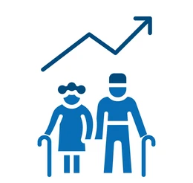
C8.1 - E2 AGE OF POPULATION
Description:
The Age of Population indicator measures the demographic structure of a community, typically expressed through metrics such as median age or the proportion of population within specific age groups (e.g., children, working-age adults, older adults).
Objective:
Its purpose is to capture population age dynamics that influence vulnerability, health outcomes, service needs, and urban planning priorities.
Relevance:
Understanding the age distribution is crucial for assessing risk and resilience: older adults and young children often face higher exposure to environmental hazards, health emergencies, and mobility constraints, while a younger or aging population can shape infrastructure demands, healthcare provision, and long-term adaptation strategies.

Slide 73
C8.1 - E2 AGE OF POPULATION
INDICATOR
Amount of population older than 64 years in the investigated area:
0.0021 Inhabitants (>64yr)/Total Urban Area (m2)
Critical value (1) = 0,003
Optimal value (0) = 0,0015
Normalised value: 0.4
Exposure Level: RATHER NEGATIVE

Slide 74
C8.1 - E2 AGE OF POPULATION
CALCULATION: STEP BY STEP
Step 1: Select and calculate the total area of the urban area
Step 2: Gather the demographic data of the selected urban area. Specially for the amount of residents over 64 years old. Use sources as national statistics office, municipal demographics, population grid datasets.
ISTAT Database
Total Population | 682 inhabitants
Total Population Over 64 years old | 114 inhabitants
Step 3: Calculate the value using the formula
Total population > 65
Total surface of urban area
Area: 0.054492 km2

Slide 75

C8.1 - E2 AGE OF POPULATION
CALCULATION: STEP BY STEP
Step 4: Normalize the result:
For the “lower is better” indicators (lower the numerical value of the indicator, the higher the performance level.), the value is normalised applying the following formula:
Normalisation values | Description
0.1 | Optimal (No improvement necessary)
0.3 | Rather positive
0.5 | Neutral
0.7 | Rather negative
0.9 | Critical (Could lead to severe consequences)
where:
Xi: value of the indicator
X_{min} = optimal indicator’s value (corresponding to score 0)
X_{max} = critical indicator’s value (corresponding to score 1)

Slide 76




C8.1 - E2 AGE OF POPULATION
CALCULATION: STEP BY STEP
Step 4: Normalize the result:
For the “lower is better” indicators (lower the numerical value of the indicator, the higher the performance level.), the value is normalised applying the following formula:
Normalisation values | Description
0.1 | Optimal (No improvement necessary)
0.3 | Rather positive
0.5 | Neutral
0.7 | Rather negative
0.9 | Critical (Could lead to severe consequences)
Rather Positive

Slide 77
OVERALL EXPOSURE
C8.1 Health Risk for Population
Code | Criterion | Normalized Value
C8.1 E1 | Population Density | 0.8
C8.1 E2 | Age of population | 0.4

Slide 78
OVERALL EXPOSURE
C8.1 Health Risk for Population
Code | Criterion | Normalized Value | Weight
C8.1 E1 | Population Density | 0.8 | 0.50
C8.1 E2 | Age of population | 0.4 | 0.50
TOTAL = 1 (100%)

Slide 79


OVERALL EXPOSURE (EXPOSURE VALUE - EV)
Normalised score
Weight
Exposure Value (EV) = 0,6
Exposure Level = RATHER NEGATIVE

Slide 80
HAZARD LIKELIHOOD
Hazards event |  | Hazard Value (HV)
Frequent | Likely to occur in a lifetime (every 0-10 years) | Very likely | 1-0,9
Probable | Likely to occur several times in a lifetime (every 0-25 year) | Likely | 0,89-0,66
Occasional | Likely to occur sometime in a lifetime (every 0-50 years) | As like as not | 0,65-0,33
Remote | Unlikely but still possible to occur in a lifetime (0-100 years) | Unlikely | 0,32-0,0
Hazard Value (HV) = 0.8 (Probable)
THIS INFORMATION IS PROVIDED BY SECAPs

Slide 81
RISK ASSESSMENT
Risk Category: Health (C8)
Exposure: Inhabitants
Hazard Value = 0,8
Exposure Value = 0,9
Vulnerability Value = 0,61
W_{HV} weight of HV
W_{EV} weight of EV
W_{V} weight of VV
0,25
0,25
RISK LEVEL = 0.72
RATHER NEGATIVE
0,5

Slide 82
References
Testo GIZ and EURAC 2017: Risk Supplement to the Vulnerability Sourcebook. Guidance on how to apply the Vulnerability Sourcebook’s approach with the new IPCC AR5 concept of climate risk. Bonn: GIZ.
Landsat 8 Bands Overview, NASA, 2013.
Università degli studi di Padova, Department Of Civil, Environmental and Architectural Engineering, Mappatura delle isole di calore urbano durante eventi estremi a supporto dei piani di adattamento: il caso studio del Comune di Venezia, Teodoro Maria, 2023.
Dodman, D., B. Hayward, M. Pelling, V. Castan Broto, W. Chow, E. Chu, R. Dawson, L. Khirfan, T. McPhearson, A. Prakash, Y. Zheng, and G. Ziervogel, 2022: Cities, Settlements and Key Infrastructure. In: Climate Change 2022: Impacts, Adaptation and Vulnerability. Contribution of Working Group II to the Sixth Assessment Report of the Intergovernmental Panel on Climate Change [H.-O. Pörtner, D.C. Roberts, M. Tignor, E.S. Poloczanska, K. Mintenbeck, A. Alegría, M. Craig, S. Langsdorf, S. Löschke, V. Möller, A. Okem, B. Rama (eds.)]. Cambridge University Press, Cambridge, UK and New York, NY, USA, pp. 907–1040, doi:10.1017/9781009325844.008.
EN ISO14091:2021 "Adaptation to climate change — Guidelines on vulnerability, impacts and risk assessment making.
Larsson N., Moro A, et al. (2007), SBMethod.
Moro A., Koja A. (2020). RBE Method - Methodology and indicators for the assessment of the level of adaptation and resilience to climate change, Habit.A project, Interreg Alcotra Program.
Moro A. (2021). Resilient Built Environment Tools, UN Climate Change Conference UK 2021 (COP26).
Moro A. et al. (2023). SBE Method, Sustainable MED Cities project, ENI CBC MED Program.
Moro A. (2024), RBE Method in spatial planning, Interreg Alpine Space ADAPTNOW.
Zebisch, M. et al. (2023). Climate Risk Sourcebook. Deutsche Gesellschaft für Internationale Zusammenarbeit (GIZ) GmbH. Bonn.

