Slide 1

SuPeRBE Training Material
Macro Area of Expertise 6:
SuPeRBE Training Material
Risk Assessment At Small Urban Scale
Hazard: Drought (D)
Climate change and built environment
Area of Expertise 6.1:
Urban Sector: Water (D4)
Fundamentals of climate change
Risk Category: Damage Risk for Water Supply Network(D4.2)
Level of competence: 2
Level of competence: 1/2/3
Activity 3.2
SuPeRBE Project (CE0200768)
Area of Expertise: 6.1 according
to the CEN Workshop Agreement 17939

Slide 2

DROUGHT
General Information
“A period of abnormally dry weather long enough to cause a serious hydrological imbalance.” (source: https://www.ipcc.ch/sr15/chapter/glossary/)
Natural phenomenon
Intensified in recent decades by climate change and unsustainable land practices
Human-induced climate change has contributed to increases in droughts due to increased atmospheric evaporative demand induced by increased temperature, decreased relative humidity, and increased net radiation
More regions are affected by drought with increasing global warming
Notes:
- Megadrought – “A megadrought is a very lengthy and pervasive drought, lasting much longer than normal, usually a decade or more” (https://www.ipcc.ch/sr15/chapter/glossary/))
Number of droughts has surged by nearly 30 per cent in frequency and intensity since 2000
result of a complicated set of events driven or amplified by climate change, as well as sometimes the mismanagement of land (For example, a hillside which is deforested is immediately degraded. The land will lose its resilience to extreme weather and will become more susceptible to both drought and flooding.)
WHO: An estimated 55 million people globally are affected by droughts every year, and they are the most serious hazard to livestock and crops in nearly every part of the world. Drought threatens people’s livelihoods, increases the risk of disease and death, and fuels mass migration. Water scarcity impacts 40% of the world’s population, and as many as 700 million people are at-risk of being displaced as a result of drought by 2030
Additional info:
https://news.un.org/en/story/2024/12/1157696
https://www.ipcc.ch/report/ar6/wg1/chapter/chapter-11/
https://www.who.int/health-topics/drought/#tab=tab_1

Slide 3
TYPES OF DROUGHT
Net water availability – caused by precipitation deficits and changes in evapotranspiration
Agricultural drought – caused by a lack of sufficient soil moisture and increased atmospheric evaporative demand
Ecological drought - caused by a lack of sufficient soil moisture and increased atmospheric evaporative demand
Hydrological drought – caused by a lack of runoff and surface water

Slide 4
AFFECTED URBAN SYSTEMS
Water supply system
  Damage risk for water treatment plants
  Damage risk for the water supply network
Environment & biodiversity
  Damage risk for urban green spaces
  Damage risk for street trees
Health
  Health risk for the population
Emergency services
  Efficiency risk for the fire brigade
  Efficiency risk for emergency medical services

Slide 5
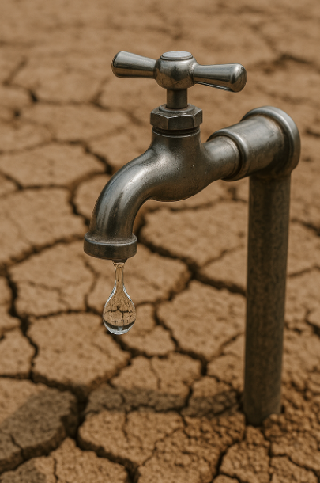
WATER SCARCITY
Seasonal, annual, or multi-annual water stress condition
Occurs when water demand frequently exceeds the sustainable supply capacity of the natural system in river basins
Driven by:
  Supply reduction and source limitations
  Increased water demand
  Water quality degradation (pollution)
  Infrastructure and operational stress
Notes:
Water scarcity can be measured as the ratio between renewable freshwater resources and water abstraction or water use
Supply reduction and source limitations:
Reduced rainfall and streamflow diminish inputs to reservoirs
Drought leads to less recharge, which leads to groundwater depletion
Water rights, inter-basin transfers, or modelled yield may fail under drought stress
Increased water demand:
Droughts often go hand in hand with heat, dry soils, etc., which increase water use for landscaping, cooling, etc. Demand can spike even as supply falls.
Water quality degradation:
Lower volumes of water cause higher concentrations of substances in source waters—nitrates, salts, pollutants, etc.
In informal settlements or poorly managed systems, when water is scarce, people may resort to alternate sources (wells, springs, etc.) that are less safe
With poorer raw water quality, more treatment (more energy, chemicals, infrastructure) is required to meet drinking water standards
Some studies show that certain organisms get more resistant to water treatments at higher temperatures
Infrastructure and operational stress:
Increased extraction and pumping can lead to more failures
Water pressure in the system declines
Leakages cause even more inefficiencies

Slide 6
RISK ASSESSMENT FOR DAMAGE RISK FOR WATER SUPPLY NETWORK
HAZARD
DROUGHT
Hazard: drought
Exposed element: Water supply network
EXPOSED ELEMENT
WATER SUPPLY NETWORK
DAMAGE RISK FOR WATER SUPPLY NETWORK
RISK CATEGORY

Slide 7
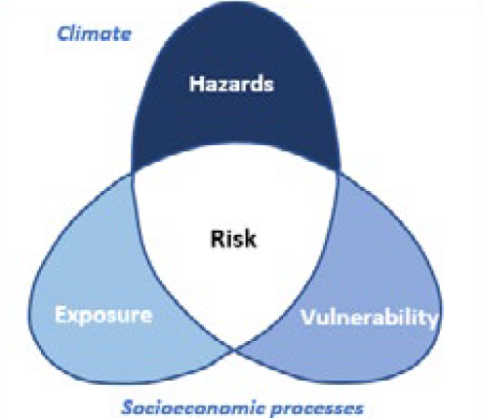
IMPACT CHAIN
HAZARD
DROUGHT
DAMAGE RISK FOR WATER SUPPLY NETWORK
RISK CATEGORY
WATER SUPPLY NETWORK
VULNERABILITY
EXPOSED ELEMENT
Adaptive capacity
Sensitivity
RISK ASSESSMENT RESULT

Slide 8
VULNERABILITY CRITERIA
HAZARD
DROUGHT
DAMAGE RISK FOR WATER SUPPLY NETWORK
Consumption
Water consumption during the tourist season
Regional competitiveness index
Water loss
RISK CATEGORY
WATER SUPPLY NETWORK
VULNERABILITY
EXPOSED ELEMENT
Adaptive capacity
Sensitivity
RISK ASSESSMENT RESULT

Slide 9
VULNERABILITY ASSESSMENT
HAZARD
DROUGHT
CRITERION | INDICATOR
Consumption | Water consumption per capita
Water consumption during the tourist season | Water consumption compared to average consumption during the tourist season (households)
Water consumption during the tourist season | Water consumption compared to average consumption during the tourist season (industry)
Regional competitiveness index | Regional competitiveness index
Water loss | Losses in the water supply network
DAMAGE RISK FOR WATER SUPPLY NETWORK
RISK CATEGORY
WATER SUPPLY NETWORK
VULNERABILITY
EXPOSED ELEMENT
Adaptive capacity
Sensitivity
RISK ASSESSMENT RESULT

Slide 10
D4.2.1 WATER CONSUMPTION PER CAPITA
Description:
The indicator measures the average volume of water supplied and consumed per person through the urban water supply network in the selected area (L/capita/day). It reflects the demand load placed on the network’s infrastructure and resources, relative to the population it serves.
Objective:
To quantify the pressure on the water supply network. To identify consumption patterns that may increase vulnerability during droughts, and to provide a baseline for evaluating efficiency of water use.
Relevance:
Higher consumption per capita = higher vulnerability
Cities with higher average consumption per person will face greater stress during drought as they have less flexibility before shortages occur. Comparing per capita use across districts helps to identify areas of inefficiency and prioritize demand management interventions. Water supply network is under more stress if the average consumption is higher due to higher pumping needs and higher stress in the network.

Slide 11
D4.2.1 WATER CONSUMPTION PER CAPITA
CALCULATION: STEP-BY-STEP EXAMPLE
The local water supply company might have this information already available; otherwise:
In the local water supply company, obtain the information about the average amount of water consumed in the selected area in a month (if that is not available, use average yearly consumption and divide it by 365 days to get average monthly consumption)
Identify the number of citizens in the selected area
Average daily consumption: 10.461.600 L/month
Number of citizens: 1.453
Divide the average monthly consumption by the number of citizens to get the average consumption per capita
$Water consumption per capita= \frac{Average consumption for the whole area}{Number of citizens}=7200$ L/capita

Slide 12
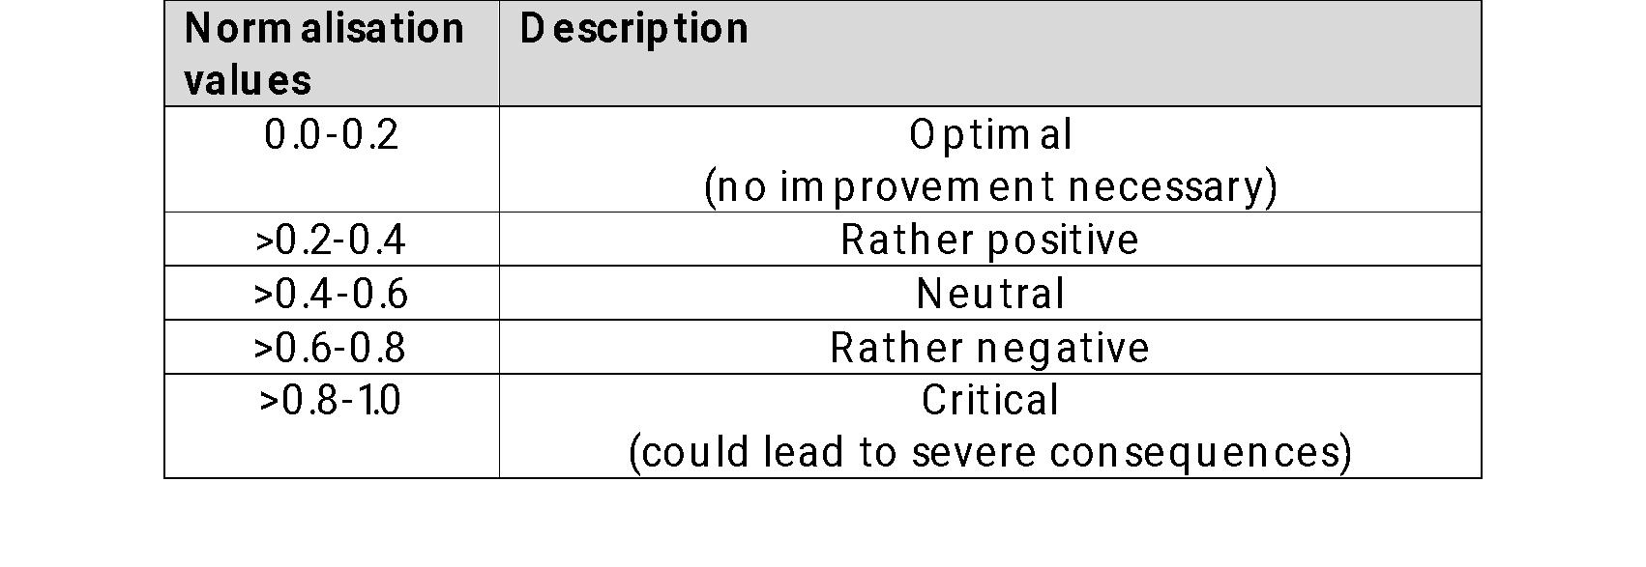
Normalisation
Normalization is a crucial step in this process, as it transforms diverse indicator values into a common scale, typically ranging from 0 to 1. This ensures that each indicator contributes proportionately and comparably to the overall resilience score, regardless of its original unit or magnitude. By applying normalization, we enable meaningful synthesis of data, facilitate benchmarking across different contexts, and support more transparent and objective decision-making in resilience evaluations.
NORMALISATION INTERVAL

Slide 13
D4.2.1 WATER CONSUMPTION PER CAPITA
BENCHMARKING
Critical value (1) = National minimum (monthly consumption)
Optimal value (0) = National maximum (monthly consumption)
Range of values: lower is better (LIB)

Slide 14
D4.2.1 WATER CONSUMPTION PER CAPITA
NORMALISATION
Indicator
Water consumption per capita: 7200 L/capita
Critical value (1) = 9000
Neutral value (0,5) = 6000
Optimal value (0) = 3000
Normalised value: 0.7
Vulnerability Level: RATHER NEGATIVE

Slide 15
D4.2.2 WATER CONSUMPTION COMPARED TO AVERAGE CONSUMPTION DURING THE TOURIST SEASON (HOUSEHOLDS)
Description:
This indicator measures the variation in household water consumption during the tourist season compared to the annual average household consumption. It reflects the additional stress placed on the urban water supply network by seasonal tourism peaks, which often cause demand surges in residential areas (e.g., households hosting guests, short-term rentals, or second homes).
Objective:
To capture seasonal demand fluctuations in water consumption linked to tourism activity, to identify the degree of vulnerability of the water supply network to sudden increases in household demand, to support planning of water supply operations (e.g., storage, pumping, treatment) during peak tourist months, and to enable utilities and municipalities to anticipate shortages, pressure drops, or rationing needs during high-demand periods.
Relevance:
During drought, baseline water availability is reduced. A surge in household demand from tourism further strains the water supply network. Networks serving tourist areas often face peak loads that can exceed design capacity, leading to pressure drops, intermittent supply, or service failures. Tourist-season consumption may reduce the availability of resources for permanent residents, thereby increasing social vulnerability and inequity risks. If consumption rises only modestly compared to the average, the network is more resilient. Large spikes indicate low adaptive capacity and a higher risk of drought-driven disruption.

Slide 16
D4.2.2 WATER CONSUMPTION COMPARED TO AVERAGE CONSUMPTION DURING THE TOURIST SEASON (HOUSEHOLDS)
CALCULATION: STEP BY STEP
Step 1: Identify which months are considered to fall under the tourist season
Step 3: Calculate the average monthly consumption in households only during the tourist season
Step 2: Calculate the average monthly consumption in households only outside of the tourist season
Step 4: Divide the average monthly consumption during the tourist season by the average monthly consumption outside of the tourist season
$\frac{Average monthly consumption during tourist season}{Average monthly consumption outside of the tourist season}= \frac{45.000.000}{8.000.000}$ = 5,6

Slide 17
D4.2.2 WATER CONSUMPTION COMPARED TO AVERAGE CONSUMPTION DURING THE TOURIST SEASON (HOUSEHOLDS)
BENCHMARKING
Critical value (1) = Consumption more than 7 times higher
…
0,7 = 5 times higher
…
0,3 = 2 times higher
…
Optimal value (0) = Same average consumption
Range of values: lower is better (LIB)

Slide 18
D4.2.2 WATER CONSUMPTION COMPARED TO AVERAGE CONSUMPTION DURING THE TOURIST SEASON (HOUSEHOLDS)
NORMALISATION
Indicator
Water consumption compared to average consumption during the tourist season (households): 5,6
Normalized Value: 0,7
Vulnerability Level: RATHER NEGATIVE

Slide 19
D4.2.3 WATER CONSUMPTION COMPARED TO AVERAGE CONSUMPTION DURING THE TOURIST SEASON (INDUSTRY)
Description:
This indicator measures the variation in industry water consumption during the tourist season compared to the annual average industry consumption. It focuses on how seasonal tourism activity influences industrial demand for water (e.g., food & beverage production, hospitality-linked laundries, service industries, cooling systems, entertainment facilities).
Objective:
To capture seasonal demand fluctuations in water consumption linked to tourism activity, to identify the degree of vulnerability of the water supply network to sudden increases in industry demand, to support planning of water supply operations (e.g., storage, pumping, treatment) during peak tourist months, and to enable utilities and municipalities to anticipate shortages, pressure drops, or rationing needs during high-demand periods.
Relevance:
During drought, baseline water availability is reduced. A surge in industry demand from tourism further strains the water supply network. The industry becomes economically vulnerable if the water supply is restricted. High seasonal industrial demand can exacerbate conflicts over water allocation between industrial, residential and ecological needs. If consumption rises only modestly compared to the average, the network is more resilient. Large spikes indicate low adaptive capacity and a higher risk of drought-driven disruption. Helps identify where water efficiency measures are most needed during drought periods.

Slide 20
D4.2.3 WATER CONSUMPTION COMPARED TO AVERAGE CONSUMPTION DURING THE TOURIST SEASON (INDUSTRY)
CALCULATION: STEP BY STEP
Step 1: Identify which months are considered to fall under the tourist season
Step 3: Calculate the average monthly consumption in the industry only during the tourist season
Step 2: Calculate the average monthly consumption in the industry only outside of the tourist season
Step 4: Divide the average monthly consumption during the tourist season by the average monthly consumption outside of the tourist season
$\frac{Average monthly consumption during tourist season}{Average monthly consumption outside of the tourist season}= \frac{15.000.000}{10.000.000}$ = 1,5

Slide 21
D4.2.3 WATER CONSUMPTION COMPARED TO AVERAGE CONSUMPTION DURING THE TOURIST SEASON (INDUSTRY )
BENCHMARKING
Critical value (1) = Consumption more than 7 times higher
…
0,7 = 5 times higher
…
0,3 = 2 times higher
…
Optimal value (0) = Same average consumption
Range of values: lower is better (LIB)

Slide 22
D4.2.3 WATER CONSUMPTION COMPARED TO AVERAGE CONSUMPTION DURING THE TOURIST SEASON (INDUSTRY)
NORMALISATION
Indicator
Water consumption compared to average consumption during the tourist season (industry): 1,5
Normalized Value: 0,2
Vulnerability Level: RATHER POSITIVE

Slide 23
D4.2.4 REGIONAL COMPETITIVENESS INDEX (RCI)
Description:
The Regional Competitiveness Index (RCI) measures the ability of a region to offer an attractive and sustainable environment for businesses and residents to live and work. It combines multiple dimensions such as economic performance, infrastructure, innovation capacity, governance quality, and environmental sustainability.
Objective:
To evaluate the adaptive capacity of a region, to integrate socio-economic resilience factors, and to identify regional disparities that may amplify vulnerabilities, since regions with a lower competitiveness index may struggle financially.
Relevance:
Regions with a high competitiveness index are typically better positioned to finance drought mitigation measures, and they can attract private and public investment into water infrastructure upgrades, reducing vulnerability to drought. A strong RCI often correlates with better governance, efficiency, and capacity to implement relevant policies and respond to crisis, and they have better capacity to adapt.

Slide 24
D4.2.4 REGIONAL COMPETITIVENESS INDEX
CALCULATION: STEP BY STEP
Step 1: Find the value of the regional competitiveness index for your area (national data or from https://ec.europa.eu/regional_policy/information-sources/maps/regional-competitiveness_en)

Slide 25
D4.2.4 REGIONAL COMPETITIVENESS INDEX
BENCHMARKING
Higher is better
Critical value (1) = National minimum
Optimal value (0) = National maximum

Slide 26
D4.2.4 REGIONAL COMPETITIVENESS INDEX
NORMALISATION
Indicator – example
Regional competitiveness index: 0,5
National maximum: 0,75
National minimum: 0,35
Normalized Value: 0,625
Vulnerability Level: Rather negative

Slide 27
D4.2.5 WATER LOSS
Description:
Average percentage of water lost in the water supply network in a year. Amount of water delivered to the household (charged) in m3 compared to the amount of water that left the water reservoir (m3). It reflects the efficiency and integrity of the water supply network.
Objective:
To quantify the inefficiency of the water distribution system, it is necessary to determine the amount of water lost before it reaches consumers. To assess the vulnerability of the network to drought impact by determining how much available supply is wasted. To support maintenance prioritisation and investment planning for network renewal, leak detection, and metering improvements. And to strengthen the operational resilience of the water supply system by minimising losses and optimising resource use during scarcity.
Relevance:
High water loss reduces the actual amount available for users, and leaks indicate old and poorly maintained infrastructure, which is prone to failure during dry and high-demand periods. Networks with low losses have higher resilience.

Slide 28
D4.2.5 WATER LOSS
CALCULATION: STEP BY STEP
Step 1: Identify the average monthly amount of water leaving the water supply plant or pumping station (in case the water supply company is buying the water from another company you can use the amount of water bought) – produced water
Step 2: Identify the average monthly amount of water delivered to the end users (can be based on the bills)
Step 3: Divide the difference between the water produced and delivered with the produced water
$\frac{Produced water −Delivered water}{Produced water}= \frac{40.000−27.000}{40.000}$ = 0,325 = 32,5%

Slide 29
D4.2.2 WATER CONSUMPTION COMPARED TO AVERAGE CONSUMPTION DURING THE TOURIST SEASON (HOUSEHOLDS)
BENCHMARKING
Critical value (1) = More than 50% losses
…
0,75 = 40%
…
0,5 = 30%
…
0,25 = 20%
…
Optimal value (0) = Less than 10% losses
Range of values: lower is better (LIB)

Slide 30
D4.2.3 WATER CONSUMPTION COMPARED TO AVERAGE CONSUMPTION DURING THE TOURIST SEASON (INDUSTRY)
NORMALISATION
Indicator
Water losses: 32,5%
Normalised Value: 0,56
Vulnerability Level: Neutral

Slide 31
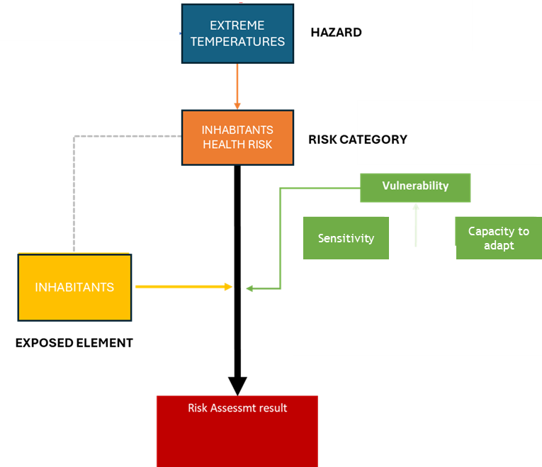
OVERALL VULNERABILITY
Criterion | Normalised value
Water consumption per capita | 0,7
Water consumption compared to average consumption during the tourist season (households) | 0,7
Water consumption compared to average consumption during the tourist season (industry) | 0,2
Regional competitiveness index | 0,625
Water lossess | 0,56

Slide 32
OVERALL VULNERABILITY
Criterion | Normalised value | Weight
Water consumption per capita | 0,7 | 0,25
Water consumption compared to average consumption during the tourist season (households) | 0,7 | 0,2
Water consumption compared to average consumption during the tourist season (industry) | 0,2 | 0,15
Regional competitiveness index | 0,625 | 0,15
Water lossess | 0,56 | 0,25
TOTAL = 1 (100%)

Slide 33
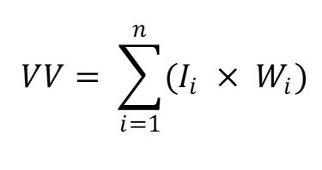
OVERALL VULNERABILITY (VULNERABILITY VALUE – VV)
Criterion | Normalised value | Weight
Water consumption per capita | 0,7 | 0,25
Water consumption compared to average consumption during the tourist season (households) | 0,7 | 0,2
Water consumption compared to average consumption during the tourist season (industry) | 0,2 | 0,15
Regional competitiveness index | 0,625 | 0,15
Water lossess | 0,56 | 0,25
Normalised score
Weight
VV = 0.7 x 0.25 + 0.7 x 0.2 + 0,2 x 0,15 + 0,625 x 0.15 + 0,56 x 0.25 = 0,58
Vulnerability Value (VV) = 0,58
Vulnerability Level = RATHER NEGATIVE

Slide 34
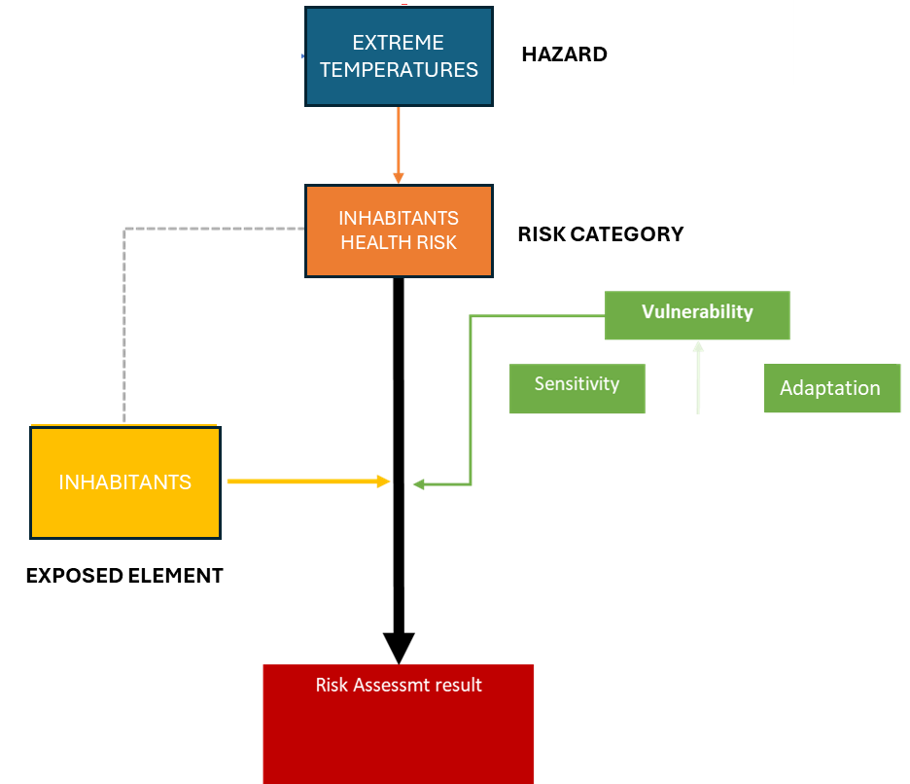
EXPOSURE OF INHABITANTS
AFTER ASSESSING VULNERABILITY, IT IS NECESSARY TO QUANTIFY TWO ADDITIONAL FACTORS TO DETERMINE THE LEVEL OF RISK:
-HAZARD
-EXPOSURE

Slide 35
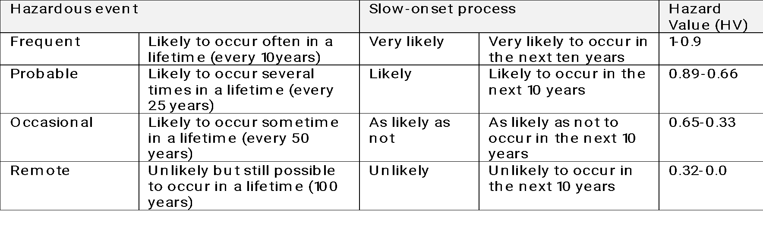
HAZARD LIKELIHOOD
Hazard Value (HV) = 0.7 (Probable)
THIS INFORMATION IS PROVIDED BY SECAPs

Slide 36
NETWORK AT RISK
CODE | CRITERION | INDICATOR
D4.2-E1-E1 | Network at risk | Length of water supply network

Slide 37
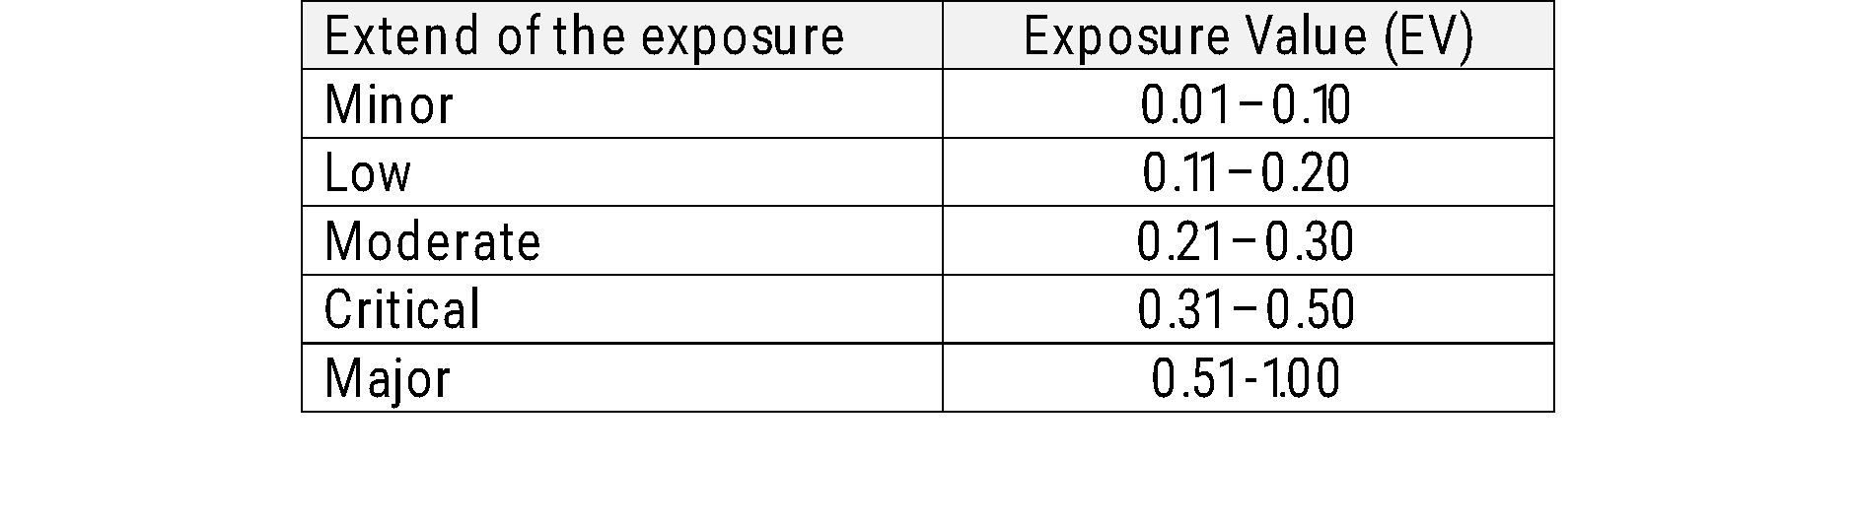
EXPOSURE OF INHABITANTS
Length of water supply network = 54 km
Critical value (1) = 100 km and more
Optimal value (0) = Less than 20 km
Normalised value (Exposure Value – EV) = 0,425
Exposure Level: CRITICAL

Slide 38
RISK ASSESSMENT
Risk Category: Water (D4)
Exposure: Water supply network
Hazard Value = 0,8
Exposure Value = 0,425
Vulnerability Value = 0,58
W_{HV} weight of HV
W_{EV} weight of EV
W_{V} weight of VV
0,5
0,25
RISK LEVEL = 0.66
RATHER NEGATIVE
0,25

