Slide 1

SuPeRBE Training Material
Macro Area of Expertise 6:
SuPeRBE Training Material
Risk Assessment At Small Urban Scale
Hazard: Drought (D)
Climate change and built environment
Area of Expertise 6.1:
Urban Sector: Environment & biodiversity (D7)
Fundamentals of climate change
Risk Category: Damage Risk for Urban Green Spaces (D7.1) & Damage Risk for Street Trees (D7.2)
Level of competence: 2
Level of competence: 1/2/3
Activity 3.2
SuPeRBE Project (CE0200768)
Area of Expertise: 6.2 according
to the CEN Workshop Agreement 17939

Slide 2
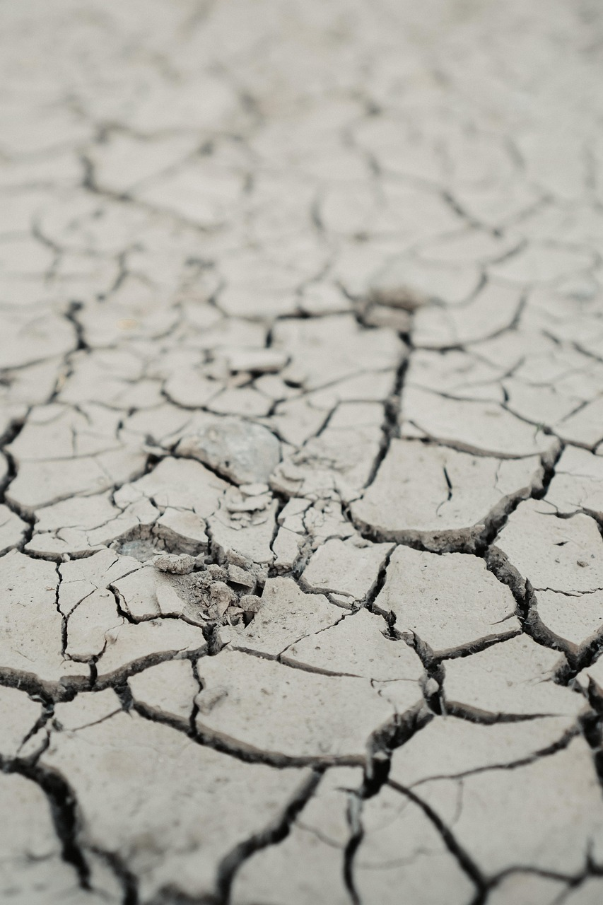
DROUGHT
General Information
“A period of abnormally dry weather long enough to cause a serious hydrological imbalance.” (source: https://www.ipcc.ch/sr15/chapter/glossary/)
Natural phenomenon
Intensified in recent decades by climate change and unsustainable land practices
Human-induced climate change has contributed to increases in droughts due to increased atmospheric evaporative demand induced by increased temperature, decreased relative humidity, and increased net radiation
More regions are affected by drought with increasing global warming
Notes:
- Megadrought – “A megadrought is a very lengthy and pervasive drought, lasting much longer than normal, usually a decade or more” (https://www.ipcc.ch/sr15/chapter/glossary/))
Number of droughts has surged by nearly 30 per cent in frequency and intensity since 2000
result of a complicated set of events driven or amplified by climate change, as well as sometimes the mismanagement of land (For example, a hillside which is deforested is immediately degraded. The land will lose its resilience to extreme weather and will become more susceptible to both drought and flooding.)
WHO: An estimated 55 million people globally are affected by droughts every year, and they are the most serious hazard to livestock and crops in nearly every part of the world. Drought threatens people’s livelihoods, increases the risk of disease and death, and fuels mass migration. Water scarcity impacts 40% of the world’s population, and as many as 700 million people are at-risk of being displaced as a result of drought by 2030
Additional info:
https://news.un.org/en/story/2024/12/1157696
https://www.ipcc.ch/report/ar6/wg1/chapter/chapter-11/
https://www.who.int/health-topics/drought/#tab=tab_1

Slide 3
TYPES OF DROUGHT
Net water availability – caused by precipitation deficits and changes in evapotranspiration
Agricultural drought – caused by a lack of sufficient soil moisture and increased atmospheric evaporative demand
Ecological drought - caused by a lack of sufficient soil moisture and increased atmospheric evaporative demand
Hydrological drought – caused by a lack of runoff and surface water

Slide 4
AFFECTED URBAN SYSTEMS
Water supply system
  Damage risk for water treatment plants
  Damage risk for the water supply network
Environment & biodiversity
  Damage risk for urban green spaces
  Damage risk for street trees
Health
  Health risk for the population
Emergency services
  Efficiency risk for the fire brigade
  Efficiency risk for emergency medical services

Slide 5
RISK ASSESSMENT FOR DAMAGE RISK FOR URBAN GREEN SPACES
HAZARD
DROUGHT
Hazard: Drought
Exposed element: Urban green spaces
EXPOSED ELEMENT
URBAN GREEN SPACES
DAMAGE RISK FOR URBAN GREEN SPACES
RISK CATEGORY

Slide 6
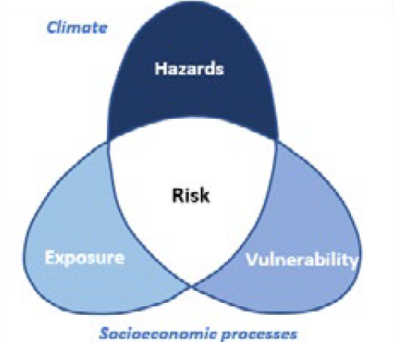
IMPACT CHAIN
HAZARD
DROUGHT
DAMAGE RISK FOR URBAN GREEN SPACES
RISK CATEGORY
URBAN GREEN SPACES
VULNERABILITY
EXPOSED ELEMENT
Adaptive capacity
Sensitivity
RISK ASSESSMENT RESULT

Slide 7
VULNERABILITY CRITERIA
HAZARD
DROUGHT
DAMAGE RISK FOR URBAN GREEN SPACES
Soil stress
Endangered species
Habitats at risk
Areas at risk
Protected urban green spaces
RISK CATEGORY
URBAN GREEN SPACES
VULNERABILITY
EXPOSED ELEMENT
Adaptive capacity
Sensitivity
RISK ASSESSMENT RESULT

Slide 8
VULNERABILITY ASSESSMENT
HAZARD
DROUGHT
CRITERION | INDICATOR
Soil stress | Soil moisture stress
Endangered species | Number of endangered species
Habitats at risk | Percentage of vulnerable habitats
Areas at risk | Percentage of protected areas
Protected urban green spaces | Percentage of watered urban green spaces
DAMAGE RISK FOR URBAN GREEN SPACES
RISK CATEGORY
URBAN GREEN SPACES
VULNERABILITY
EXPOSED ELEMENT
Adaptive capacity
Sensitivity
RISK ASSESSMENT RESULT

Slide 9
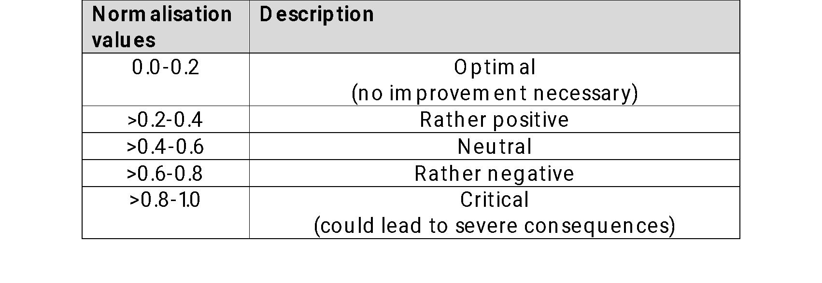
Normalisation
Normalization is a crucial step in this process, as it transforms diverse indicator values into a common scale, typically ranging from 0 to 1. This ensures that each indicator contributes proportionately and comparably to the overall resilience score, regardless of its original unit or magnitude. By applying normalization, we enable meaningful synthesis of data, facilitate benchmarking across different contexts, and support more transparent and objective decision-making in resilience evaluations.
NORMALISATION INTERVAL

Slide 10
D7.1.1 SOIL MOISTURE STRESS
Description:
Number of days in a year on which soil moisture levels are not sufficient to meet the vegetation water demand (based on the requirements of plant species by land use type and the amount of water available in the soil)
Objective:
To quantify soil water deficit as an early indicator of drought, to assess ecosystem and vegetation vulnerability, and to integrate hydro-climatic and land-surface data.
Relevance:
Declining soil moisture is often the first indicator of drought conditions. Soil moisture stress reduces vegetation cover and evapotranspiration, and persistent dryness affects ecosystem stability.

Slide 11
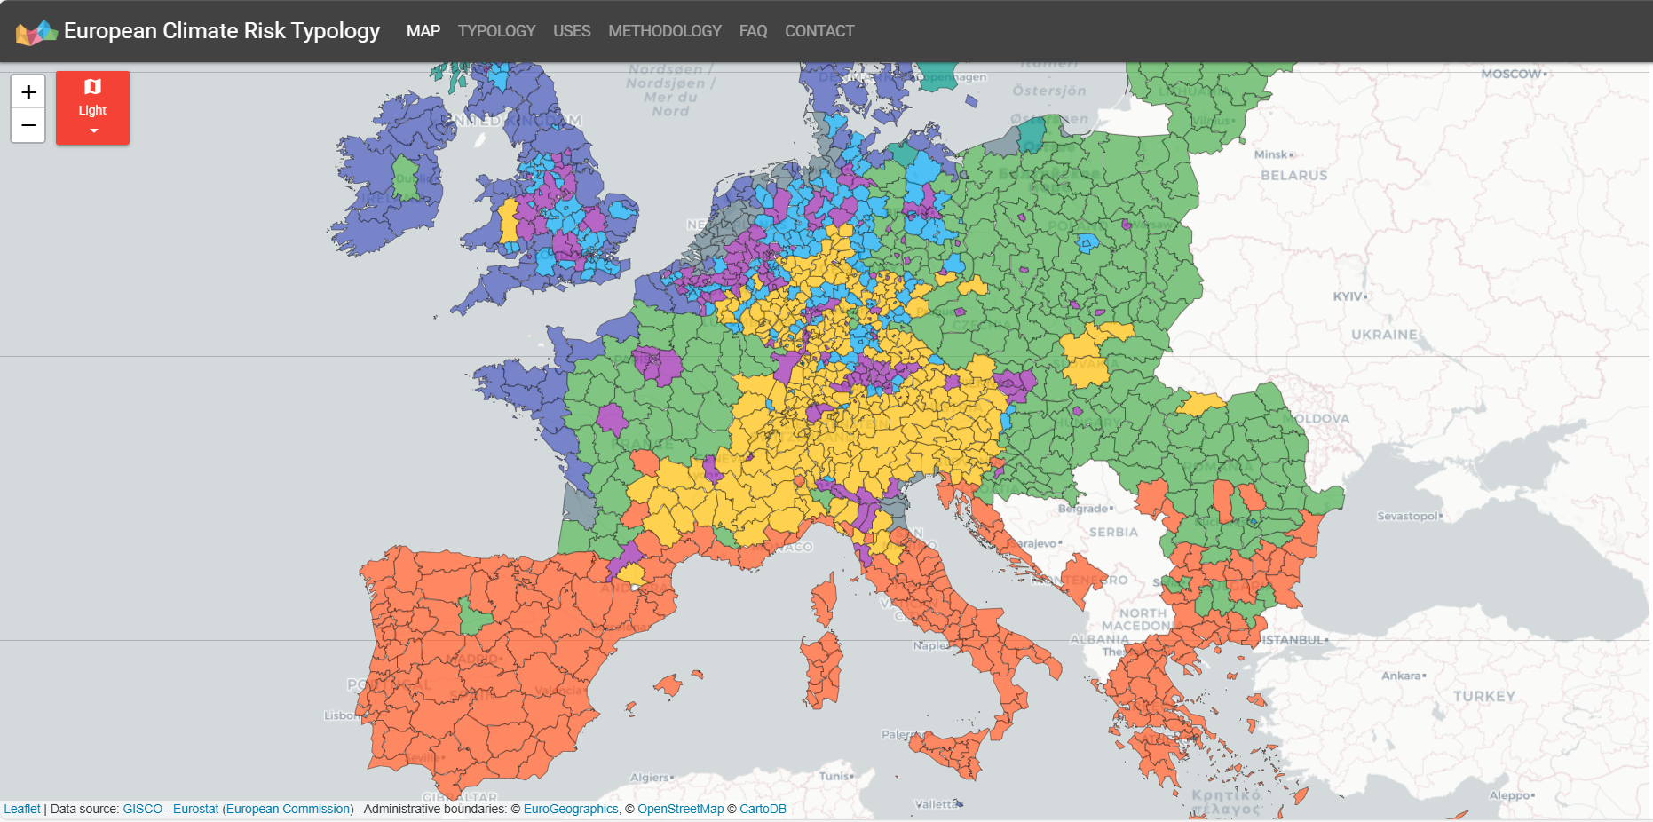
D7.1.1 SOIL MOISTURE STRESS
CALCULATION: STEP-BY-STEP EXAMPLE
Find the data for your area at: https://european-crt.org/map.html or the national database

Slide 12
D7.1.1 SOIL MOISTURE STRESS
BENCHMARKING
Critical value (1) = National average +20%
Optimal value (0) = National average -20%
Range of values: higher is better (HIB)

Slide 13
D7.1.1 SOIL MOISTURE STRESS
NORMALISATION
Indicator
Soil moisture stress: 120
National average: 110
Critical value (1) = 132
Optimal value (0) = 88
Normalised value: 0.73
Vulnerability Level: RATHER NEGATIVE

Slide 14
D7.1.2 NUMBER OF ENDANGERED SPECIES
Description:
The number of species classified as endangered living in the area.
Objective:
To quantify biodiversity vulnerability at the local scale, to assess how drought contributes to species endangerment, to support environmental risk management by identifying ecological hotspots that need protection, and to integrate ecological indicators into drought risk assessment frameworks, linking environmental degradation to long-term sustainability.
Relevance:
Drought reduces surface water availability, making endangered species and species with specialised habitats needs particularly vulnerable. A high (or rising) number of endangered species indicates reduced ecosystem resilience.

Slide 15
D7.1.2 NUMBER OF ENDANGERED SPECIES
CALCULATION: STEP BY STEP
Step 1: Find the number of endangered species living in the area in the local or national database

Slide 16
D7.1.2 NUMBER OF ENDANGERED SPECIES
BENCHMARKING
Critical value (1) = 5 or more endangered species
Optimal value (0) = 1 endangered species
Range of values: lower is better (LIB)

Slide 17
D7.1.2 NUMBER OF ENDANGERED SPECIES
NORMALISATION
Indicator
Number of endangered species: 3
Normalised Value: 0,5
Vulnerability Level: NEUTRAL

Slide 18
D7.1.3 PERCENTAGE OF VULNERABLE HABITAT
Description:
Percentage of area covered by habitats that are at risk of drought. An expert estimates the risk of habitats.
Objective:
To quantify the spatial extent of habitats sensitive to drought stress, and to assess ecosystem exposure and vulnerability to reduced water availability.
Relevance:
Drought reduces soil moisture, groundwater levels and surface water flow, leading to habitat degradation or loss. A high percentage of vulnerable habitats indicates that local biodiversity and ecosystem services are at risk.

Slide 19
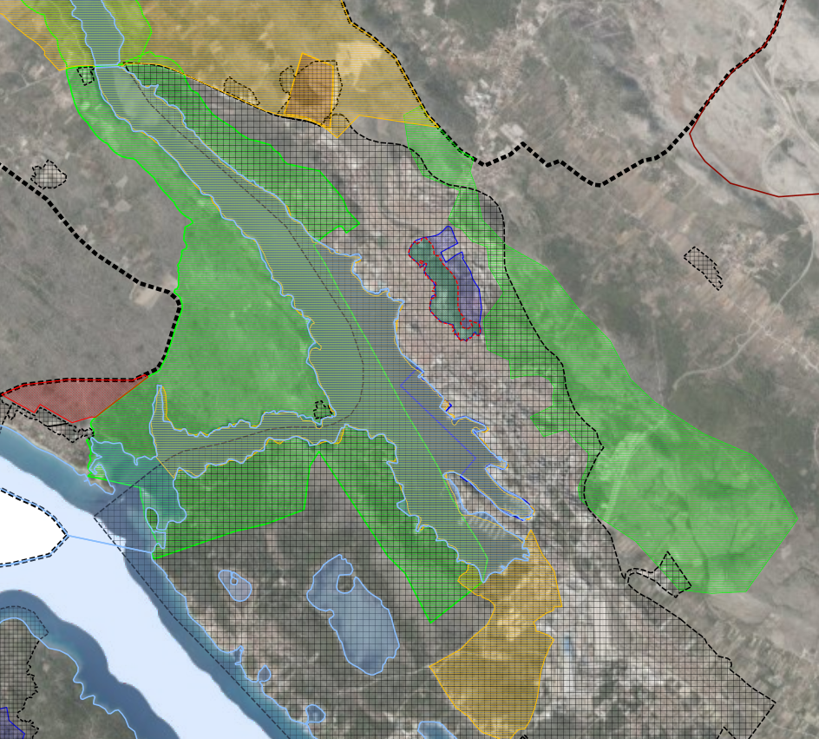

D7.1.3 PERCENTAGE OF VULNERABLE HABITAT
CALCULATION: STEP BY STEP
Step 2: Based on your expert knowledge, estimate which of these habitats are at risk
Step 1: Use the local spatial plan in GIS to identify protected areas, natural habitats, etc.
Step 3: Calculate the area of habitats at risk
Step 4: Divide the area of habitats at risk by the total area of neighbourhood to get a percentage of habitats that are at risk
$$\frac{Habitat at risk (km2)}{Total neighbourhood area (km2)}×100$$

Slide 20
D7.1.3 PERCENTAGE OF VULNERABLE HABITAT
BENCHMARKING
Critical value (1) = 40% or more
Optimal value (0) = 0%
Range of values: lower is better (LIB)

Slide 21
D7.1.3 PERCENTAGE OF VULNERABLE HABITAT
NORMALISATION
Indicator
Percentage of vulnerable habitats: 15%
Normalized Value: 0,38
Vulnerability Level: RATHER POSITIVE

Slide 22
D7.1.4 Percentage of protected areas
Description:
Percentage of area that is under Natura 2000 protection or similar.
Objective:
To quantify the extent of land under environmental protection and evaluate its role in reducing vulnerability, and to provide an indicator of ecological resilience and adaptive capacity within urban areas.
Relevance:
Protected areas often include water-rich or climate-buffering ecosystems that help retain water and maintain microclimates. They harbour biodiversity, ecological stability, and adaptive capacity. In the urban context, the presence of protected areas supports urban cooling, water retention and air quality regulation.

Slide 23

D7.1.4 Percentage of protected areas
CALCULATION: STEP BY STEP
Step 1: Find the area of the Natura 2000 (or similar) protected area in the assessed neighbourhood
Step 2: Divide the Natura 2000 (or similar) area by the the total area of the neighbourhood to get the percentage
$$\frac{Natura 2000 area \left[km2\right]}{Total area \left[km2\right]}×100$$

Slide 24
D7.1.4 Percentage of protected areas
BENCHMARKING
Critical value (1) = 0%
Optimal value (0) = 40% or more
Range of values: higher is better (HIB)

Slide 25
D7.1.4 Percentage of protected areas
NORMALISATION
Indicator
Percentage of protected areas: 12%
Normalized Value: 0,7
Vulnerability Level: Rather negative

Slide 26
D7.1.5 PERCENTAGE OF WATERED URBAN GREEN SPACES
Description:
Percentage of urban green spaces that are regularly watered during the drought periods.
Objective:
To assess the sustainability and resilience of urban green infrastructure under drought conditions, to evaluate how much of a city’s green infrastructure depends on active watering and to what extent it is vulnerable to water scarcity.
Relevance:
Watered green spaces help maintain vegetation vitality, evapotranspiration cooling, and biodiversity habitats. Maintaining green areas mitigates the Urban Heat Island (UHI), and improves air quality.

Slide 27

D7.1.5 PERCENTAGE OF WATERED URBAN GREEN SPACES
CALCULATION: STEP BY STEP
Step 1: Identify the area of all urban green spaces in neighbourhood
Step 3: Divide the area of watered urban green spaces by the total area of urban green spaces to get the percentage
Step 2: Identify the area of urban green spaces that are frequently watered
$\frac{Watered urban green spaces}{All urban green spaces}$ x 100

Slide 28
D7.1.5 PERCENTAGE OF WATERED URBAN GREEN SPACES
BENCHMARKING
Critical value (1) = 0%
Optimal value (0) = 100%
Range of values: higher is better (HIB)

Slide 29
D7.1.5 PERCENTAGE OF WATERED URBAN GREEN SPACES
NORMALISATION
Indicator
Percentage of watered urban green spaces: 40%
Normalised Value: 0,6
Vulnerability Level: Rather negative

Slide 30
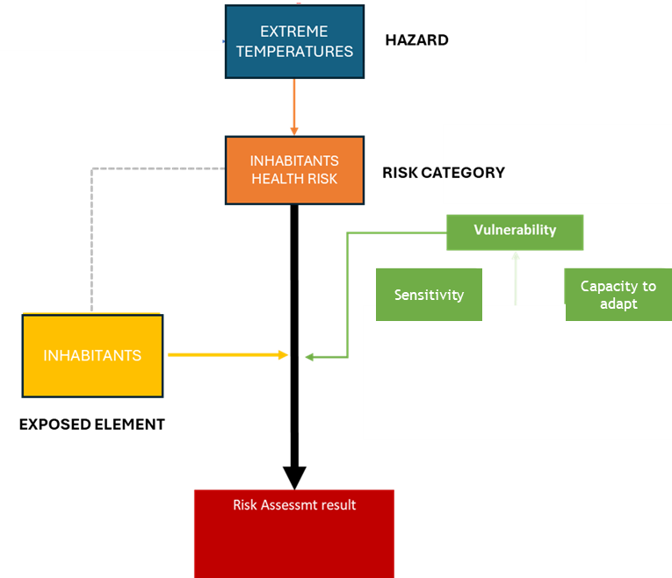
OVERALL VULNERABILITY
Criterion | Normalised value
Soil moisture stress | 0,73
Number of endangered species | 0,5
Percentage of vulnerable habitats | 0,38
Percentage of protected areas | 0,7
Percentage of watered urban green spaces | 0,6

Slide 31
OVERALL VULNERABILITY
Criterion | Normalised value | Weight
Soil moisture stress | 0,73 | 0,25
Number of endangered species | 0,5 | 0,2
Percentage of vulnerable habitats | 0,38 | 0,15
Percentage od protected areas | 0,7 | 0,15
Percentage of watered urban green spaces | 0,6 | 0,25
TOTAL = 1 (100%)

Slide 32
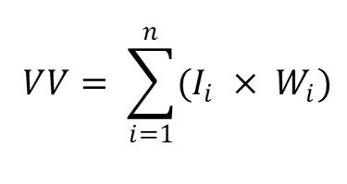
OVERALL VULNERABILITY (VULNERABILITY VALUE – VV)
Criterion | Normalised value | Weight
Soil moisture stress | 0,73 | 0,25
Number of endangered species | 0,5 | 0,2
Percentage of vulnerable habitats | 0,38 | 0,15
Percentage od protected areas | 0,7 | 0,15
Percentage of watered urban green spaces | 0,6 | 0,25
Normalised score
Weight
VV = 0.73 x 0.25 + 0.5 x 0.2 + 0,38 x 0,15 + 0,7 x 0.15 + 0,6 x 0.25 = 0,5945
Vulnerability Value (VV) = 0,5945
Vulnerability Level = RATHER NEGATIVE

Slide 33
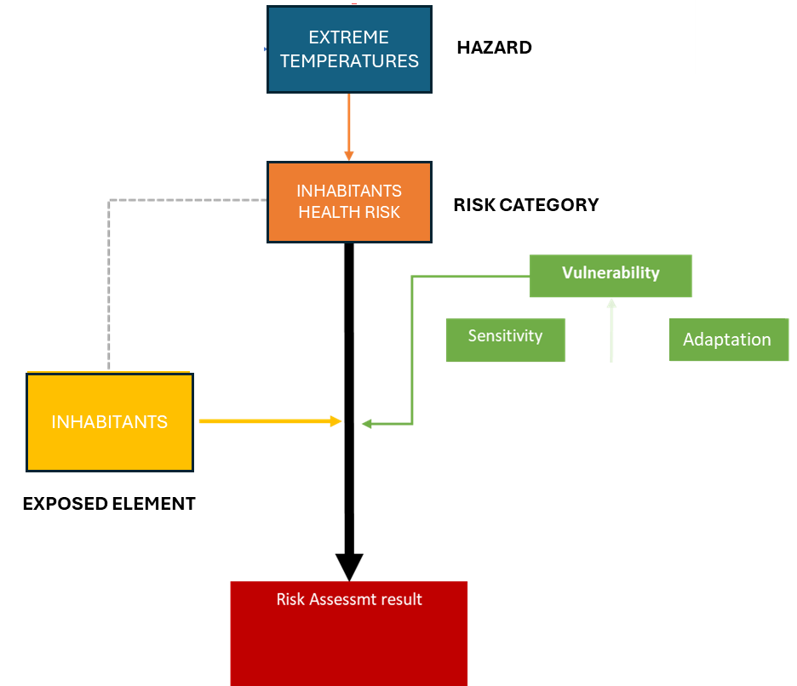
EXPOSURE OF INHABITANTS
AFTER ASSESSING VULNERABILITY, IT IS NECESSARY TO QUANTIFY TWO ADDITIONAL FACTORS TO DETERMINE THE LEVEL OF RISK:
-HAZARD
-EXPOSURE

Slide 34
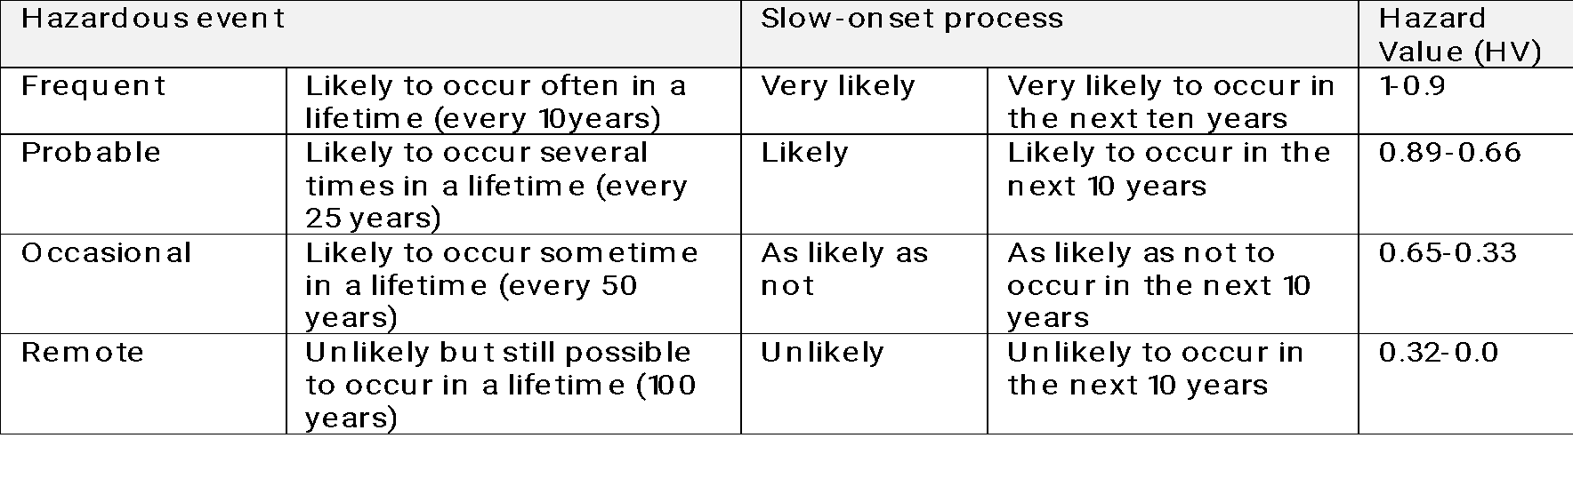
HAZARD LIKELIHOOD
Hazard Value (HV) = 0.6 (Occasional)
THIS INFORMATION IS PROVIDED BY SECAPs

Slide 35
EXPOSED AREA
CODE | CRITERION | INDICATOR
D7.1-E1 | Exposed area | Area of urban green spaces

Slide 36
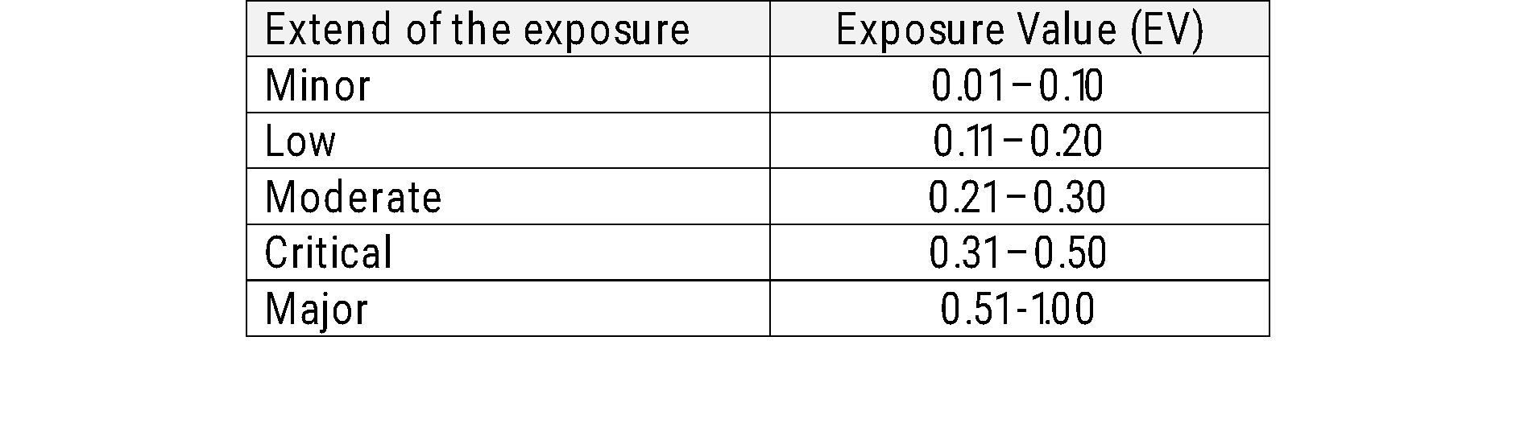
EXPOSURE OF URBAN GREEN SPACES
Area of urban green space = 7
Critical value (1) = 10 km and more
Optimal value (0) = Less than 0,5 km
Normalised value (Exposure Value – EV) = 0,684
Exposure Level: MAJOR

Slide 37
RISK ASSESSMENT
Risk Category: Environment and biodiversity (D7)
Exposure: Damage risk for urban green spaces (D7.1)
Hazard Value = 0,6
Exposure Value = 0,684
Vulnerability Value = 0,5945
W_{HV} weight of HV
W_{EV} weight of EV
W_{V} weight of VV
0,5
0,25
RISK LEVEL = 0.62
RATHER NEGATIVE
0,25

