Slide 1

SuPeRBE Training Material
Macro Area of Expertise:
SuPeRBE Training Material
B14. Floods – Location
Climate change and built environment
Area of Expertise:
B14.1 Proximity
Fundamentals of climate change
Level of competence: 1,2,3
Level of competence: 2
Activity 3.2
SuPeRBE Project (CE0200768)

Slide 2

ç
ç
SuPeRBE Training Material
Macro Area of Expertise 10:
SuPeRBE Training Material
Risk Assessment At Building Scale
Hazard: FLOODS (B)
Climate change and built environment
Area of Expertise AD5.5:
Building Element: Location (B14)
Fundamentals of climate change
Risk Category: Proximity (B14.1)
Level of competence: 2
Level of competence: 1/2/3
Activity 3.2
SuPeRBE Project (CE0200768)

Slide 3
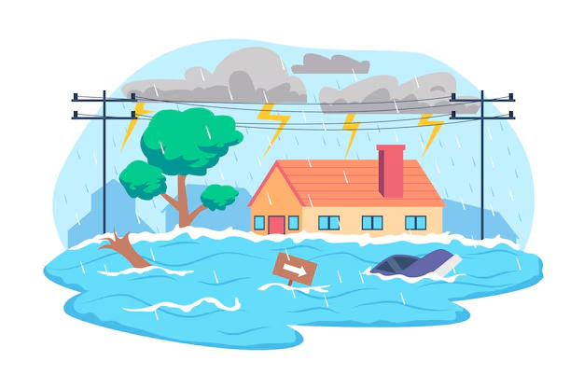
FLOODS
General Information
Floods happen when water overflows onto normally dry land, caused by heavy rain, river overflow, storm surges, or melting snow and ice. They are one of the most frequent and damaging climate-related hazards.
Why does it happen?
More extreme rainfall from climate change overwhelms rivers and drainage.
Sea-level rise increases coastal flooding and storm surge impacts.
Urbanization (paved surfaces, poor drainage) makes cities more flood-prone.
Deforestation and land use change reduce natural water absorption.
How frequent or severe?
Floods are happening more often and are becoming more intense, affecting millions of people annually. Some regions see Floods with 1-in-100 year intensity occurring far more frequently.

Slide 4
FLOODS AND BUILDINGS
Exposure to floods can lead to:
Water infiltration, through façades, windows, basements, and ground level openings.
Deterioration of building loading capacity, through the water infiltration on structural system (walls, columns, piles, foundations)
Sewer backflow, re-entering buildings through floor drains.
Disruption of building operation, including temporary closure or limited access to some areas, and disruption in electricity and clean water services.
Damage to stored items, materials, appliances, personal belongings.
Temporary displacement of residents or workers
Impacts on public health due to derived issues, such as mold exposure, chronic respiratory conditions, and economic hardship that worsens health inequalities.

Slide 5
RISK ASSESSMENT FOR THE BUILDINGS
Hazard: Floods
Exposed Element: Building’s Location
HAZARD
FLOODS
EXPOSED ELEMENT
Building’s Proximity
Building’s Location
RISK CATEGORY

Slide 6
IMPACT CHAIN
FLOODS
ISSUE
Damage risk for Buildings Location
RISK CATEGORY
Building’s (Proximity)
VULNERABILITY
CRITERION
EXPOSED ELEMENT
Sensitivity
Level of
Adaptation
RISK LEVEL
INDICATOR
VALUE OF THE INDICATOR

Slide 7
VULNERABILITY CRITERIA AND INDICATORS
FLOODS
ISSUE
Code | Criterion | Indicator
B14.1.1 | Natural Flood Defence Buffers | Use of natural barriers like vegetation around site to slow water flow and limit water exposure
B14.1.2 | Protective barriers | Use of removable flood barriers or walls to protect the site without altering its appearance and structural integrity
Damage risk for Building’s Location
RISK CATEGORY
Building’s Proximity
VULNERABILITY
CRITERION
EXPOSED ELEMENT
Sensitivity
Level of
Adaptation
RISK LEVEL
INDICATOR
VALUE OF THE INDICATOR

Slide 8
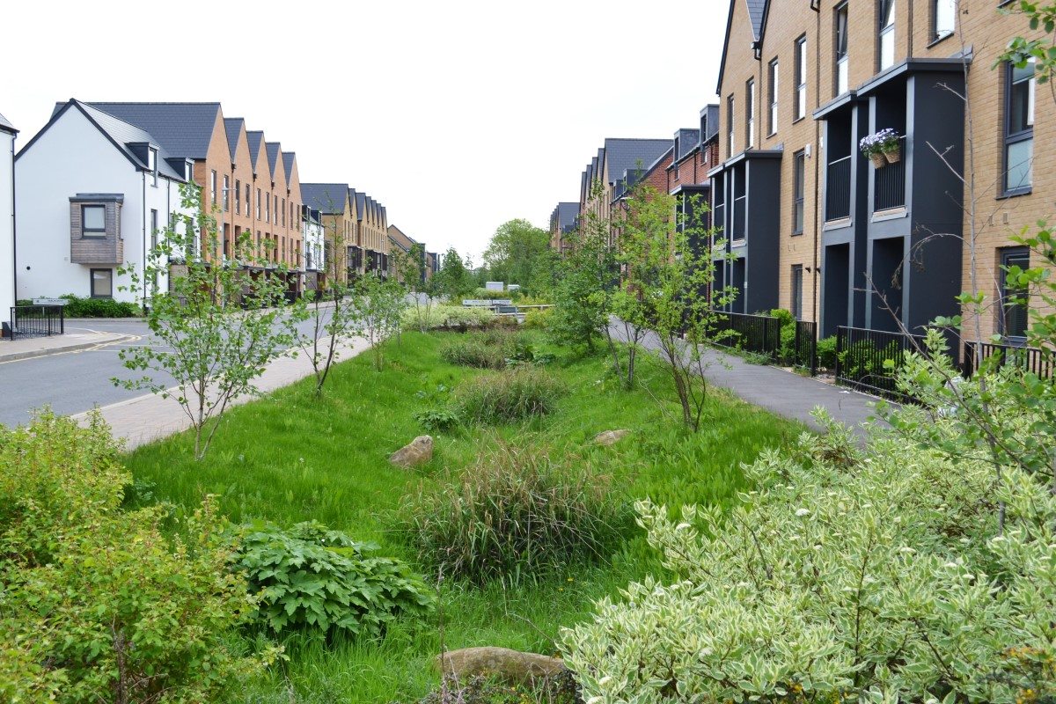
B14.1.1. Natural Flood Defence Buffers
Description:
This criteria refers to the implementation of natural flood defence buffers such as vegetation, wetlands, or earth berms around the site to reduce water flow velocity and absorb floodwaters reducing flood exposure.
Objective:
Assess whether the site integrates nature-based buffering strategies as part of its flood resilience approach.
Relevance:
Natural flood defence buffers enhance urban climate resilience by providing a low-impact, multifunctional protection strategy that complements structural flood measures. They reduce surface runoff, improve infiltration, and mitigate erosion while delivering co-benefits such as biodiversity enhancement, microclimate regulation, and improved public space quality. Their passive nature makes them particularly robust under climate uncertainty and suitable for long-term adaptation strategies

Slide 9
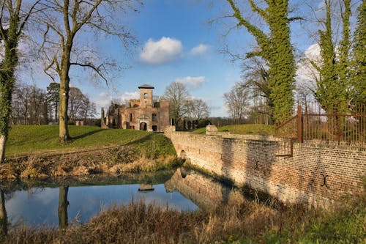
B14.1.1. Natural Flood Defence Buffers
Indicator
Use of nature-based barriers like vegetation around site to slow water flow and limit water exposure.
Type of value: - (qualitative evaluation)
Units: Boolean
Critical value (1) = Absence of natural flood defence buffers at the building site
Optimal value (0) = Continuous natural flood defence buffers that are explicitly integrated into the flood risk mitigation strategy.

Slide 10
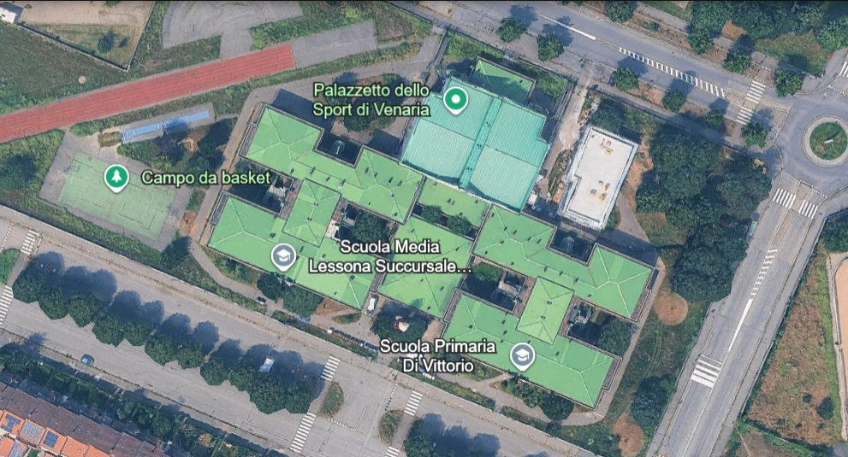
B14.1.1. Natural Flood Defence Buffers
CALCULATION: STEP BY STEP
Step 1: Data Collection
Review Landscape design documents, environmental impact assessments, and satellite imagery to determine the existence of Nature-based flood defence buffers in the proximity of the assessed building.
e.g. Venaria Reale, Piedmont, Italy
Primary school
Natural Flood Defence Buffer within 10 meters of the Building’s perimeter? – Yes
Break down: Green Infrastructure around the perimeter of the building.
Normalized value: Yes → 0
Step 2: Indicator Calculation
Define the availability and functionality of natural flood defence buffers in the proximity of the Building’s perimeter (e.g., Yes/No).
Step 3: Normalize the result
The value is normalised according to Boolean criteria.
      If the indicator has a positive evaluation (YES), the normalized value is 0 (Optimal)
If the indicator has a negative evaluation (NO), the normalized value is 1 (Critical)
Optimal
*Illustrative value for example purposes. Does not represent the current conditions of the case study

Slide 11
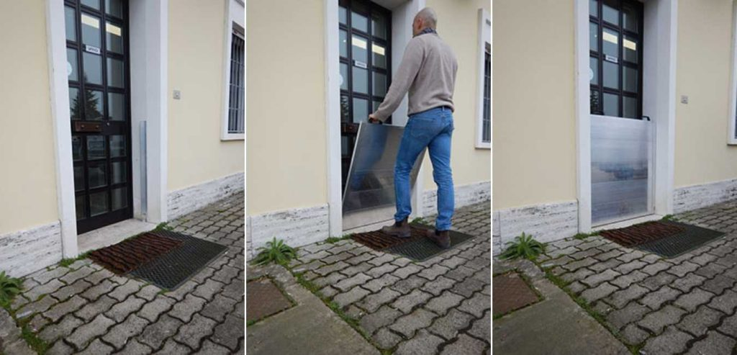
B14.1.2. Protective Barriers
Description:
This criteria evaluates the use of removable or deployable flood barriers and walls designed to protect the site during flood events while preserving the site's appearance and structural integrity when not in use.
Objective:
Assess whether adaptable and operational flood protection measures are incorporated into the site design, including their availability, integration, and readiness for deployment during flood events.
Relevance:
Protective barriers are highly relevant for urban areas where permanent flood defences are impractical or undesirable due to spatial, aesthetic, or heritage constraints. Their deployable nature allows targeted protection during extreme events, supporting adaptive flood risk management under increasing climate variability. When well designed and supported by clear deployment procedures, these systems significantly reduce site vulnerability while maintaining everyday functionality and visual quality.

Slide 12
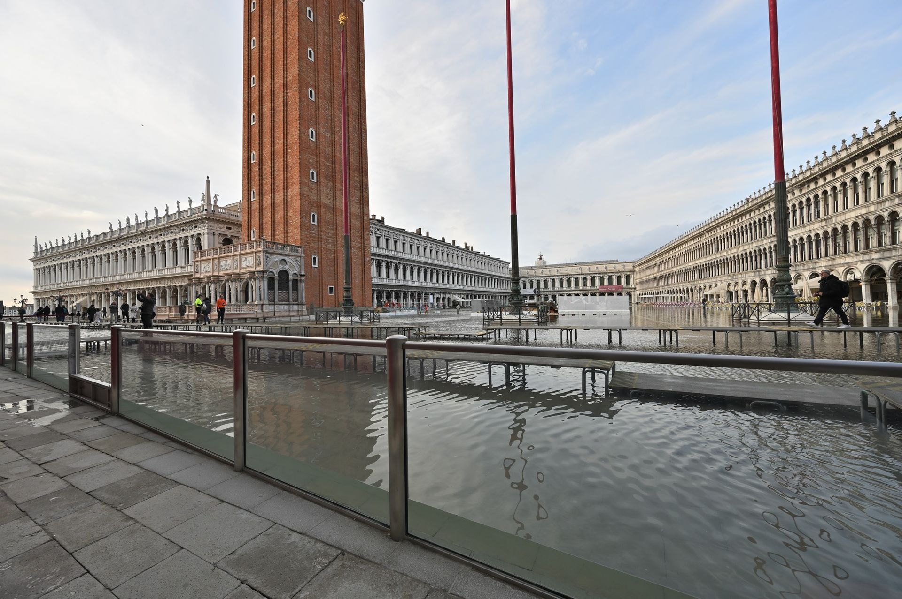
B14.1.2. Protective Barriers
Indicator
Use of removable flood barriers or walls to protect the site without altering its appearance and structural integrity.
Type of value: High value is better
Units: Boolean
Critical value (1) = No protective barriers installed
Optimal value (0) = Optimal installation of protective barriers

Slide 13
B14.1.2. Protective Barriers
CALCULATION: STEP BY STEP
Step 1: Data Collection
Review design documents and operational plans to verify specifications for removable flood barriers, their planned storage, and deployment procedures.
e.g. Venaria Reale, Piedmont, Italy
Primary school
Removable flood protective barriers available and functioning? - No
Normalized value: No → 1
Step 2: Indicator Calculation
Define the availability and functionality of removable flood protective barriers (e.g., Yes/No).
Critical
Step 3: Normalize the result
The value is normalised according to Boolean criteria.
      If the indicator has a positive evaluation (YES), the normalized value is 0 (Optimal)
If the indicator has a negative evaluation (NO), the normalized value is 1 (Critical)
*Illustrative value for example purposes. Does not represent the current

