Slide 1

SuPeRBE Training Material
Macro Area of Expertise:
SuPeRBE Training Material
B10. Floods – Sanitary Systems
Climate change and built environment
Area of Expertise:
B10.4 Drainage Systems
Fundamentals of climate change
Level of competence: 1,2,3
Level of competence: 2
Activity 3.2
SuPeRBE Project (CE0200768)

Slide 2

ç
ç
SuPeRBE Training Material
Macro Area of Expertise 10:
SuPeRBE Training Material
Risk Assessment At Building Scale
Hazard: FLOODS (B)
Climate change and built environment
Area of Expertise AD5.5:
Building Element: Sanitary Systems (B10)
Fundamentals of climate change
Risk Category: Drainage Systems (B10.4)
Level of competence: 2
Level of competence: 1/2/3
Activity 3.2
SuPeRBE Project (CE0200768)

Slide 3

FLOODS
General Information
Floods happen when water overflows onto normally dry land, caused by heavy rain, river overflow, storm surges, or melting snow and ice. They are one of the most frequent and damaging climate-related hazards.
Why does it happen?
More extreme rainfall from climate change overwhelms rivers and drainage.
Sea-level rise increases coastal flooding and storm surge impacts.
Urbanization (paved surfaces, poor drainage) makes cities more flood-prone.
Deforestation and land use change reduce natural water absorption.
How frequent or severe?
Floods are happening more often and are becoming more intense, affecting millions of people annually. Some regions see Floods with 1-in-100 year intensity occurring far more frequently.

Slide 4
FLOODS AND BUILDINGS
Exposure to floods can lead to:
Water infiltration, through façades, windows, basements, and ground level openings.
Deterioration of building loading capacity, through the water infiltration on structural system (walls, columns, piles, foundations)
Sewer backflow, re-entering buildings through floor drains.
Disruption of building operation, including temporary closure or limited access to some areas, and disruption in electricity and clean water services.
Damage to stored items, materials, appliances, personal belongings.
Temporary displacement of residents or workers
Impacts on public health due to derived issues, such as mold exposure, chronic respiratory conditions, and economic hardship that worsens health inequalities.

Slide 5
RISK ASSESSMENT AT THE BUILDING SCALE
Hazard: Floods
Exposed Element: Drainage Systems
HAZARD
FLOODS
EXPOSED ELEMENT
Drainage Systems
Damage risk for the Sanitary Systems
RISK CATEGORY

Slide 6
IMPACT CHAIN
FLOODS
ISSUE
Damage risk for Sanitary System
RISK CATEGORY
Drainage Systems
VULNERABILITY
CRITERION
EXPOSED ELEMENT
Sensitivity
Level of
Adaptation
RISK LEVEL
INDICATOR
VALUE OF THE INDICATOR

Slide 7
VULNERABILITY CRITERIA AND INDICATORS
FLOODS
ISSUE
Damage risk for Sanitary Systems
RISK CATEGORY
Code | Criterion | Indicator
B10.4.1 | Ground Level Hydrostatic Flood Vents | Size of ground level hydrostatic flood vents
Drainage
Systems
VULNERABILITY
CRITERION
EXPOSED ELEMENT
Sensitivity
Level of
Adaptation
RISK LEVEL
INDICATOR
VALUE OF THE INDICATOR

Slide 8
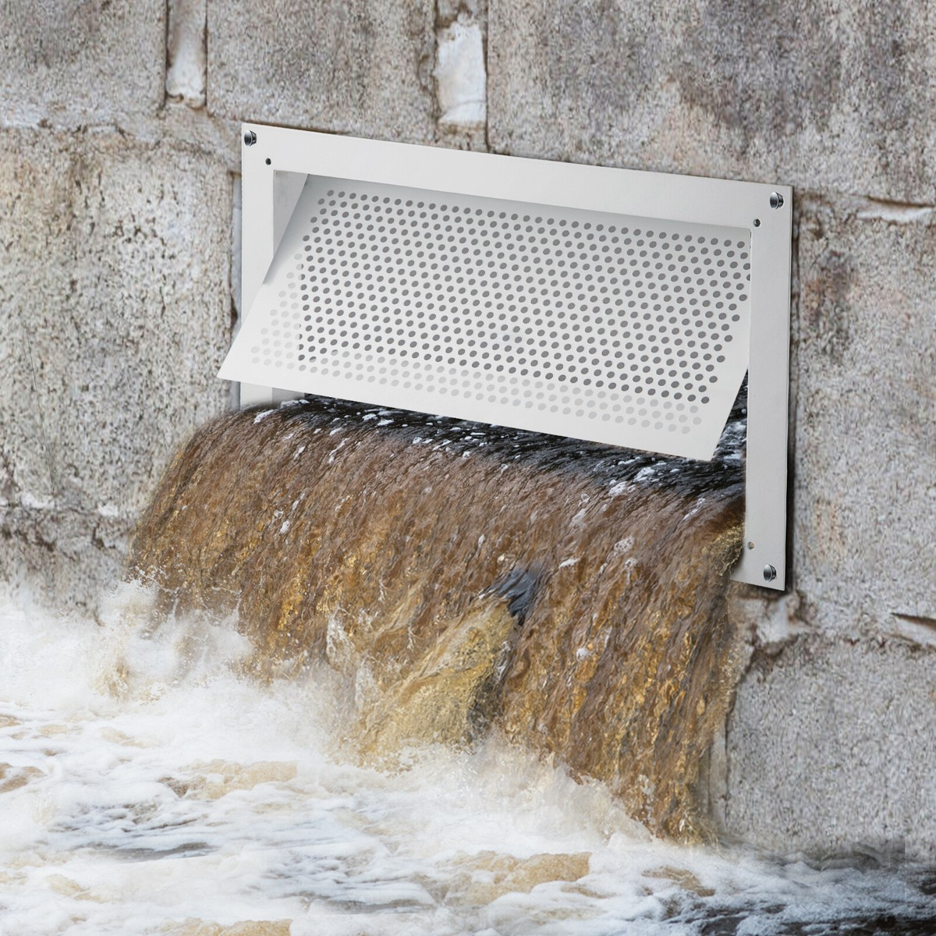
B10.4.1. Ground Level Hydrostatic Flood Vents
Description:
This criteria measures the size and number of ground-level hydrostatic flood vents designed to equalize water pressure and reduce structural damage during flooding.
Objective:
To assess whether the total size and number of ground-level hydrostatic flood vents are sufficient to equalize water pressure between the interior and exterior of enclosed spaces during flooding, thereby reducing structural stress and damage..
Relevance:
It is critical for building flood resilience, as properly sized hydrostatic flood vents help prevent wall failure, foundation damage, and costly structural repairs. By allowing controlled water entry and pressure equalization, the indicator supports safer building performance during flood events, reduces post-flood recovery needs, and ensures compliance with flood-resilient design standards and regulations..

Slide 9
B10.4.1. Ground Level Hydrostatic Flood Vents
Indicator
Size of ground level hydrostatic flood vents
Type of value: High value is better
Units: m² of flood vent area per m² of enclosed area
Critical value (1) = 0
Optimal value (0) = 0.01 m² of flood vent opening per 1 m² of enclosed

Slide 10
B10.4.1. Ground Level Hydrostatic Flood Vents
CALCULATION: STEP BY STEP
$$Indicator=Size of ground level hydrostatic flood vents$$
Step 1: Data Collection
Retrieve the design floorplans and drawings of the analysed building
Review design drawings and specifications to verify planned size and number of hydrostatic flood vents
e.g. Veneria Reale, Piedmont, Italy
Primary school
Number of flood vents: 8
Total flood vent area: 0.9 m²
Building’s enclosed area: 110 m²
Compared to the proposed optimal value: 6 m
Indicator:
$$\frac{0.9}{110}=0.0082$$
$$0.0082$$ m² of flood vent per m² of building’s enclosed area
Step 2: Indicator Calculation
Evaluate the total size (sum) of existing hydrostatic flood vents in the building of analysis
Compare this area value with the enclosed area of the building of analysis
Evaluate if the building meet resilience standards.
*Illustrative value for example purposes. Does not represent the current conditions of the case study

Slide 11
B10.4.1. Ground Level Hydrostatic Flood Vents
CALCULATION: STEP BY STEP
Step 3: Normalize the result
The value is normalised applying the following formula (For Indicators where High Value is Better):
e.g. Veneria Reale, Piedmont, Italy
Primary school
Period of study – January 2025
$$Xnorm= \frac{xmax−xi}{xmax− xmin}$$
$$Xnorm=\frac{0.01 −0.0082}{0.01 −0}​=0.18$$
where:
Xi: value of the indicator
X_{max} = optimal indicator’s value (corresponding to score 0)
X_{min} = critical indicator’s value (corresponding to score 1)
$$Xnorm=0.18$$
Normalisation values | Description
0.1 | Optimal (No improvement necessary)
0.3 | Rather positive
0.5 | Neutral
0.7 | Rather negative
0.9 | Critical (Could lead to severe consequences)
Rather Positive - Optimal

