Slide 1

SuPeRBE Training Material
Macro Area of Expertise:
SuPeRBE Training Material
B4. Floods - Facade
Climate change and built environment
Area of Expertise:
B 4.2 Façade Openings
Fundamentals of climate change
Level of competence: 1,2,3
Level of competence: 2
Activity 3.2
SuPeRBE Project (CE0200768)

Slide 2

ç
ç
SuPeRBE Training Material
Macro Area of Expertise 10:
SuPeRBE Training Material
Risk Assessment At Building Scale
Hazard: FLOODS (B)
Climate change and built environment
Area of Expertise AD5.5:
Building Element: FAÇADE (B4)
Fundamentals of climate change
Risk Category: Façade Openings (B4.2)
Level of competence: 2
Level of competence: 1/2/3
Activity 3.2
SuPeRBE Project (CE0200768)

Slide 3

FLOODS
General Information
Floods happen when water overflows onto normally dry land, caused by heavy rain, river overflow, storm surges, or melting snow and ice. They are one of the most frequent and damaging climate-related hazards.
Why does it happen?
More extreme rainfall from climate change overwhelms rivers and drainage.
Sea-level rise increases coastal flooding and storm surge impacts.
Urbanization (paved surfaces, poor drainage) makes cities more flood-prone.
Deforestation and land use change reduce natural water absorption.
How frequent or severe?
Floods are happening more often and are becoming more intense, affecting millions of people annually. Some regions see Floods with 1-in-100 year intensity occurring far more frequently.

Slide 4
FLOODS AND BUILDINGS
Exposure to floods can lead to:
Water infiltration, through façades, windows, basements, and ground level openings.
Deterioration of building loading capacity, through the water infiltration on structural system (walls, columns, piles, foundations)
Sewer backflow, re-entering buildings through floor drains.
Disruption of building operation, including temporary closure or limited access to some areas, and disruption in electricity and clean water services.
Damage to stored items, materials, appliances, personal belongings.
Temporary displacement of residents or workers
Impacts on public health due to derived issues, such as mold exposure, chronic respiratory conditions, and economic hardship that worsens health inequalities.

Slide 5
RISK ASSESSMENT FOR THE HEALTH OF INHABITANTS
Hazard: Floods
Exposed Element: Façade Openings
HAZARD
FLOODS
EXPOSED ELEMENT
Façade Openings
Damage risk for Façades
RISK CATEGORY

Slide 6
IMPACT CHAIN
FLOODS
ISSUE
Damage risk for Façades
RISK CATEGORY
Façade
Openings
VULNERABILITY
CRITERION
EXPOSED ELEMENT
Sensitivity
Level of
Adaptation
RISK LEVEL
INDICATOR
VALUE OF THE INDICATOR

Slide 7
VULNERABILITY CRITERIA AND INDICATORS
FLOODS
ISSUE
Code | Criterion | Indicator
B4.2.1 | Safe Windows and Shutters | Share of windows protected against hail.
B4.2.2 | Sealing Effectiveness | Share of openings with effective water/air infiltration protection.
Damage risk for Façades
RISK CATEGORY
Façade
Openings
VULNERABILITY
CRITERION
EXPOSED ELEMENT
Sensitivity
Level of
Adaptation
RISK LEVEL
INDICATOR
VALUE OF THE INDICATOR

Slide 8
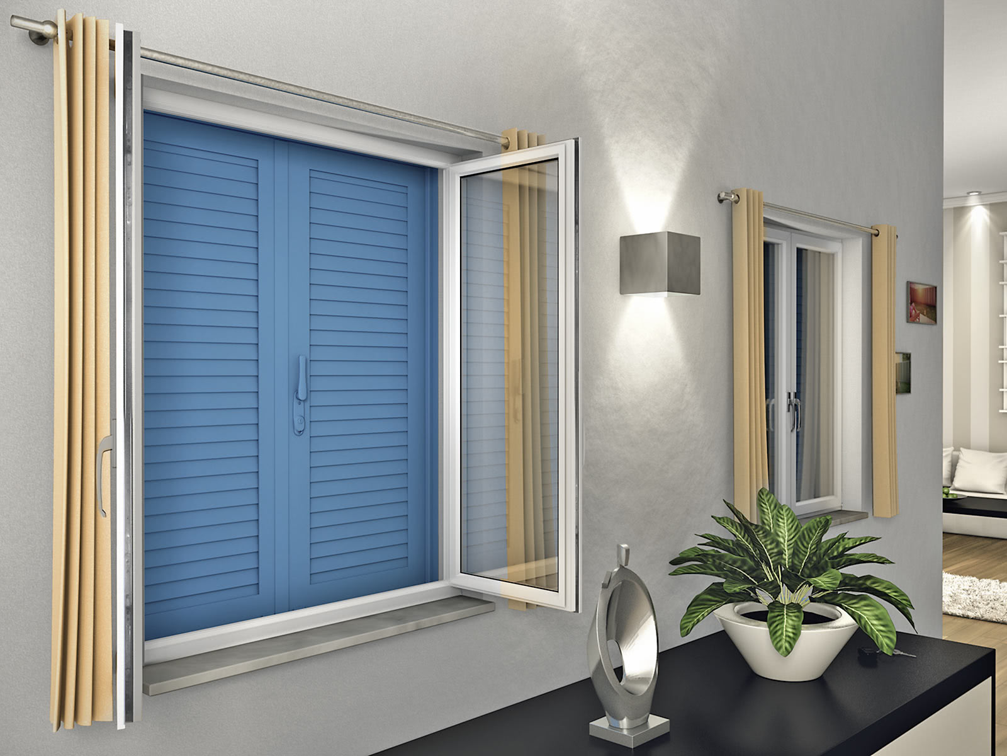
B4.2.1. Safe Windows and Shutters
Description:
This indicator evaluates the percentage of windows equipped with hail-resistant glazing, shutters, or protective screens designed to withstand hail impact.
Objective:
To assess the building’s ability to reduce damage from hail events by evaluating the percentage of windows equipped with hail-resistant glazing, shutters, or protective screens designed to withstand hail impact without loss of performance or safety function.
Relevance:
Windows protected with hail-resistant materials or impact-tested shutters significantly decrease the risk of glass breakage, interior water infiltration, and costly post-event repairs during severe hailstorms. Ensuring robust window protection enhances occupant safety, safeguards interior assets, and preserves building functionality during extreme weather conditions. Increasing the share of protected windows strengthens overall building resilience, helps maintain property value, and supports climate-adaptive design in areas susceptible to frequent or intense hail events.

Slide 9

B4.2.1. Safe Windows and Shutters
Indicator
Share of windows protected against hail
Type of value: High value is better
Units: %
Critical value (1) = 0%
Optimal value (0) = 100%
$$Indicator=\left(\frac{Number of protected windows}{Total number of windows}​\right)×100$$

Slide 10
B4.2.1. Safe Windows and Shutters
CALCULATION: STEP BY STEP
$$Indicator=(\frac{Number of protected windows}{Total number of windows}​)×100$$
Step 1: Data Collection
Get the information about the number of protected windows of the investigated building during the year of assessment: hail-resistant or impact-resistant glazing, certified shutters or storm panels, protective external screens designed for hail impact. (Numerator)
Get the information about the total number of windows of the investigated building during the year of assessment (denominator).
e.g. Veneria Reale, Piedmont, Italy
Primary school
Period of study – January 2025
Number of protected windows: 44
Total number of windows: 120
$\left(\frac{44}{120}​\right)×100$ = 36,6% of protected windows in the building
Step 2: Indicator Calculation
Divide the number of protected windows by the total number of windows, and multiply by 100
*Illustrative value for example purposes. Does not represent the current conditions of the case study

Slide 11


B4.2.1. Safe Windows and Shutters
CALCULATION: STEP BY STEP
Step 3: Normalize the result
The value is normalised applying the following formula (For Indicators where High Value is Better):
e.g. Veneria Reale, Piedmont, Italy
Primary school
Period of study – January 2025
$$Xnorm= \frac{xmax−xi}{xmax− xmin}$$
$$Xnorm=\frac{100 −36,6}{100 −0}​=0,63$$
where:
Xi: value of the indicator
X_{max} = optimal indicator’s value (corresponding to score 0)
X_{min} = critical indicator’s value (corresponding to score 1)
$$Xnorm=0.63$$
Normalisation values | Description
0.1 | Optimal (No improvement necessary)
0.3 | Rather positive
0.5 | Neutral
0.7 | Rather negative
0.9 | Critical (Could lead to severe consequences)
Neutral

Slide 12
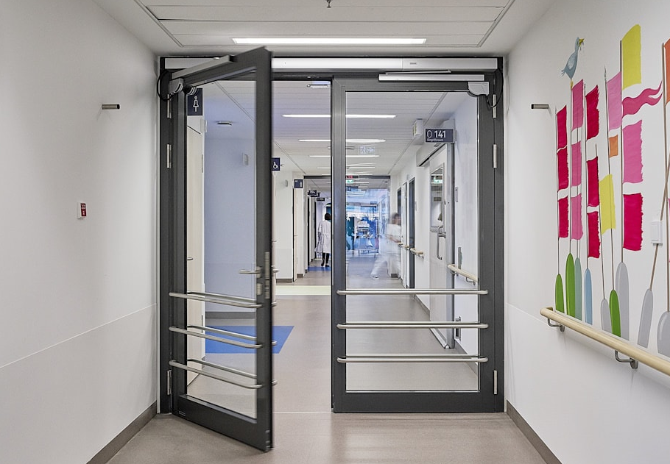
B4.2.2. Sealing Effectiveness
Description:
This indicator measures the percentage of building openings (e.g. windows, doors, vents) equipped with effective seals, gaskets, or membranes to prevent water and air infiltration.
Objective:
To assess how effectively the building envelope limits unwanted water and air infiltration through its openings. Its goal is to verify the presence of protective measures that reduce infiltration risks and support building resilience and energy efficiency.
Relevance:
Proper sealing of openings is essential for protecting the building against climate-related hazards such as wind-driven rain, humidity, and strong winds. Effective seals and gaskets help prevent moisture penetration, mold formation, and indoor air leakage, improving structural durability and indoor comfort. Furthermore, limiting infiltration reduces uncontrolled heat exchange, supporting thermal performance and decreasing energy demand for heating and cooling. This indicator directly contributes to safer, healthier, and more energy-efficient buildings, particularly in areas exposed to heavy rain, storms, or temperature fluctuations.

Slide 13
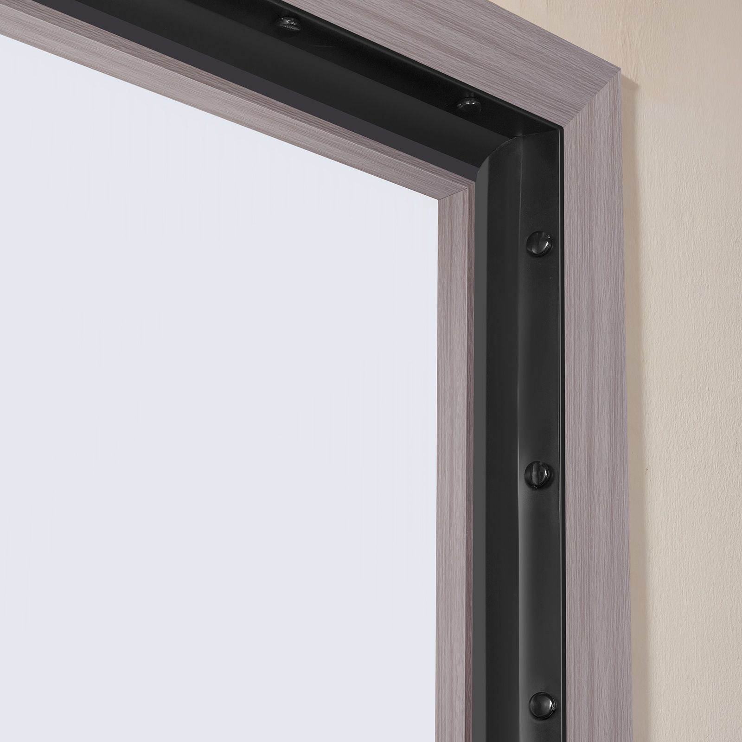

B4.2.2. Sealing Effectiveness
Indicator
Share of openings with effective water/air infiltration protection
Type of value: High value is better
Units: %
Critical value (0) = 0%
Optimal value (1) = 100%
$$Indicator=\left(\frac{Protected openings to infiltration​}{Total openings} \right)×100$$

Slide 14

B4.2.2. Sealing Effectiveness
CALCULATION: STEP BY STEP
$$Indicator=\left(\frac{Protected openings to infiltration​}{Total openings} \right)×100$$
Step 1: Data Collection
Get the information about the number of protected openings of the investigated building during the year of assessment: effective seals, gaskets, or membranes to prevent water and air infiltration.. (Numerator)
Get the information about the total number of openings of the investigated building during the year of assessment (denominator).
e.g. Veneria Reale, Piedmont, Italy
Primary school
Period of study – January 2025
Number of protected openings: 60
Total number of openings: 230
$(\frac{60}{230}​)×100$ = 26% of protected openings in the building
Step 2: Indicator Calculation
Divide the number of protected openings by the total number of openigns, and multiply by 100
*Illustrative value for example purposes. Does not represent the current

Slide 15

B4.2.2. Sealing Effectiveness
CALCULATION: STEP BY STEP
Step 3: Normalize the result
The value is normalised applying the following formula (For Indicators where High Value is Better):
e.g. Veneria Reale, Piedmont, Italy
Primary school
Period of study – January 2025
$$Xnorm= \frac{xmax−xi}{xmax− xmin}$$
$$Xnorm=\frac{100 −26}{100 −0}​=0,74$$
where:
Xi: value of the indicator
X_{max} = optimal indicator’s value (corresponding to score 0)
X_{min} = critical indicator’s value (corresponding to score 1)
$$Xnorm=0.74$$
Normalisation values | Description
0.1 | Optimal (No improvement necessary)
0.3 | Rather positive
0.5 | Neutral
0.7 | Rather negative
0.9 | Critical (Could lead to severe consequences)
Rather negative

