Slide 1

SuPeRBE Training Material
Macro Area of Expertise:
SuPeRBE Training Material
B8. Floods – Energy System
Climate change and built environment
Area of Expertise:
B 8.3 Electricity generation and distribution
Fundamentals of climate change
Level of competence: 1,2,3
Level of competence: 2
Activity 3.2
SuPeRBE Project (CE0200768)

Slide 2

ç
ç
SuPeRBE Training Material
Macro Area of Expertise 10:
SuPeRBE Training Material
Risk Assessment At Building Scale
Hazard: FLOODS (B)
Climate change and built environment
Area of Expertise AD5.5:
Building Element: Energy System (B8)
Fundamentals of climate change
Risk Category: Electricity generation and distribution (B8.3)
Level of competence: 2
Level of competence: 1/2/3
Activity 3.2
SuPeRBE Project (CE0200768)

Slide 3
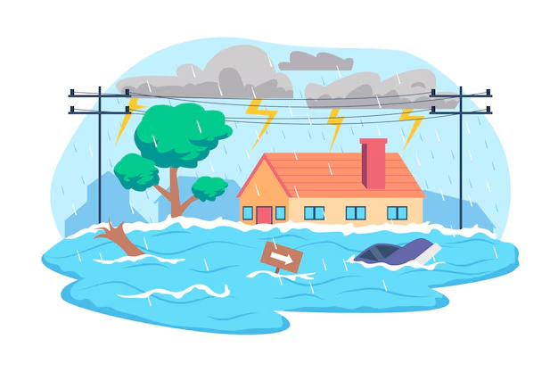
FLOODS
General Information
Floods happen when water overflows onto normally dry land, caused by heavy rain, river overflow, storm surges, or melting snow and ice. They are one of the most frequent and damaging climate-related hazards.
Why does it happen?
More extreme rainfall from climate change overwhelms rivers and drainage.
Sea-level rise increases coastal flooding and storm surge impacts.
Urbanization (paved surfaces, poor drainage) makes cities more flood-prone.
Deforestation and land use change reduce natural water absorption.
How frequent or severe?
Floods are happening more often and are becoming more intense, affecting millions of people annually. Some regions see Floods with 1-in-100 year intensity occurring far more frequently.

Slide 4
FLOODS AND BUILDINGS
Exposure to floods can lead to:
Water infiltration, through façades, windows, basements, and ground level openings.
Deterioration of building loading capacity, through the water infiltration on structural system (walls, columns, piles, foundations)
Sewer backflow, re-entering buildings through floor drains.
Disruption of building operation, including temporary closure or limited access to some areas, and disruption in electricity and clean water services.
Damage to stored items, materials, appliances, personal belongings.
Temporary displacement of residents or workers
Impacts on public health due to derived issues, such as mold exposure, chronic respiratory conditions, and economic hardship that worsens health inequalities.

Slide 5
RISK ASSESSMENT FOR THE BUILDINGS
Hazard: Floods
Exposed Element: Electricity generation and distribution system
HAZARD
FLOODS
EXPOSED ELEMENT
Electricity generation and distribution
Damage risk for the Energy System
RISK CATEGORY

Slide 6
IMPACT CHAIN
FLOODS
ISSUE
Damage risk for Energy System
RISK CATEGORY
Energy System
VULNERABILITY
CRITERION
EXPOSED ELEMENT
Sensitivity
Level of
Adaptation
RISK LEVEL
INDICATOR
VALUE OF THE INDICATOR

Slide 7
VULNERABILITY CRITERIA AND INDICATORS
Code | Criterion | Indicator
B8.3.1 | Electric energy systems located above flood threshold | Elevation of electric energy systems
B8.3.2 | Quick-Disconnect Power Systems | Availability of systems allowing rapid disconnection of power to prevent electrical hazards during floods
B8.3.3 | Elevated Electrical Outlets | Share of electrical outlets installed above the designated flood level
FLOODS
ISSUE
Damage risk for Energy Systems
RISK CATEGORY
Energy
Systems
VULNERABILITY
CRITERION
EXPOSED ELEMENT
Sensitivity
Level of
Adaptation
RISK LEVEL
INDICATOR
VALUE OF THE INDICATOR

Slide 8

B8.3.1 Electric Energy
Description:
This metric records the installed elevation of electrical energy systems relative to a defined flood protection elevation level. It ensures these systems are sited above the minimum safe elevation to mitigate flood-related risks.
Objective:
Evaluate the exposure and resilience of electrical energy systems to flooding by verifying that critical components are installed above a flood protection elevation.
Relevance:
This metric aims to promote building-level flood resilience by preventing power outages and electricity related safety hazards, supporting continuity of building operations, reducing recovery costs, and ensuring compliance with safety regulations.

Slide 9

B8.3.1 Electric Energy
Indicator
Elevation of electric energy systems
Type of value: High value is better
Units: m
Critical value (1) = 0
Optimal value (0) = 6
$$Indicator=Elevation of electricy energy systems$$

Slide 10
B8.3.1 Electric Energy
CALCULATION: STEP BY STEP
$$Indicator=Elevation of electricy energy systems$$
Step 1: Data Collection
Identify the electric systems planned in design documents.
Reference local floodplain maps and regulatory flood elevation data to establish required protection levels.
e.g. Veneria Reale, Piedmont, Italy
Primary school
Electric systems height:
Electricity installations: 2 m, 2.5m, 5 m
Compared to the proposed optimal value: 6 m
All the systems follow a sub-optimal value, for normalization, compare with the most critical.
Step 2: Indicator Calculation
Review design drawings and equipment layout plans to verify planned installation elevations of each system
Compare planned elevations against flood protection thresholds to assess compliance
*Illustrative value for example purposes. Does not represent the current conditions of the case study

Slide 11


B8.3.1 Electric Energy
CALCULATION: STEP BY STEP
Step 3: Normalize the result
The value is normalised applying the following formula (For Indicators where High Value is Better):
e.g. Veneria Reale, Piedmont, Italy
Primary school
Period of study – January 2025
$$Xnorm= \frac{xmax−xi}{xmax− xmin}$$
$$Xnorm=\frac{6 −2}{6 −0}​=0,667$$
where:
Xi: value of the indicator
X_{max} = optimal indicator’s value (corresponding to score 0)
X_{min} = critical indicator’s value (corresponding to score 1)
$$Xnorm=0.667$$
Normalisation values | Description
0.1 | Optimal (No improvement necessary)
0.3 | Rather positive
0.5 | Neutral
0.7 | Rather negative
0.9 | Critical (Could lead to severe consequences)
Rather Negative

Slide 12

B8.3.2. Quick-disconnect Power Systems
Description:
This metric evaluates whether building or facility electrical systems include quick-disconnect mechanisms (like emergency shutoff switches, remote disconnects, or automatic breakers) that enable fast power isolation to minimize electrical hazards during flood events.
Objective:
This indicator assesses whether electrical systems are equipped with quick-disconnect mechanisms that allow rapid isolation of power during flood events, reducing the risk of electrical accidents and system damage..
Relevance:
Quick-disconnect power systems strengthen building-level flood resilience and occupant safety by enabling fast response in emergency situations, minimizing risks such as electrocution and fire, supporting safe evacuation and emergency operations, and ensuring compliance with electrical safety and flood-risk management standards..

Slide 13
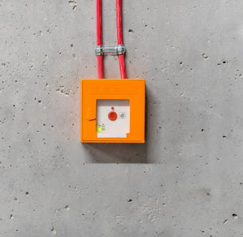
B8.3.2. Quick-disconnect Power Systems
Indicator
Availability of systems allowing rapid disconnection of power to prevent electrical hazards during floods
Type of value: High value is better
Units: Boolean
Critical value (1) = Critical quick-disconnection mechanisms
Optimal value (0) = Functional quick-disconnection mechanisms

Slide 14
B8.3.2. Quick-disconnect Power Systems
CALCULATION: STEP BY STEP
Step 1: Data Collection
Identify the electric systems planned in design documents.
Perform qualitative assessment using design information
e.g. Venaria Reale, Piedmont, Italy
Primary school
Quick-disconnect power systems available and functioning: Yes
Normalized value: Yes → 0
Step 2: Indicator Calculation
Define the availability and functionality of quick-disconnect power systems (e.g., Yes/No).
Optimal
Step 3: Normalize the result
The value is normalised according to Boolean criteria.
      If the indicator has a positive evaluation (YES), the normalized value is 0 (Optimal)
If the indicator has a negative evaluation (NO), the normalized value is 1 (Critical)
*Illustrative value for example purposes. Does not represent the current

Slide 15

B8.3.3. Elevated Electrical Outlets
Description:
Proportion of electrical outlets installed at heights above the designated flood level to prevent electrical hazards and service disruption during flood events.
Objective:
This criteria evaluates whether electrical outlets are installed above the designated flood level to reduce the risk of electrical hazards and service disruption during flood events.
Relevance:
Elevated electrical outlets enhance building-level flood resilience and safety by preventing short circuits, electrocution risks, and power outages, reducing damage to electrical systems, supporting faster post-flood recovery, and ensuring compliance with flood protection and electrical safety standards.

Slide 16
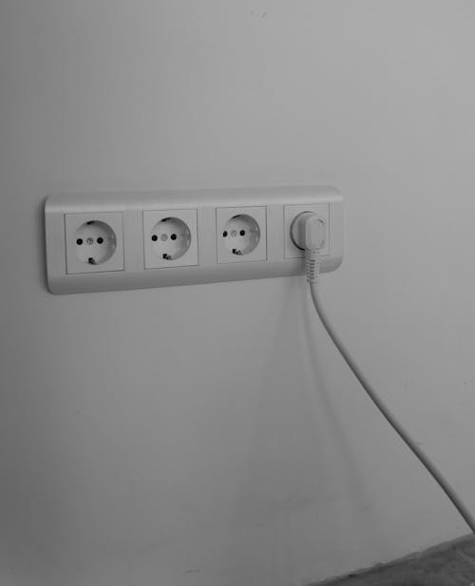
B8.3.3. Elevated Electrical Outlets
Indicator
Share of electrical outlets installed above the designated flood level
Type of value: High value is better
Units: %
Critical value (1) = 0%
Optimal value (0) = 100%
$$Indicator=\frac{\#Outlets installed above the designated flood level}{\#Total of outlets}$$

Slide 17
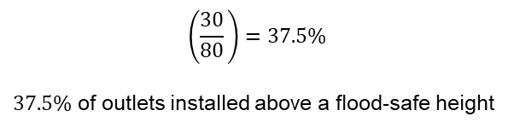
B8.3.3. Elevated Electrical Outlets
CALCULATION: STEP BY STEP
$$Indicator=\frac{\#Outlets installed above the designated flood level}{\#Total of outlets}$$
Step 1: Data Collection
Identify the electric systems planned in design documents.
Review electrical design drawings and specifications to verify planned heights of electrical outlets relative to flood level benchmarks.
e.g. Veneria Reale, Piedmont, Italy
Primary school
Number of outlets installed above a flood-safe height: 30
Total number of outlets: 80
Step 2: Indicator Calculation
Divide the number of electrical outlets installed above a flood-safe height, by the total number of electrical outlets in the analyzed building
$$\left(\frac{30}{80}​\right)=37.5\%$$
$37.5\%$ of outlets installed above a flood-safe height
*Illustrative value for example purposes. Does not represent the current

Slide 18

B8.3.3. Elevated Electrical Outlets
CALCULATION: STEP BY STEP
Step 3: Normalize the result
The value is normalised applying the following formula (For Indicators where High Value is Better):
e.g. Veneria Reale, Piedmont, Italy
Primary school
Period of study – January 2025
$$Xnorm= \frac{xmax−xi}{xmax− xmin}$$
$$Xnorm=\frac{100 −37.5}{100 −0}​=0.625$$
where:
Xi: value of the indicator
X_{max} = optimal indicator’s value (corresponding to score 0)
X_{min} = critical indicator’s value (corresponding to score 1)
$$Xnorm=0.625$$
Normalisation values | Description
0.1 | Optimal (No improvement necessary)
0.3 | Rather positive
0.5 | Neutral
0.7 | Rather negative
0.9 | Critical (Could lead to severe consequences)
Rather negative - Neutral

