Slide 1

SuPeRBE Training Material
Macro Area of Expertise:
SuPeRBE Training Material
11 Decision Making for climate adaptation
Climate change and built environment
Area of Expertise:
11.1 Decision Making for climate adaptation at small urban scale and building scale.
Fundamentals of climate change
Level of competence: 2
Level of competence: 1,2,3
Activity 3.2
SuPeRBE Project (CE0200768)

Slide 2






Understanding why adaptation is necessary at urban and building scales
Introduction: why urban and building scale adaptation?
Climate-related hazards, including heatwaves, storms, flooding, and drought, are increasing in both frequency and intensity.
While individual buildings may be directly exposed to hazards, entire neighborhoods experience interconnected vulnerabilities that cannot be addressed in isolation.
Current tools mainly address single buildings but lack integration into broader, systemic adaptation strategies at the neighbourhood or city scale.
A Heavy precipitation
B Floods
C Extreme heat
D Droughts
E Storms
F Wild-fire
G Mass Movement

Slide 3

Understanding why adaptation is necessary at urban and building scales
Introduction: SuPeRBE Decision-Making Model
The SuPeRBE Decision-Making Model, supported by the RBTool (for buildings) and RNTool (for neighbourhoods), provides a structured, step-by-step framework for assessing building and urban scale vulnerabilities, identifying weaknesses, and defining effective multi-scalar interventions.
Decision Making at neighbourhood scale guides and shapes adaptation actions at the broader scale, providing parallelly the guidelines that determine/impact the DM at building scale.
Adaptation is an iterative and participatory process, combining technical analysis with stakeholder input to ensure measures are feasible, inclusive, and context-specific.

Slide 4
Understanding why adaptation is necessary at urban and building scales
Key concepts before staring:
Hazard: Climate-related event. Ex. Flood, storm. | Exposure: What is at risk. Ex. Basement prone to flooding (buildings scale), critical infrastructure (neighbourhood scale)
Vulnerability: How sensitive the exposed element is. Ex. Old drainage system (building scale), insufficient green spaces (neighbourhood scale) | Adaptative Capacity: Ability to cope, recover, or adjust. Ex. Green roof / rain garden → absorbs part of the rainfall.
Climate Risk across scales

Slide 5
Understanding why adaptation is necessary at urban and building scales
The SuPeRBE framework
Purpose:
The Decision Making Method (DM) provides a structured, step-by-step process for climate adaptation, supporting municipalities and planners to assess risks, prioritize actions, and implement adaptive measures.
Scope:
Based on DIN EN ISO 14091 and the RBE-CE assessment system, the DM enables cross-sectoral, multi-scale evaluation. Works alongside RB Tool for Building-Scale and RN Tool for Urban-scale Assessment .
Key Strengths:
-Iterative and flexible: supports continuous learning and adaptation.
-Participatory: engages stakeholders at every stage.
-Scalable: applicable across cities and governance contexts.

Slide 6
Understanding why adaptation is necessary at urban and building scales
The SuPeRBE framework
Overview of the 8 different phases of the DM:
1.Initiation
Urban Area and Buildings Selection
Expert Team Selection
Data Collection
Stakeholders Identification
2.Preparation
Climate Hazard Identification
Key Urban Sectors Identification
RNTool and RBTool Contextualization
Data Sources Identification
3.Diagnosis
Current State Assessment
Weakness Identification
Summary Report and SWOT Analysis
4.Strategic definition
Target Setting
Constraints amd Restrictions Identification
Participatory Methods
Participatory Methods
Participatory Methods
Participatory Methods

Slide 7
Understanding why adaptation is necessary at urban and building scales
The SuPeRBE framework
Overview of the 8 different phases of the DM:
5.Adaptation Scenarios
Scenarios Development
Intervention Selection
Financing Mechanisms
Participatory Methods
6.Decision-Making
Scenario Assessment
Ranking Process
Optimal Scenario Selection
Participatory Methods
7.Adaptation Concept
Concept Definition
8.Implementation & Monitoring
Iterative Process

Slide 8
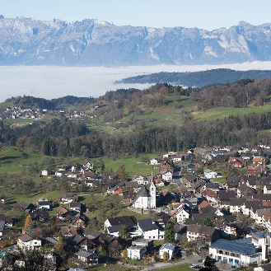
Defining the scope and preparing the groundwork for adaptation at both scales
Phase 1: Initiation
Objective: Define the scope and set the foundation for the adaptation concept at building/neighbourhood scale.
Main tasks:
Selection of urban area and buildings for adaptation:
-Provide description: physical, functional, social aspects
-Define boundaries using criteria such as proximity, ownership, context, period of construction.
-List resources, governance, preparedness measures
Set up the Expert Team (SuPeRBE Working Group):
-Appointed by municipality, the SuPeRBE WG manages the process acting as an interface.
Collect key data:
-Gather qualitative and quantitative information on climatic profile, vulnerabilities, risks
-On-site assessments, surveys, questionnaires, workshops
SCHNIFIS [AT]

Slide 9

Defining the scope and preparing the groundwork for adaptation at both scales
Phase 1: Initiation
Stakeholder Identification:
Municipal departments/local authorities (planning, health & safety, green areas, mobility)
Experts (urban planners, energy managers, landscape designers)
Utilities & service providers (energy, water, waste)
Public interest groups (residents’ associations, NGOs, clubs, politicians)
External parties (banks, funding agencies)
Roles in SuPeRBE Platform:
Owner – initiates & manages projects (municipality/property owner)
Assessor – conducts risk assessment (experts)
Observer – views & provides input (public, utilities, funding bodies)
Participatory methods:
Kick-off meetings, stakeholder mapping, site visits and interviews

Slide 10
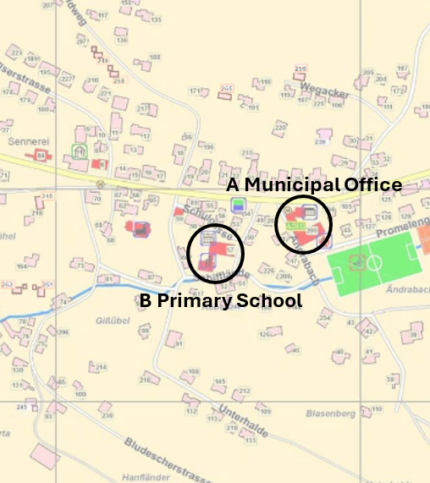
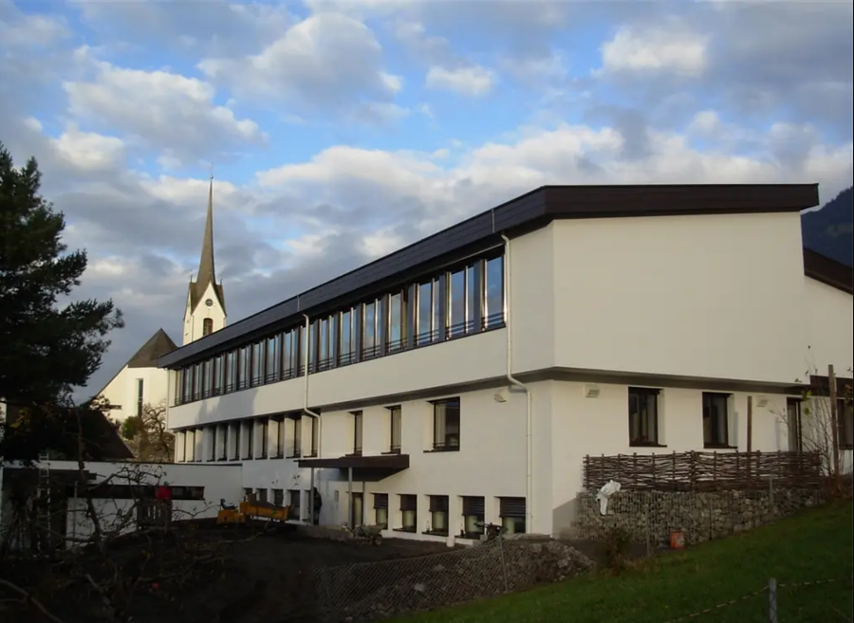
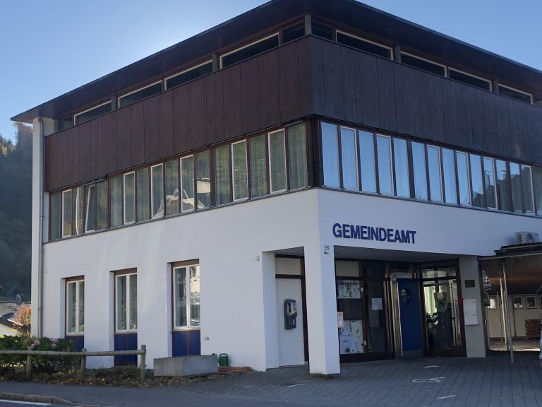
Defining the scope and preparing the groundwork for adaptation at both scales
Phase 1: Initiation
Practical Example. Urban area and building selection.
Stakeholder identification.
Stakeholder Identification in Schnifis:
Citizens
Members of the fire brigade
Farmers
Municipal representatives
Urban planners and architects
Energy managers
Primary school of Schnifis
Pilot case example in Schnifis, Austria
Municipal office of Schnifis

Slide 11
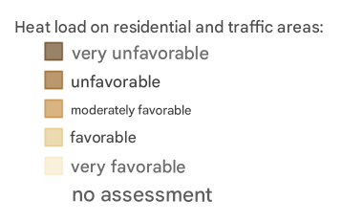
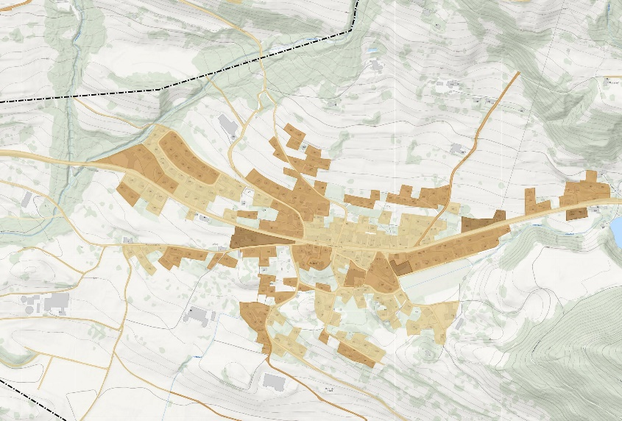
Defining the scope and preparing the groundwork for adaptation at both scales
Phase 1: Initiation
Practical Example.
Collection of qualitative and quantitative information.
Current vulnerabilities in Schnifis:
Proximity to floodplain
Drought in forest and farming land
Urban heat island effect
Lack of finance
Lack of space for flood water drainage
Increasing housing
Map showing strong physical strain from heat load in Schnifis area

Slide 12
Defining the scope and preparing the groundwork for adaptation at both scales
Phase 1: Initiation
Learning checkpoint:
When starting an adaptation process for a building, which stakeholders would you involve first, and why?
Urban Planner
Researcher
Architect
Energy planner
Municipality representative
Project developer
ADMINISTRATOR
OWNER
ASSESSOR
Notes:
Answer:
Building owner / property manager → decision-making authority
Occupants / tenants → provide insights into comfort and daily issues
Municipal representatives → align with regulations and incentives
Technical experts (architects, energy managers) → provide assessment expertise

Slide 13

Defining the scope and preparing the groundwork for adaptation at both scales
Phase 2: Preparation
Objective: Build the information base for developing the adaptation concept.
Main tasks:
Identify climate hazards and impacts:
-Heavy precipitation, floods, extreme heat, droughts, storms, wildfires, mass movement.
Identify key urban sectors exposed/vulnerable to hazards:
-Buildings, transport, energy, water, waste, health, environment, ICT, economy, etc.
Contextualize RBE Method - RBTool and RNTool:
-Select criteria (exposure & vulnerability)
-Set benchmarks (0 = optimal, 1 = critical)
-Calculate the observed value

Slide 14

Defining the scope and preparing the groundwork for adaptation at both scales
Phase 2: Preparation
Data sources Identification:
Municipal/regional departments (planning, mobility, energy, etc.)
Public agencies, utilities, statistical offices
Building owners/tenants, certificates (e.g., energy performance)
Databases, GIS, open sources, on-site inspections
Participatory methods:
Stakeholders central to tool contextualization
Co-define criteria & priorities through: surveys, questionnaires and workshops
Notes:
Should I add examples from Schnifis? Should I translate it to english?

Slide 15












Defining the scope and preparing the groundwork for adaptation at both scales
Phase 2: Preparation
Structure of RBTool – Macro categories
The key Building Components (as seen in AD2.2 RBTool) are:
Foundations
Ventilation System
Landscaping
Load Bearing Structural Frame
Sanitary Systems
Occupants
Other Systems
Location
Non-load Bearing Elements
Energy System
Community
Utilities

Slide 16

Defining the scope and preparing the groundwork for adaptation at both scales
Phase 2: Preparation
Structure of RNTool – Macro categories
The key Urban Sectors (as seen in AD2.3 RNTool) are:
Buildings (Heavy precipitation, Floods, Extreme Heat, Storms, Mass Movement)
Water (Heavy precipitation, Floods, Drought)
Emergency Services (Heavy precipitation, Floods, Extreme Heat, Drought, Storms, Wild-Fire, Mass Movement)
Energy (Heavy precipitation, Extreme Heat, Storms)
Environment and Biodiversity (Extreme Heat, Drought)
Tourism (Heavy precipitation, Extreme Heat, Mass Movement)
Transport (Heavy precipitation, Floods, Extreme Heat, Storms, Wild-fire, Mass Movement)
Health (Heavy precipitation, Floods, Extreme Heat, Drought, Storms)

Slide 17


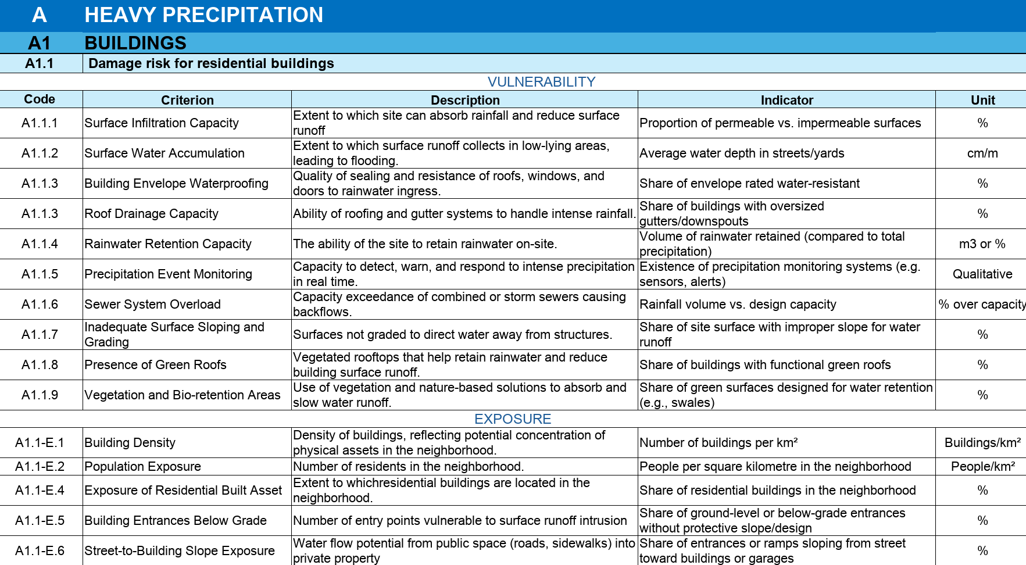


Defining the scope and preparing the groundwork for adaptation at both scales
Phase 2: Preparation
Practical RNTool Example.
Identification of climate hazard, urban sectors and criteria
affected in Schnifis.
Heavy precipitation
FLOOD
Extreme
heat
drought
storm
wildfire
Mass movement
BIOLOGICAL HAZARD

Slide 18
Defining the scope and preparing the groundwork for adaptation at both scales
Phase 2: Preparation
Practical RNTool Example.
Indication of Benchmark value (in case they need to be modified) and Observed value for each selected criterion.
A HEAVY PRECIPITATION
A1 BUILDINGS
A1.1 Damage risk for residential buildings
Code | Criterion | Indicator | Unit | Range of values | Benchmark (value 0) | Benchmark (value 1) | Observed value
A1.1.8 | Presence of Green Roofs | Share of buildings with functional green roofs | % | HIB | > 50% | < 10% | 17,2%
Process should be repeated for each criterion.

Slide 19
Defining the scope and preparing the groundwork for adaptation at both scales
Phase 2: Preparation
Learning checkpoint:
What types of data sources are typically used to gather information on hazards, exposure, and vulnerability?

Slide 20
Analysing the current state and identifying key weaknesses of urban areas and buildings for adaptation
Phase 3: Diagnosis
Objective: Analyse the current condition and adaptation level of buildings and neighbourhoods to identify risks and set the basis for future targets.
Main tasks:
Assessing the current state
-Each building/ neighbourhood criterion is evaluated against benchmarks set in Phase 2. Indicator values are normalized to calculate risk levels.
Assignment of weights (prioritization) and ranking
-Criteria are then weighted, a strategic step that is the responsibility of the Municipality, primarily the Technical Coordinator. Performance/ risk scores indicate whether elements are performing well or require attention.
-Experts rank criteria to highlight the most critical weaknesses.
Identification of weaknesses :
-Weak points are prioritised based on scores relative to benchmarks.
-Includes both quantitative data from RBTool/RNTool and qualitative input from occupants (surveys/workshops).
-Reveals vulnerabilities in structural elements, building systems, and functionality

Slide 21
Analysing the current state and identifying key weaknesses of urban areas and buildings for adaptation
Phase 3: Diagnosis
Practical RNTool Example. Normalizing values.
A HEAVY PRECIPITATION
A1 BUILDINGS
A1.1 Damage risk for residential buildings
Code | Criterion | Indicator | Unit | Range of values | Benchmark (value 0) | Benchmark (value 1) | Observed value
A1.1-E.5 | Building entrances below grade | Share of ground-level or below-grade entrances without protective slope/design | % | LIB | 0% | > 30% | 19,5%
Given that LIB (Lower is better) and that:
Optimal benchmark (score = 0) → 0% of building entrances below grade
Critical benchmark (score = 1) → 30% of building entrances below grade
Observed value → ~19,5% of building entrances below grade
​$$\text{Normalized} \text{score}\text{=} \frac{\text{Optimal} \text{benchmark}\text{ − }\text{Observed} \text{b}\text{enchmark}}{\text{Optimal} \text{benchmark} − \text{Critica}\text{l} \text{value}}\text{ ; }\text{Normalized} \text{score}\text{=} \frac{\text{0}\text{ −}\text{ 19,5}}{\text{0 − }\text{3}\text{0}}$$ = 0,65

Slide 22
Analysing the current state and identifying key weaknesses of urban areas and buildings for adaptation
Phase 3: Diagnosis
Practical RNTool Example. Normalizing values.
A HEAVY PRECIPITATION
A1 BUILDINGS
A1.1 Damage risk for residential buildings
Code | Criterion | Indicator | Unit | Range of values | Benchmark (value 0) | Benchmark (value 1) | Observed value
A1.1.8 | Presence of Green Roofs | Share of buildings with functional green roofs | % | HIB | > 50% | < 10% | 17,2%
Given that HIB (Higher is better) and that:
Optimal benchmark (score = 0) → 50% of roofs are green
Critical benchmark (score = 1) → 10% of roofs are green
Observed value → ~17,2% of roofs are green
​$$\text{Normalized} \text{score}\text{=} \frac{\text{Optimal} \text{benchmark}\text{ −} \text{Observed} \text{b}\text{enchmark}}{\text{Optimal} \text{benchmark} − \text{Critica}\text{l} \text{value}}\text{ ; }\text{Normalized} \text{score}\text{=} \frac{\text{50 }\text{−}\text{ 17,2}}{\text{50 − 10}}$$ = 0,82
Process should be repeated for all selected criterion.

Slide 23
Analysing the current state and identifying key weaknesses of urban areas and buildings for adaptation
Phase 3: Diagnosis
Practical RNTool Example. Weight assignment and calculation of overall risk score.
A HEAVY PRECIPITATION
A1 BUILDINGS
A1.1 Damage risk for residential buildings
Code | Criterion | Description | Normalised values | Weight | Weighted value/ score
A1.1.1 | Surface Infiltration Capacity | Proportion of permeable vs. impermeable surfaces | 0.70 | 0.30 | 0,210
A1.1.3 | Roof Drainage Capacity | Share of buildings with oversized gutters/downspouts | 0.50 | 0.15 | 0,075
A1.1.8 | Presence of Green Roofs | Share of buildings with functional green roofs | 0.82 | 0.25 | 0,205
A1.1-E.1 | Building Density | Number of buildings per km² | 0.30 | 0.05 | 0,015
A1.1-E.5 | Building Entrances Below Grade | Share of ground-level or below-grade entrances without protective slope/design | 0.65 | 0.25 | 0,163
Overall risk score |  |  |  | 1 | 0,668

Slide 24
Analysing the current state and identifying key weaknesses of urban areas and buildings for adaptation
Phase 3: Diagnosis
Practical RNTool Example.
Ranking example of the RNTool scores to identify the most critical issues.
Assessment criterion |  |  | Score
A1.1.8 | Presence of Green Roofs | Share of buildings with functional green roofs | 0,82
A1.1.1 | Surface Infiltration Capacity | Proportion of permeable vs. impermeable surfaces | 0,7
A1.1-E.5 | Building Entrances Below Grade | Share of ground-level or below-grade entrances without protective slope/design | 0,65
A1.1.3 | Roof Drainage Capacity | Share of buildings with oversized gutters/downspouts | 0,5
A1.1-E.1 | Building Density | Number of buildings per km² | 0,3
Given that:
-Optimal benchmark → score = 0
-Critical benchmark → score = 1
Notes:
Adapt to RBTool

Slide 25
Analysing the current state and identifying key weaknesses of urban areas and buildings for adaptation
Phase 3: Diagnosis
Diagnosis Summary Report and SWOT Analysis:
Summarises main findings and key weaknesses at building scale
Provides recommendations for handling weaknesses in subsequent phases
SWOT Analysis interconnecting strengths, weaknesses, opportunities and threats, allowing also to link between categories.
Participatory methods:
Occupant feedback, expert knowledge, and workshops complement quantitative assessment.
Strengths |  | Weaknesses
-Strategic location for emergency coordination -Natural areas buffer climate impacts -Low pollution supports public health -Skilled population aids adaptation -Good medical facilities for crisis response | -Education and cooperation hubs for knowledge sharing -Solid infrastructure (water, health, education) -Tolerant, engaged community -Diverse economy reduces risk concentration -Strong local identity (“Hue”) fosters cohesion | -Slow urban growth delays adaptation -Outdated infrastructure (drainage, waste) -Limited local resources for upgrades -Nature encroached, reducing buffers -Low climate risk awareness -Complex governance slows action | -Weak environmental protection -Underused public/natural spaces -High unemployment reduces adaptability -Poor investor links and weak tourism network -Inadequate public safety infrastructure
Opportunities |  | Threats
-Funding/support for resilience projects -Training in health and green sectors -Develop as health/resilience tourism hub -Nature-based solutions for adaptation | -Integrate resilience in heritage plans -Promote low-impact tourism niches -Public-private partnerships for upgrades -Leverage “Hue” brand for awareness and funds | -Climate risks (flooding, heat, storms) -High exposure to natural hazards -Heritage/ ecosystem loss reduces buffers -Regional competition for resources -Globalization weakens local systems | -Unregulated growth increases exposure -Shorter tourism seasons from weather shifts -Fragmented geography hampers response -Growth may conflict with resilience goals

Slide 26
Analysing the current state and identifying key weaknesses of urban areas and buildings for adaptation
Phase 3: Diagnosis
Learning checkpoint:
What information should a diagnosis report provide to guide future adaptation strategies?
Notes:
Answer:
A diagnosis report should summarize the current state of neighbourhoods and buildings, highlight key strengths and weaknesses, identify vulnerabilities, and include recommendations for action. It often incorporates a SWOT analysis and stakeholder input to guide evidence-based adaptation strategies.

Slide 27
Analysing the current state and identifying key weaknesses of urban areas and buildings for adaptation
Phase 4: Strategic definition
Objective: Define framework conditions for adaptation design by setting targets and identifying constraints. Here the diagnosis results are translated into clear targets.
Main tasks:
Setting adaptation targets:
-Define clear, measurable targets for building adaptation before scenario planning. Use RBTool and RNTool to set target scores for each assessment criterion.
-Targets must be SMART: Specific, Measurable, Attainable, Relevant, Time-bound
-Targets are interdependent; interventions may address multiple hazards simultaneously (e.g., green roofs reduce flood and heat risks)
Identify constraints:
Constraints must be identified and assessed individually for each site to guide feasible adaptation measures. Its early recognition prevents non-compliant interventions.

Slide 28

Analysing the current state and identifying key weaknesses of urban areas and buildings for adaptation
Phase 4: Strategic definition
Possible constraints and restrictions to take into account:
Legal constraints (e.g. Building Codes, Cultural Heritage Protection)
Technical constraints (e.g. Architecture, Systems)
Financial constraints (e.g. Investment Cost, ROI)
Environmental constraints (e.g. Climatic conditions, urban morphology)
Stakeholder based restrictions
Participatory methods:
PGS (Participatory Guarantee System) workshops are highly recommended.
Stakeholders can help validate targets, constraints, and restrictions
Notes:
Should we mention the PGS workshops?

Slide 29
Analysing the current state and identifying key weaknesses of urban areas and buildings for adaptation
Phase 4: Strategic definition
Practical RNTool Example.
Target score setting and calculation of the Target value.
Assessment criterion |  | Indicator | Diagnosis score | Target Score
A1.1.8 | Presence of Green Roofs | Share of buildings with functional green roofs | 0,82 | 0,2
Given that:
Optimal benchmark (score = 0) → 50% of roofs are green
Critical benchmark (score = 1) → 10% of roofs are green
Normalized targeted score → 0,2
​$$\text{T}\text{arget} \text{value} \text{=}$$ Optimal benchmark $$− \text{Normalized} \text{targeted} \text{score}\text{ ∗ (}\text{Optimal} \text{benchmark}\text{ − }\text{Critical} \text{b}\text{enchmark}\text{) }$$
​
​$$\text{T}\text{arget} \text{value} \text{=}\text{ 50 }−$$0,2 * (50 $$−$$ 10) = 42 % of green roofs is the Targeted value
Notes:
Adapt to RBTool

Slide 30
Analysing the current state and identifying key weaknesses of urban areas and buildings for adaptation
Phase 4: Strategic definition
Practical RNTool Example.
Target score setting and calculation of the Target value.
Assessment criterion |  | Indicator | Diagnosis score | Target Score | Target Value
A1.1.8 | Presence of Green Roofs | Share of buildings with functional green roofs | 0,82 | 0,2 | 42 % (considering an optimal Benchmark value of 50% and an inadequate value of 10%)
A1.1.1 | Surface Infiltration Capacity | Proportion of permeable vs. impermeable surfaces | 0,7 | 0,2 | 64% (considering an optimal Benchmark value of 70% and an inadequate value of 40%)
A1.1-E.5 | Building Entrances Below Grade | Share of ground-level or below-grade entrances without protective slope/design | 0,65 | 0,3 | 9 % (considering an optimal Benchmark value of 0% and an inadequate value of above 30%)
A1.1.3 | Roof Drainage Capacity | Share of buildings with oversized gutters/downspouts | 0,5 | 0,1 | 87% (considering an optimal Benchmark value of 90% and an inadequate value of under 60%)
Notes:
Adapt to RBTool

Slide 31
Analysing the current state and identifying key weaknesses of urban areas and buildings for adaptation
Phase 4: Strategic definition
Learning checkpoint:
How would you define realistic adaptation targets at both the building and urban scale, and what types of constraints could limit their implementation?
Notes:
Answer:
At the building scale, realistic adaptation targets might include measures such as:
Increasing the share of buildings with green roofs to improve water retention.
Ensuring oversized gutters and downspouts for better drainage.
Reducing the number of below-grade entrances without protective features.
At the urban scale, targets may focus on:
Increasing surface infiltration capacity by expanding permeable areas.
Improving district-wide drainage systems.
Enhancing urban cooling through tree planting and green corridors.
Constraints that may limit these targets include:
Legal: building codes, cultural heritage rules, protected zones.
Technical: structural load capacity, outdated infrastructure, soil conditions.
Financial: affordability for residents, availability of subsidies, ROI concerns.
Environmental: topography, groundwater levels, microclimate.
Stakeholder-based: acceptance by residents, ownership models, competing land uses.

Slide 32
Developing and evaluating alternative adaptation scenarios for buildings and neighbourhoods
Phase 5: Adaptation scenarios
Objective: Develop a set of distinct, feasible adaptation scenarios, each meeting the defined performance targets.
Main tasks:
Develop adaptation scenarios by combining hard (technological, structural) and soft (policies, training) interventions into coherent packages.
Differentiate scenarios to allow meaningful comparison in the decision-making phase (value assessment).
Select interventions. Start from weaknesses identified in the Diagnosis Phase; filter out interventions restricted by legal, technical, or contextual constraints.
Evaluate interventions by assessing contribution to performance targets, consider synergies and interdependencies between building and neighbourhood levels (e.g., energy, water systems).
Iterative refinement. Use RBTool/RNTool and Simulation Hub of the SuPeRBE platform to test and adjust intervention packages until performance targets are met.

Slide 33

Developing and evaluating alternative adaptation scenarios for buildings and neighbourhoods
Phase 5: Adaptation scenarios
Key considerations in scenario development:
Integrated approach: Foster cross-sectoral innovation, efficient resource use, and long-term resilience.
Financing mechanisms: Secure feasibility by evaluating grants, loans, loan guarantees, energy performance contracting (ESCOs), tax incentives…
Stakeholder participation: Organize a PGS workshop to collect input from inhabitants, occupants, and stakeholders; integrate their expectations and priorities into scenario design.

Slide 34
Developing and evaluating alternative adaptation scenarios for buildings and neighbourhoods
Phase 5: Adaptation scenarios
Practical Example.
Selection and evaluation of interventions for each Scenario.
Scenario 3 – Urban Area
Assessment criterion |  | Target Score
A1.1.8 | Presence of Green Roofs | 0,2
A1.1.1 | Surface Infiltration Capacity | 0,2
A1.1-E.5 | Building Entrances Below Grade | 0,3
A1.1.3 | Roof Drainage Capacity | 0,1
✓
✓
✓
✓
Notes:
Adapt to RBTool

Slide 35
Developing and evaluating alternative adaptation scenarios for buildings and neighbourhoods
Phase 5: Adaptation scenarios
Learning checkpoint:
Why is it important to develop multiple, distinct adaptation scenarios instead of just one?
Notes:
Answer:
Enables comparison of cost, performance, and timeframe
Offers flexibility if one scenario is blocked (legal, technical, financial issues)
Encourages creativity and innovation (hard vs. soft measures)
Strengthens stakeholder participation by offering alternatives

Slide 36
Selecting the optimal adaptation scenario while using assessment scores, stakeholder input, and qualitative criteria
Phase 6: Decision-Making
Objective: Select the optimal adaptation scenario based on performance, cost-efficiency, timeframe, and co-benefits among the scenarios developed in Phase 5.
Main tasks:
Assessment of scenarios:
-Evaluate interventions using RBTool and RNTool.
-Update and calculate performance scores with simulated indicator values from the SuPeRBE platform.
-Compare the different scenarios.
Ranking of Scenarios:
-Weight assignment(urban vs. buildings) to calculate overall risk/ performance value of each scenario.
-Consider overall risk value, costs, timeframe, and synergy effects.
-Derive an Adaptation Efficiency Score (risk × cost factor).

Slide 37
Selecting the optimal adaptation scenario while using assessment scores, stakeholder input, and qualitative criteria
Phase 6: Decision-Making
Key elements in Decision-Making:
Tools & Methods:
-RBTool → for quantitative scoring of adaptation.
-Simulation Hub of the SuPeRBE Platform → for calculating updated indicator values.
Calculated Parameters:
- Overall Risk Value → weighted sum of RBTool scores
Decision Parameters:
- Synergy Effects → co-benefits across hazards and sectors
- Timeframe → short-term, mid-term, long-term
- Financial Mechanisms & Non-simulated Aspects → considered qualitatively
- Costs → low € (factor 1.0), medium €€ (factor 1.1), high €€€ (factor 1.2)
Participation, transparency and inclusiveness:
- Feedback gathered from occupants, users, and stakeholders before final decisions.

Slide 38
Selecting the optimal adaptation scenario while using assessment scores, stakeholder input, and qualitative criteria
Phase 6: Decision-Making
Practical RNTool Example.
Weight assignment and calculation of overall performance score for each Urban Area, Buldings A and B. Urban Area – Scenario 3:
A HEAVY PRECIPITATION
A1 BUILDINGS
A1.1 Damage risk for residential buildings
Code | Criterion | Description | Target score | Weight | Weighted value/ score
A1.1.1 | Surface Infiltration Capacity | Proportion of permeable vs. impermeable surfaces | 0.20 | 0.20 | 0,04
A1.1.3 | Roof Drainage Capacity | Share of buildings with oversized gutters/downspouts | 0.10 | 0.45 | 0,045
A1.1.8 | Presence of Green Roofs | Share of buildings with functional green roofs | 0.20 | 0.20 | 0,04
A1.1-E.5 | Building Entrances Below Grade | Share of ground-level or below-grade entrances without protective slope/design | 0.30 | 0.15 | 0,045
Overall performance score |  |  |  | 1 | 0,17

Slide 39
Selecting the optimal adaptation scenario while using assessment scores, stakeholder input, and qualitative criteria
Phase 6: Decision-Making
Practical Example.
Repeat the process for remaining scenarios.
Scenarios | Urban area RNTool score | Building A RBTool score | Building B RBTool score
Scenario 1 | 0,3 | 0,4 | 0,5
Scenario 2 | 0,5 | 0,1 | 0,2
Scenario 3 | 0,17 | 0,5 | 0,4

Slide 40
Selecting the optimal adaptation scenario while using assessment scores, stakeholder input, and qualitative criteria
Phase 6: Decision-Making
Practical Example.
Weight assignment for each element (urban area and buildings).
Calculation of the weighted score for each scenario.
Element | Weight
Urban area | 90 %
Building A | 7 %
Building B | 3 %
Assessment | Assessment’s score (Z) | Weight (Priority level) (Y) | Weighted score (Z x Y)
RNTool - Urban area | 0,17 | 0,9 (90%) | 0,153
RBTool - Building A | 0,5 | 0,07 (7%) | 0,035
RBTool - Building B | 0,4 | 0,03 (3%) | 0,012
Scenario 3 score |  |  | 0,20

Slide 41
Selecting the optimal adaptation scenario while using assessment scores, stakeholder input, and qualitative criteria
Phase 6: Decision-Making
Practical Example.
Application of decision parameters to each scenario (synergy effect, time and cost).
Scenarios | Scenario score | Synergy effect | Time | Estimated cost
Scenario 1 | 0,31 | Moderate | Mid | €€
Scenario 2 | 0,4 | Low | Long | €€€
Scenario 3 | 0,2 | High | Short | €

Slide 42
Selecting the optimal adaptation scenario while using assessment scores, stakeholder input, and qualitative criteria
Phase 6: Decision-Making
Practical Example.
Calculation of the evaluation/ efficiency score for each scenario.
Formula: Efficiency Score = Risk Value × Cost Factor
Heavy precipitation
Scenarios | Overall risk/performance value | Estimated cost | Cost factor | Adaptation Efficiency score
Scenario 1 | 0,31 | €€ | 1,1 | 0,34
Scenario 2 | 0,4 | €€€ | 1,2 | 0,48
Scenario 3 | 0,2 | € | 1,0 | 0,2
BEST
Lower Efficiency score = better

Slide 43
Selecting the optimal adaptation scenario while using assessment scores, stakeholder input, and qualitative criteria
Phase 6: Decision-Making
Learning checkpoint:
If two scenarios show similar RBTool performance, what other factors would guide your decision?
Notes:
Answer:
Cost: Which scenario is more affordable or has stronger financing options?
Timeframe: Which can be implemented faster or with less disruption?
Synergies: Which offers more co-benefits (e.g., green roofs = flood + heat reduction)?
Stakeholder acceptance: Which is more supported by building users/owners?

Slide 44
Developing and structuring an integrated adaptation concept with implementation and monitoring plans
Phase 7: Adaptation concept
Objective: Provide a detailed, chronologically sequenced adaptation concept that defines interventions, establishing a solid basis for effective climate adaptation planning.
Main tasks:
Indentify and describe interventions for selected scenario.
Organize interventions according to building-level issues, aligned with RBTool and RNTool categories, such as:
-Structural safety, energy efficiency, water management, thermal comfort, occupant safety and usability.
Outline key information required for each intervention (detailed in next slide)
Sequence interventions chronologically. Prioritize interventions for effective and efficient adaptation.
Establish a foundation for future integrated planning and adapatation projects.

Slide 45

Developing and structuring an integrated adaptation concept with implementation and monitoring plans
Phase 7: Adaptation concept
Key information to be specified for each intervention:
Key information | Description
Description and expected results | Explain what the intervention is and what outcomes or improvements it aims to achieve.
Activities and works needed for implementation | Specify the concrete actions, works, or measures required to carry out the intervention.
Implementation timeline | Provide the expected duration and key milestones for completing the intervention.
Budget estimation and financial scheme | Estimate costs and indicate how the intervention will be financed (e.g., funding sources, cost-sharing).
Responsible actors and partnership | Identify the individuals, teams, or organizations accountable for implementation and any collaborators.
Reference stakeholders | List relevant stakeholders who should be consulted or informed during the intervention.
Links with existing or planned strategies | Show how the intervention aligns with, complements, or supports broader policies, plans, or programs.

Slide 46
Developing and structuring an integrated adaptation concept with implementation and monitoring plans
Phase 7: Adaptation concept
Learning checkpoint:
How would you sequence interventions at both the building and urban scales in an adaptation concept to ensure efficiency, feasibility, and integration with broader urban planning?

Slide 47

Developing and structuring an integrated adaptation concept with implementation and monitoring plans
Phase 8: Implementation and monitoring
Objective: Ensure effective, adaptive implementation of climate adaptation measures at the building and neighbourhood scale through continuous monitoring, stakeholder engagement, and iterative feedback.
Main tasks:
Establish a project-specific system to monitor progress and performance during implementation/ construction and use.
Develop measurable indicators specific to the project and adaptation solutions; track them via the SuPeRBE platform.
Collect and analyze data to evaluate performance against project targets, local developments, and regional policies.
Engage stakeholders in informed decision-making using descriptive analytics.
Adjust actions based on monitoring results and stakeholder feedback to ensure continuous improvement and long-term sustainability.

Slide 48
Developing and structuring an integrated adaptation concept with implementation and monitoring plans
Phase 8: Implementation and monitoring
Iterative process and key considerations:
An iterative process consists of a continuous cycle of implement → monitor → evaluate → adjust, ensuring the project adapts to new data, stakeholder feedback, and changing conditions.
This approach ensures adaptability, transparency, and alignment with climate adaptation goals.
Key focus areas are:
  Risk consequences and mitigation,
  Stakeholders’ needs and roles,
  Time frame and responsibilities.

Slide 49
Developing and structuring an integrated adaptation concept with implementation and monitoring plans
Phase 8: Implementation and monitoring
Learning checkpoint:
Which performance indicators would you track to verify if building and neighbourhood adaptation measures are working as intended?

Slide 50
Developing and structuring an integrated adaptation concept with implementation and monitoring plans
The SuPeRBE framework
Iterative process:
1.Initiation
Urban Area and Buildings Selection
Expert Team Selection
Data Collection
Stakeholders Identification
2.Preparation
Climate Hazard Identification
Key Urban Sectors Identification
RNTool and RBTool Contextualization
Data Sources Identification
3.Diagnosis
Current State Assessment
Weakness Identification
Summary Report and SWOT Analysis
4.Strategic definition
Target Setting
Constraints amd Restrictions Identification
Participatory Methods
Participatory Methods
Participatory Methods
Participatory Methods
5.Adaptation Scenarios
Scenarios Development
Intervention Selection
Financing Mechanisms
Participatory Methods
6.Decision-Making
Scenario Assessment
Ranking Process
Optimal Scenario Selection
Participatory Methods
7.Adaptation Concept
Concept Definition
8.Implementation & Monitoring
Iterative Process

